Slide 1
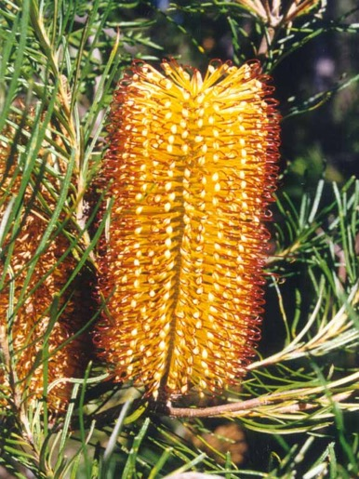

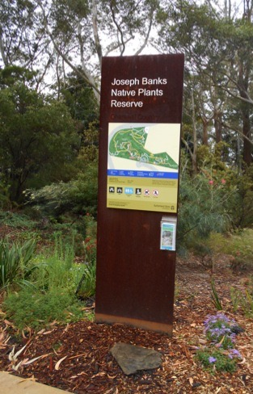
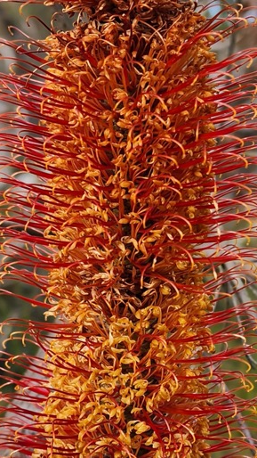

Beautiful banksias
Rhonda Daniels
Sutherland Shire Environmental Citizen of the Year 2025
Australian Plants Society
rhdaniels@bigpond.com

Slide 2
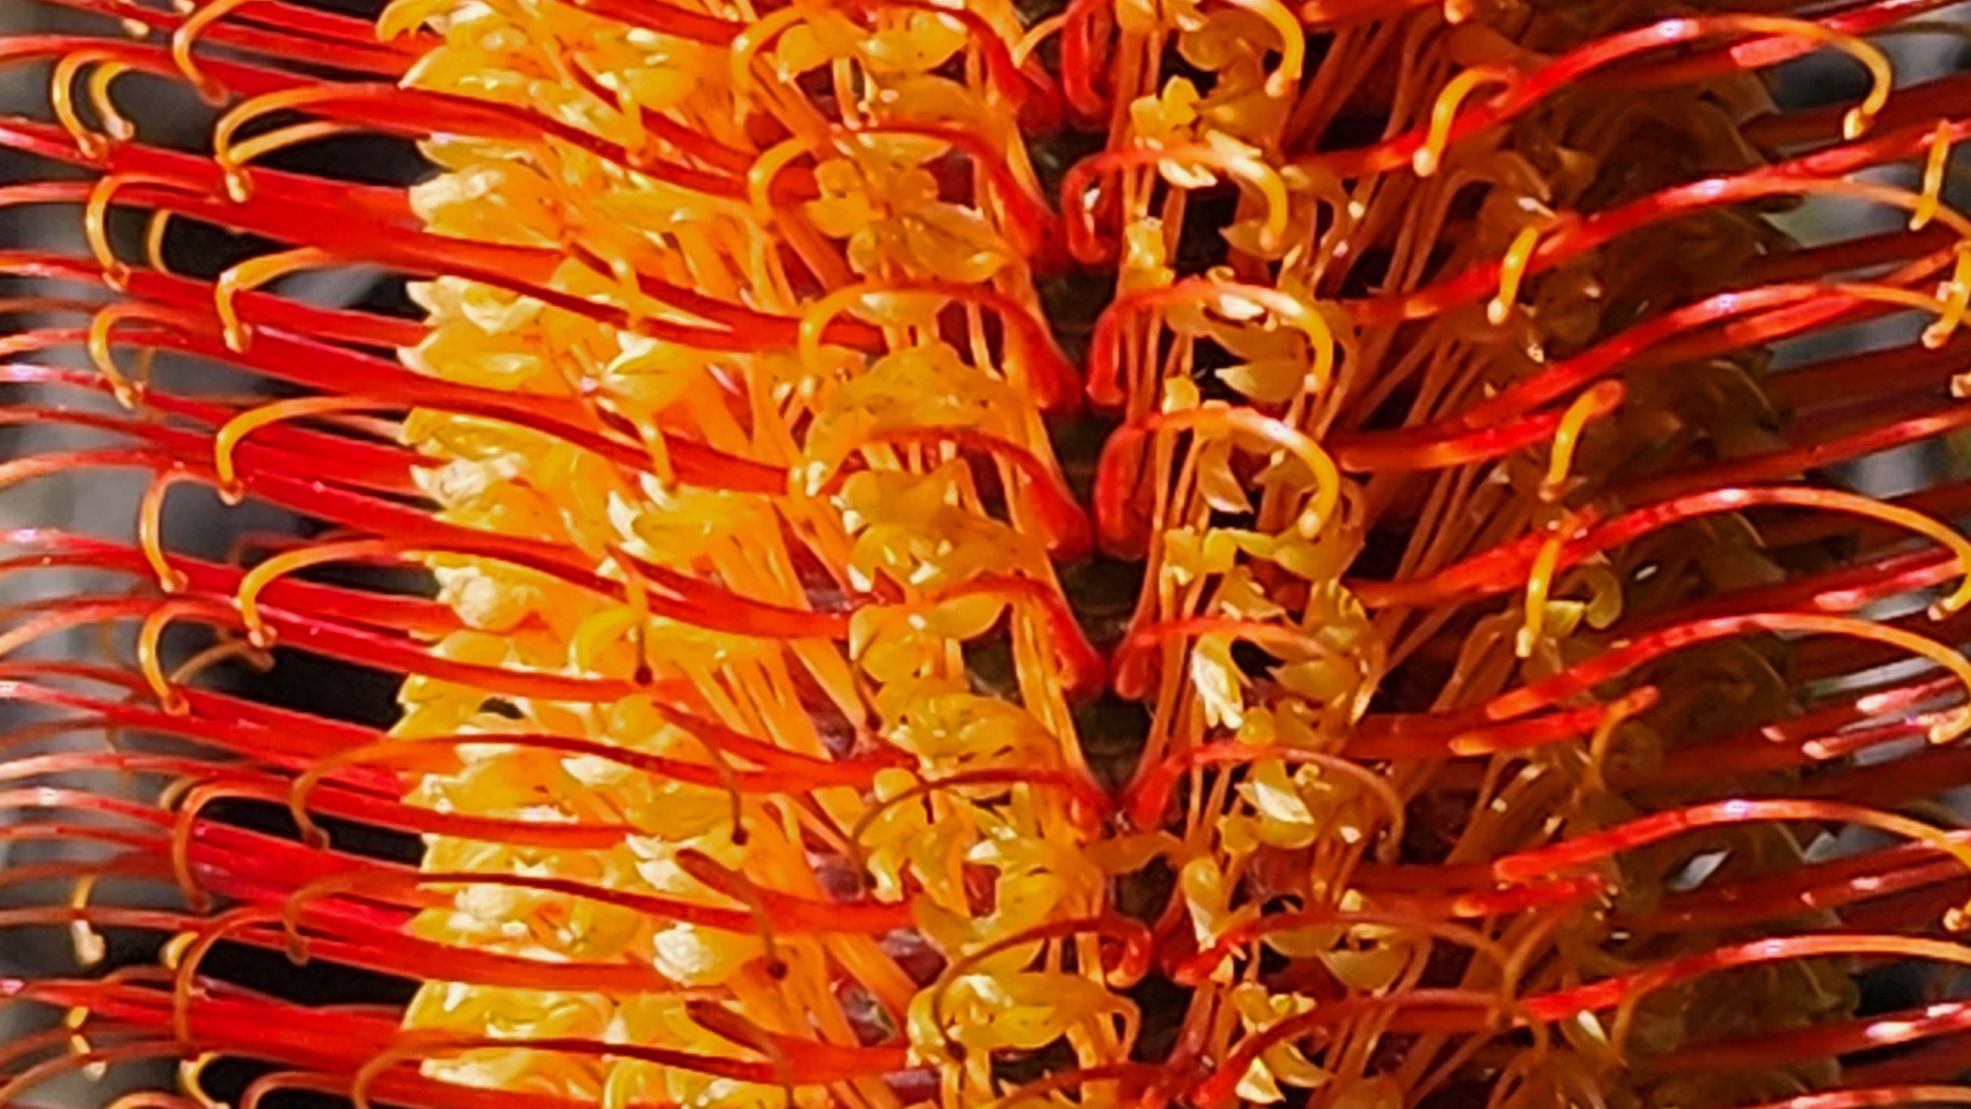
Outline
Aboriginal and Colonial times
Banksia botany, flowers and seeds
Joseph Banks
Local banksias
Enjoying native plants in public gardens

Slide 3
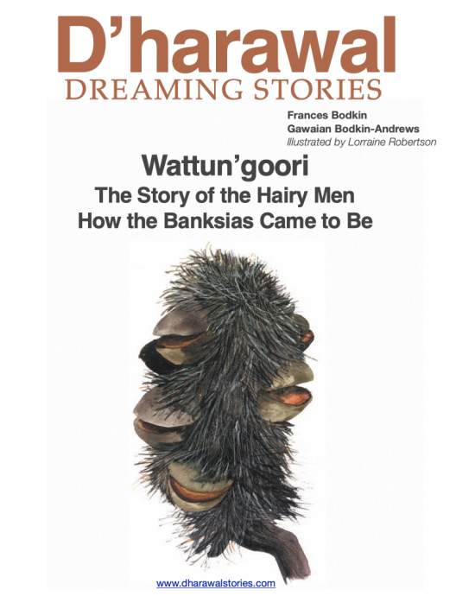
Aboriginal significance
Names for banksias
Variable, names often referred to
functions, uses or habitats
Dharawal country
  Wattun’goori
  Wattangaree
  Wattung-Urree
  Wadhangarii
Uses of banksias
Drank nectar from flowers and soaked flowers in water
Hunted nectar-feeding birds
Used flower cones to carry embers of fire
Used styles for combs and art brushes
https://dharawalstories.com/wp-content/uploads/2015/05/wattungoori922kb.pdf

Slide 4
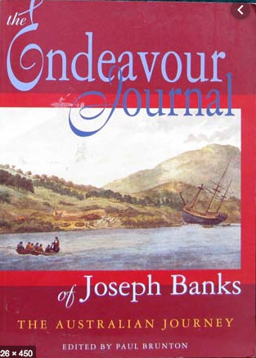
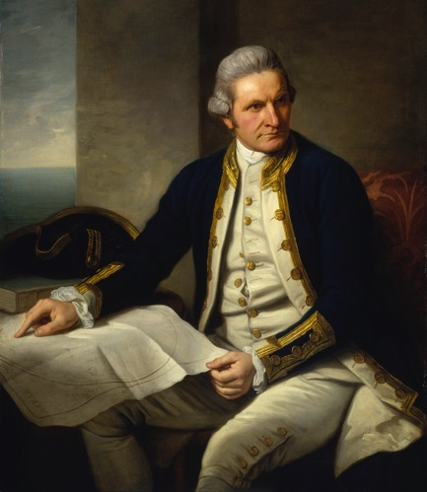
Banksias “discovered”
Joseph Banks in Australia, 1770
Collected many specimens with Solander, but did not name them
  Kurnell/Botany Bay in April 1770:
  Banksia serrata, Banksia integrifolia and Banksia ericifolia
  Qld: Banksia dentata
Kept 250,000 word journal
Captain James Cook (1728–1779)
By Nathaniel Dance 1776
Commissioned by Joseph Banks

Slide 5
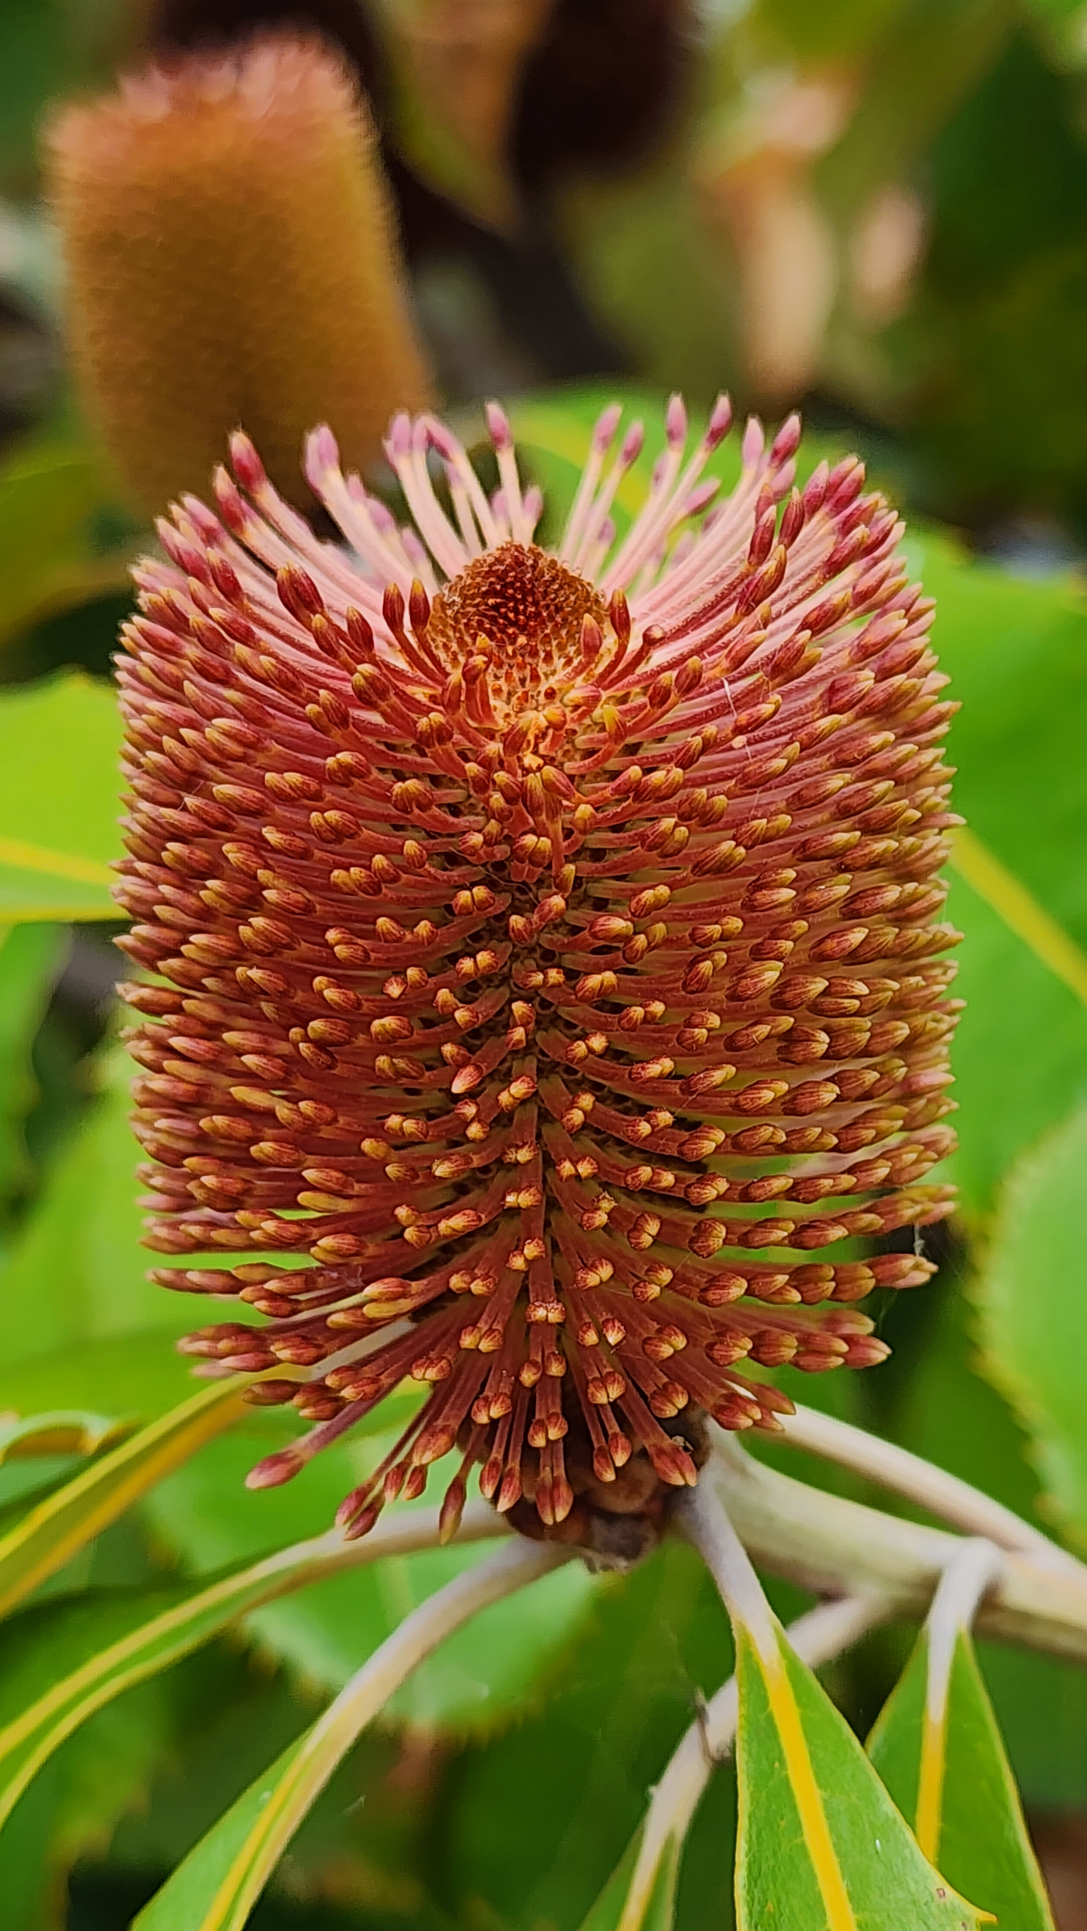
Banksia genus
Named and published in 1782 by son of Carl Linnaeus
with Banksia serrata as the ‘type species’
Proteaceae family inc Grevillea, Hakea, Isopogon, Petrophile, Persoonia and Telopea
About 100 species, subspecies and varieties
  most species in south-western WA and inland
  about 15 species on the east coast
  1 tropical species B. dentata (also in New Guinea)
Lumpers vs splitters taxonomy debate
  Dryandra now in Banksia

Slide 6
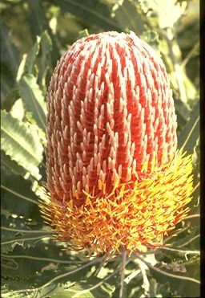
Banksia flowers
Autumn and winter, long-lasting
Creams, yellows, oranges, reds
Colour changes as flowers develop and open
Large, cylindrical flower spike
Each spike has many individual flowers,
up to 6,000 on Banksia grandis
Flower opening:
  in species with a straight or gently curved style,
  the flowers open from the base of the spike
  in most species with a hooked style, the top flowers open first
Lots of nectar: “honeysuckles”
Banksia menziesii
Banksia menziesii

Slide 7
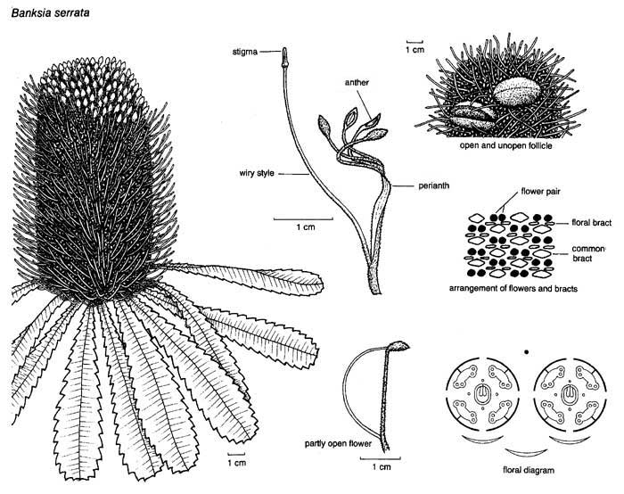
https://www.anbg.gov.au/banksia/banksia-serrata-illust.jpg

Slide 8
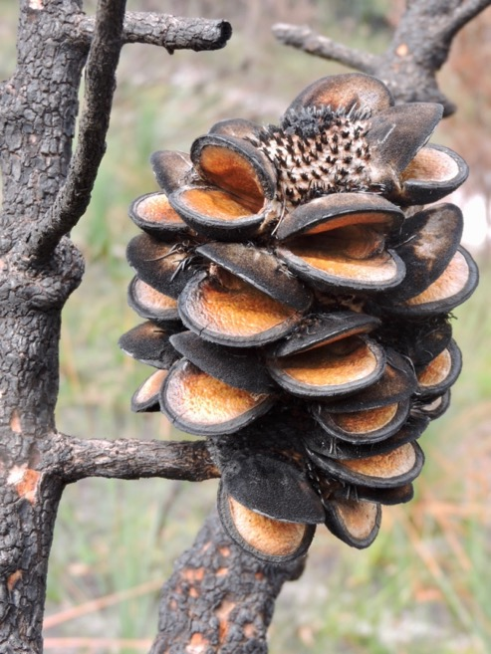
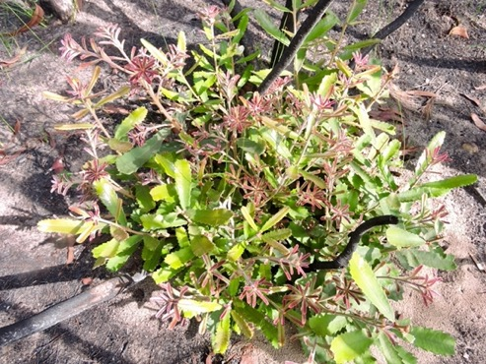
Banksia seeds
Pollinated by animals (bees, birds and small mammals)
Some flowers mature into woody seed follicles (<2% of flowers per spike)
Often need heat to open and release the seed, with papery wing and separator
Some regenerate after fire from a lignotuber
and can be pruned hard
– B. serrata, B. integrifolia and B. spinulosa
Others killed in fire and regenerate from
seed, often released by heat – B. ericifolia
Banksia menziesii
Banksia serrata
Banksia menziesii

Slide 9
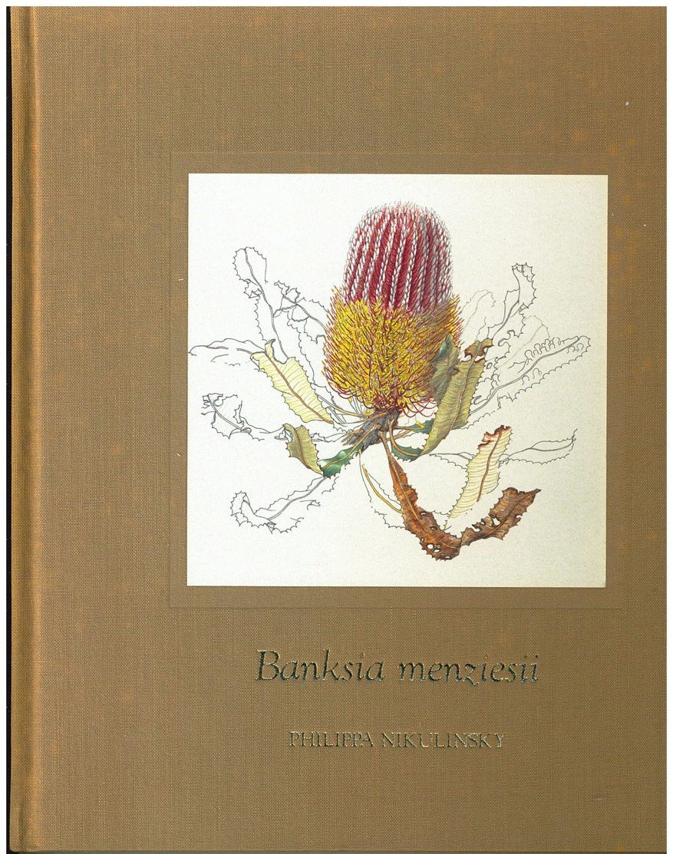
Lifecycle of a banksia
Banksia menziesii
by Philippa Nikulinsky

Slide 10
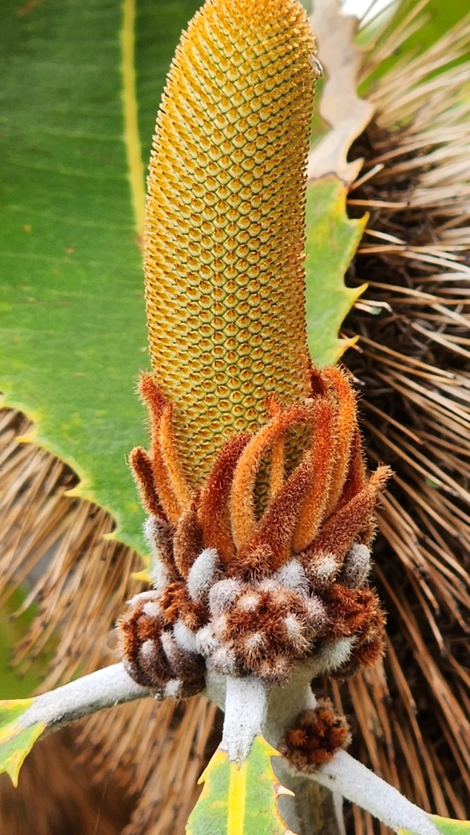
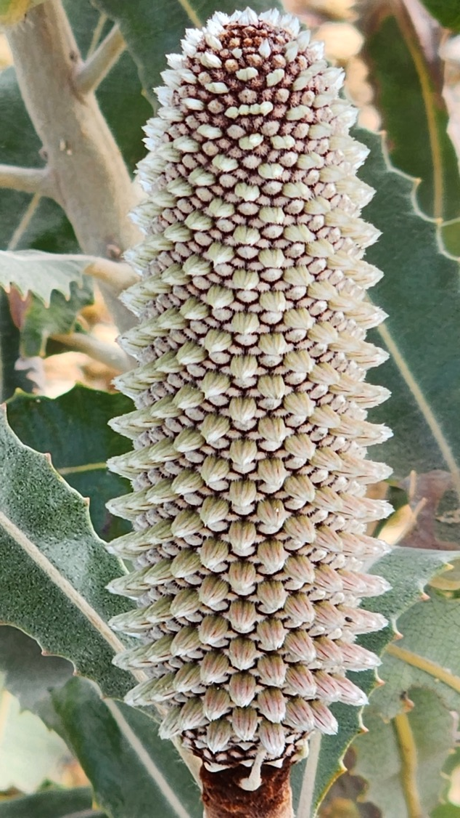
Banksia robur (B. Simpson)

Slide 11
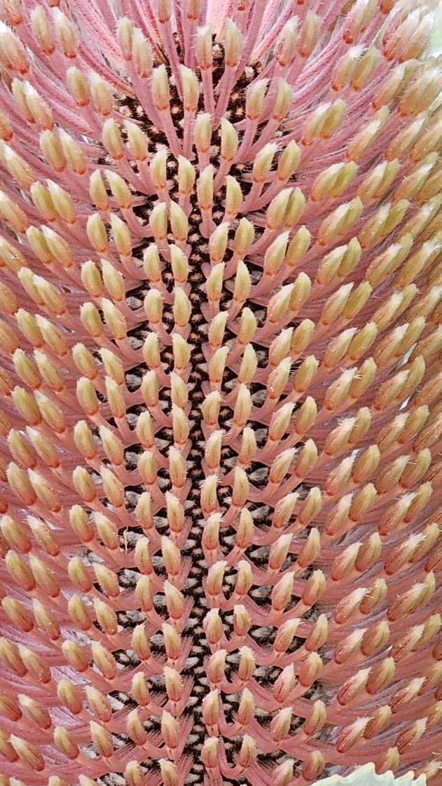
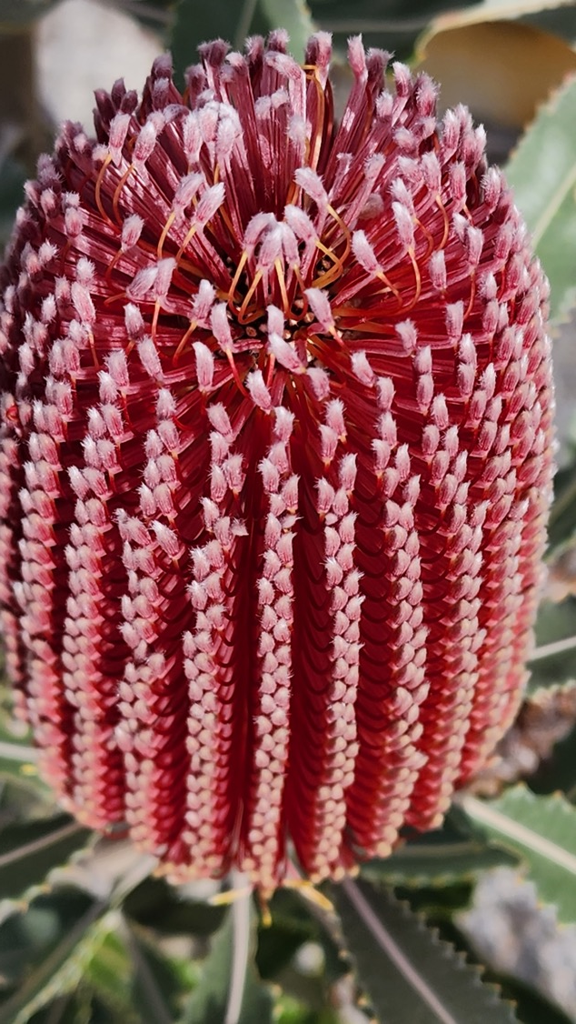

Slide 12
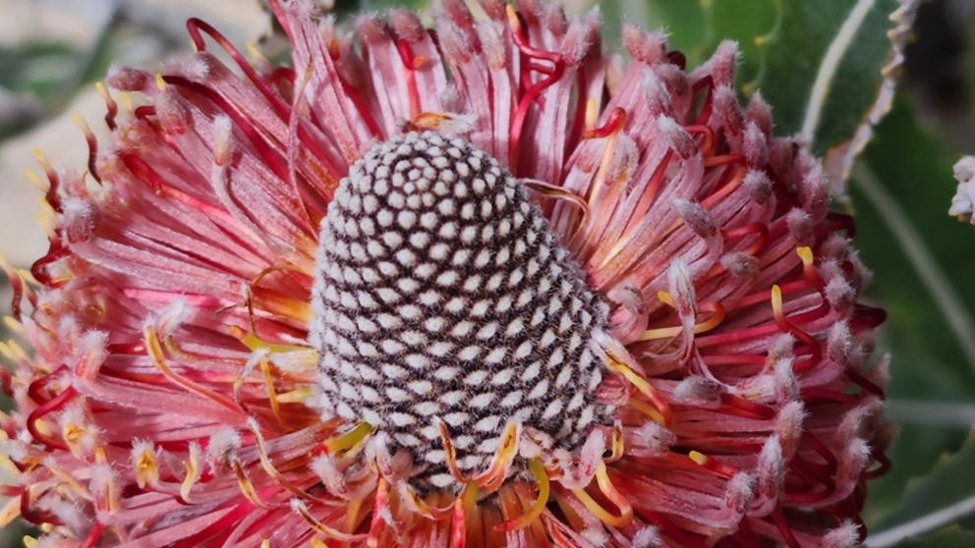
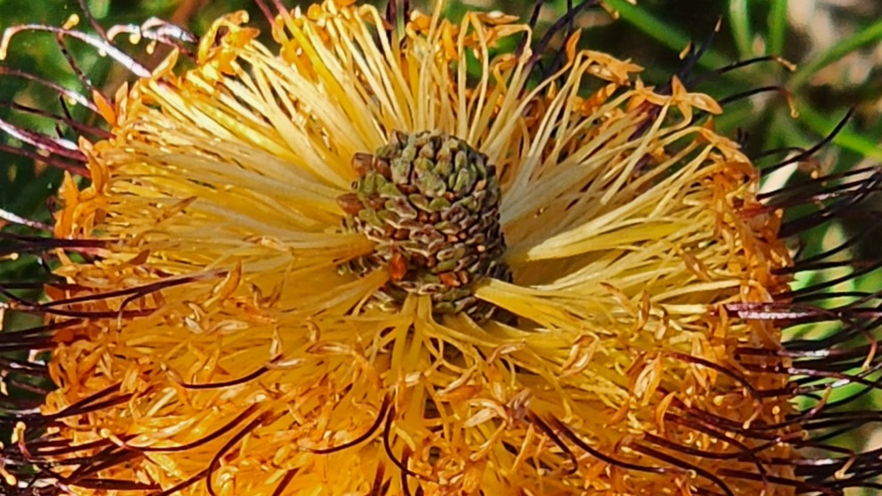

Slide 13
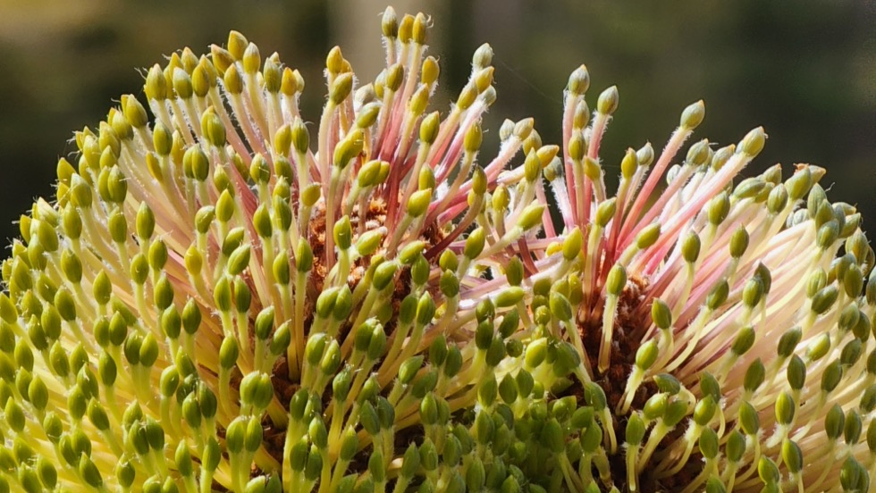
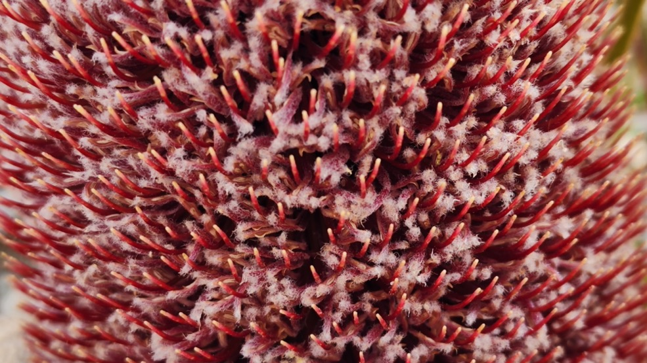

Slide 14
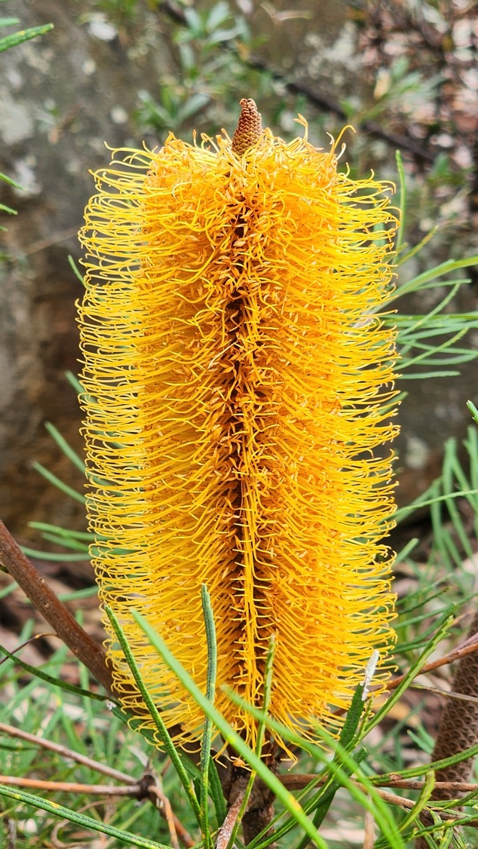
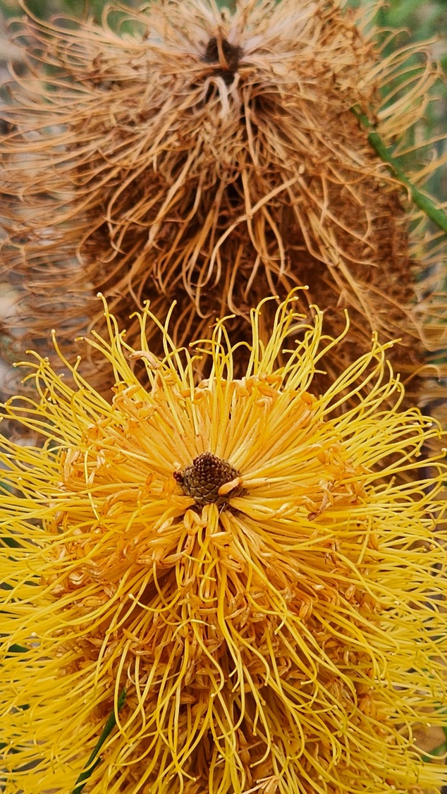
Banksia spinulosa

Slide 15
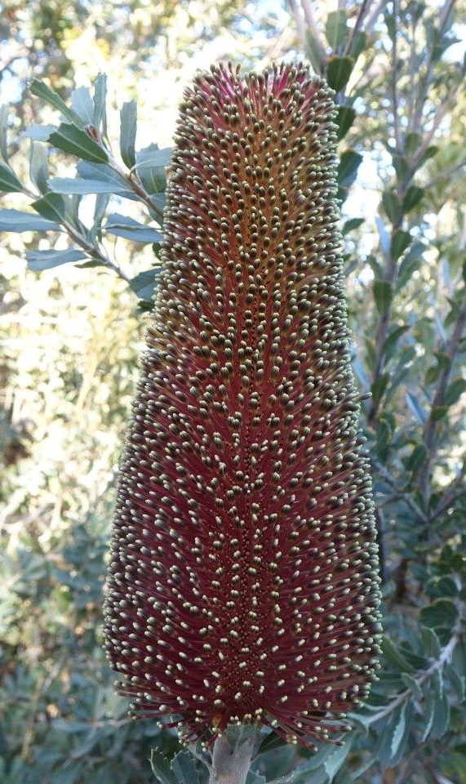
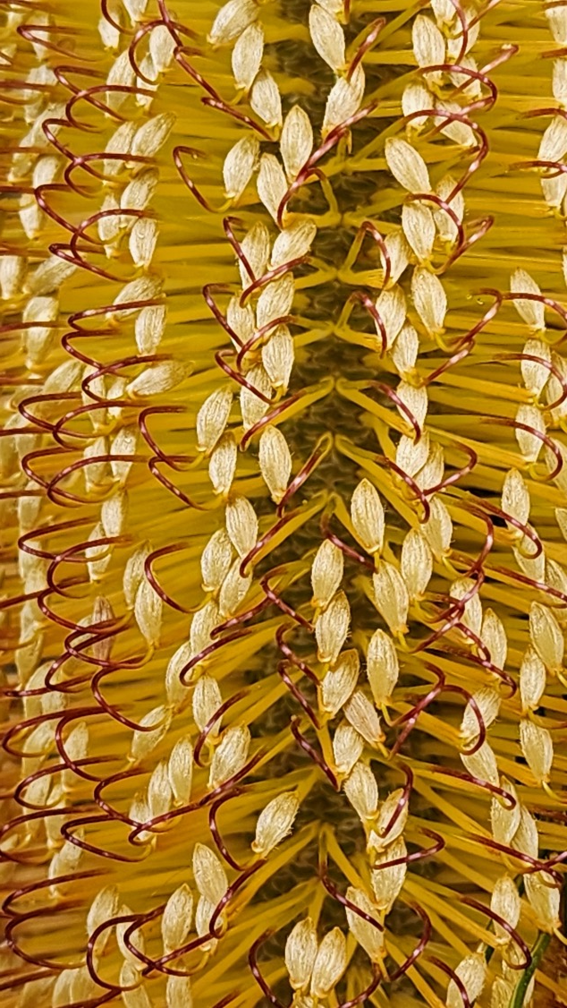
Banksia praemorsa

Slide 16
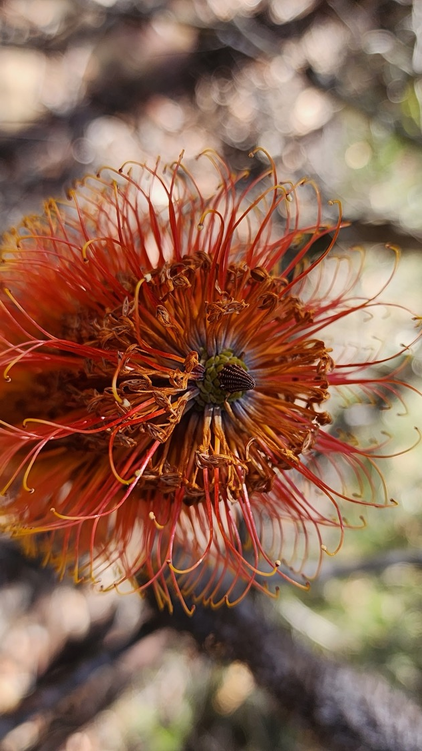
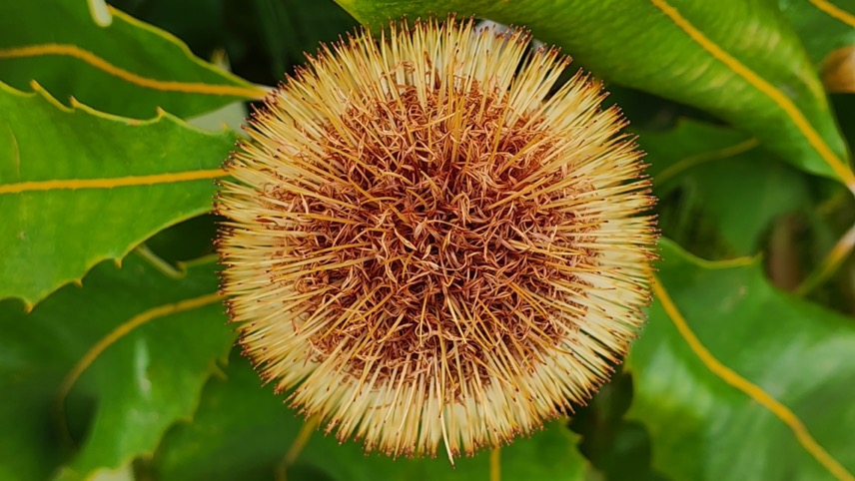

Slide 17
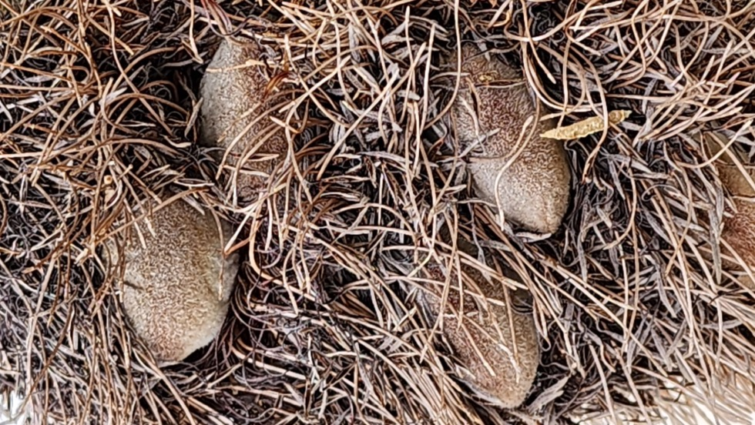
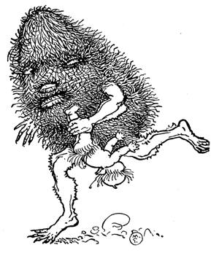
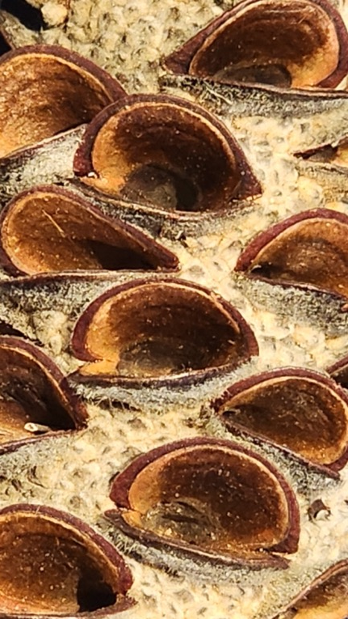
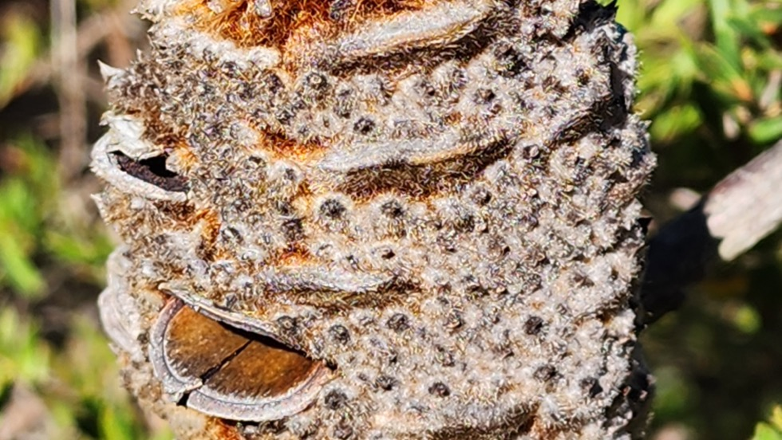

Slide 18
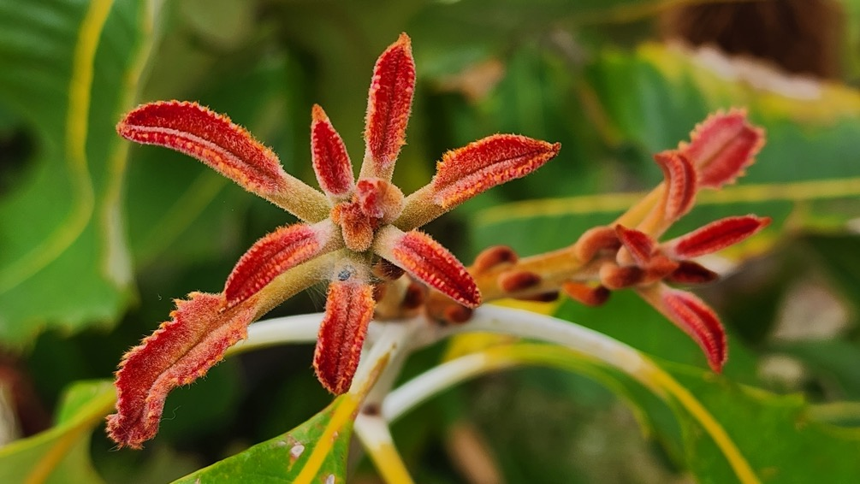
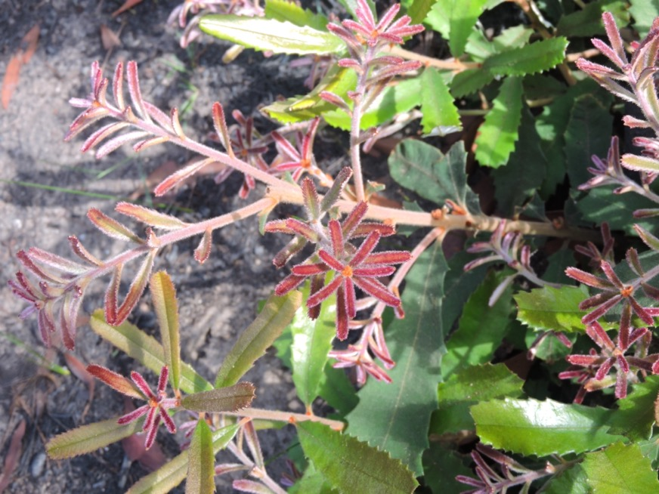

Slide 19
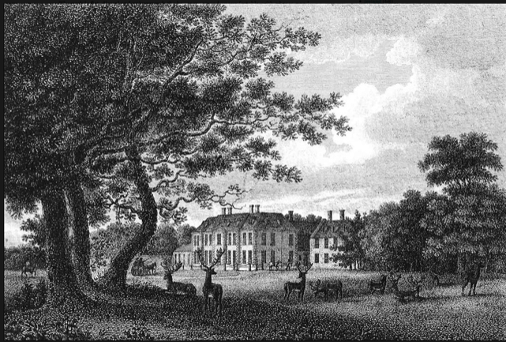
Sir Joseph Banks – before Australia
Early life
1743 – only son of a wealthy landowner in Lincolnshire
1761 – inherited fortune and pursued passion for natural history
1766 – elected a Fellow of the Royal Society
Family estate Revesby (demolished)

Slide 20
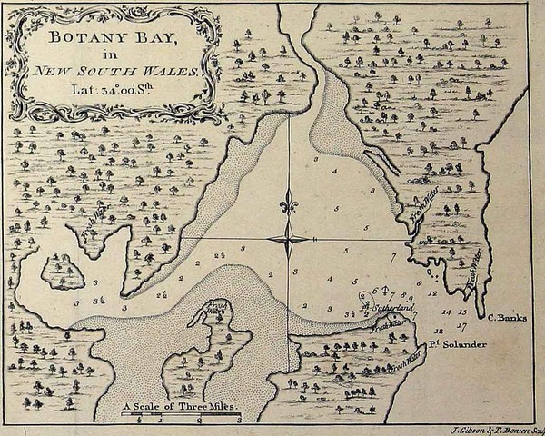
Sir Joseph Banks – in Australia
3 year Voyage, August 1768 to July 1771
Joined James Cook’s 1768 expedition to Tahiti for transit of Venus, with Royal Society
Paid for himself and party of 7 and supplies
  plus Swedish botanist Dr Daniel Solander (1733–1782) as guest
Collected on east coast of Australia:
  Botany Bay in NSW, 28 April – 5 May 1770
  Endeavour River in Qld, 17 June – 3 August 1770

Slide 21

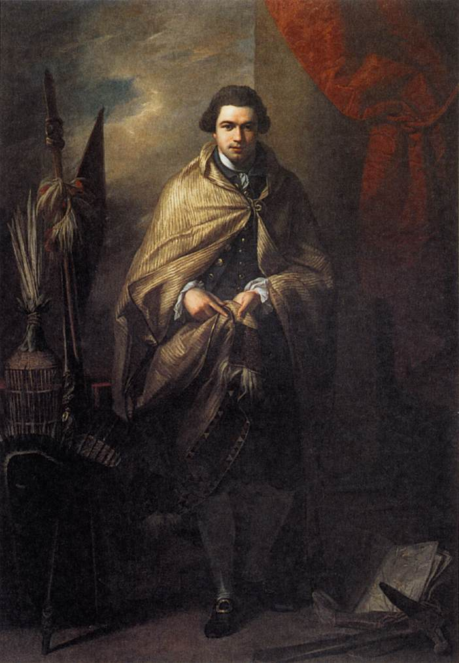
Sir Joseph Banks – after Australia
Home in July 1771 to public acclaim
Long life as patron of the natural sciences
By Joshua Reynolds c1771-73
By Benjamin West c1773

Slide 22
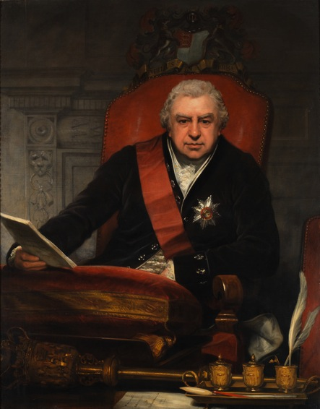
Sir Joseph Banks, patron
Facilitator, supporter, networker, benefactor
President of the Royal Society
for 41 years in Age of Enlightenment
Royal Botanic Gardens, Kew and
British Museum, Linnean Society
and Horticultural Society
Australian interests
Paid plant collectors in Australia
Equipped Flinders’ expedition in 1802
No property interests in Australia
Character
‘unusually likeable’, generous,
enthusiastic, energetic
Died in 1820, aged 77 years
By Thomas Phillips c1808-09

Slide 23
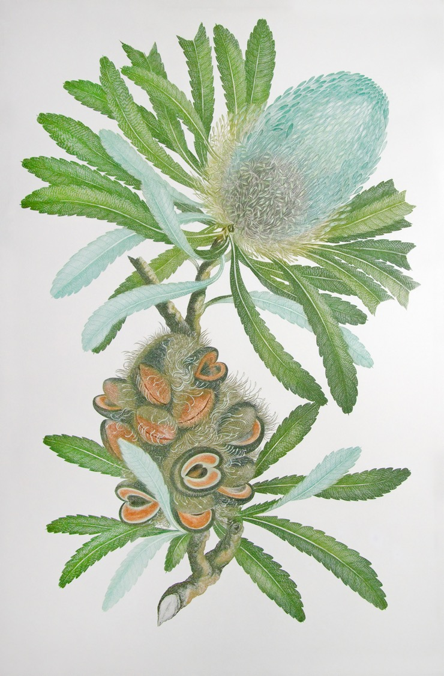
A patron, not a botanist
The Florilegium
Banks commissioned over 700 engravings 1772–1784, known as Banks’ Florilegium
Never published in Banks’ lifetime – impact of Solander’s death in 1782?
1990 – complete set in colour by British Museum
2017 – 147 prints in a more affordable book
Banksia serrata

Slide 24
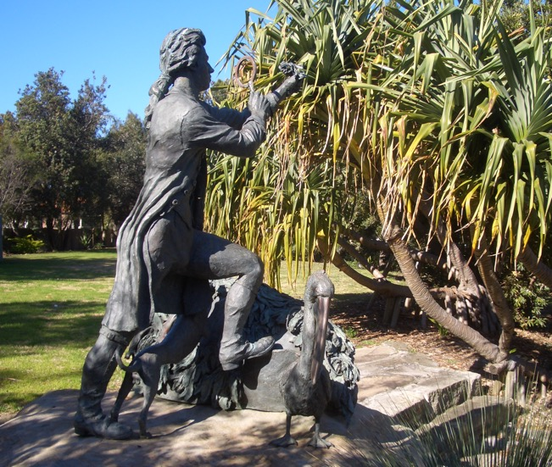
Banks in place names
Cape Banks at head of Botany Bay
Sydney suburbs: Bankstown, Banksia, Banksmeadow
Federal electorate of Banks
Joseph Banks Native Plants Reserve, Kareela
Sir Joseph Banks Park, Botany
Bankstown (= Banks’ Town)
  named by Governor Hunter
  in 1797 after Flinders and Bass
  explored Georges River
  Revesby after family estate
Almost: Continent of Banksia
Plus 80 plant species
sydney-city.blogspot.com/2011/09/botany-sir-joseph-banks-park-sculpture.html

Slide 25
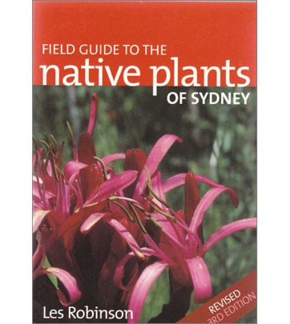
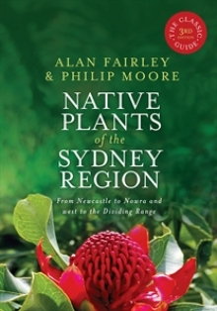
Our local banksias
Identifying Sydney region banksias
Leaf: shape, size, margins, underside colour
Flower: size and colour
Species name often refers to leaf characteristics
Banksia aemula
Banksia ericifolia
Banksia integrifolia
Banksia marginata
Banksia oblongifolia
Banksia paludosa
Banksia robur
Banksia serrata
Banksia spinulosa
Note: Many varieties of B. spinulosa,
and may interbreed with B. ericifolia

Slide 26
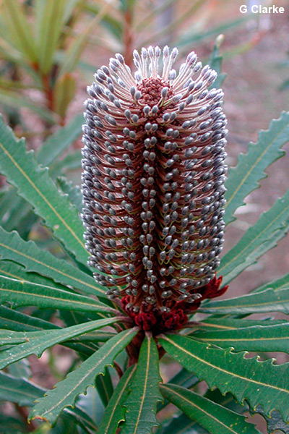
Other east coast banksias
Banksia aquilonia (Qld)
Banksia conferta (Qld)
Banksia plagiocarpa (Hinchinbrook, Qld)
Banksia canei (Snowy Mountains)
Banksia croajingolensis (Vic)
Plus very rare
Banksia vincentia (Jervis Bay)
Now considered form of B. spinulosa
Banksia plagiocarpa
anpsa.org.au

Slide 27
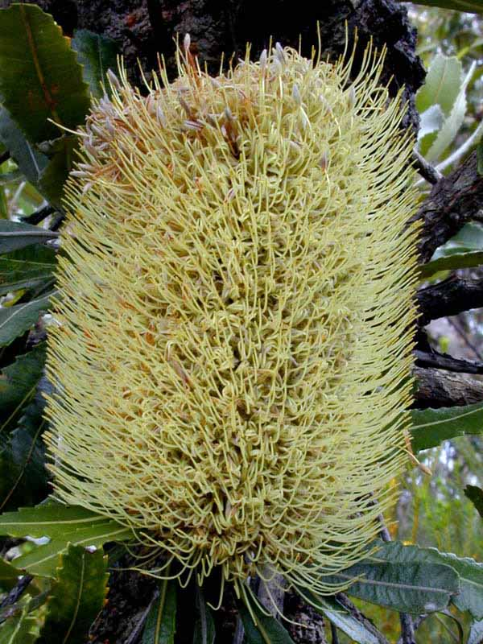
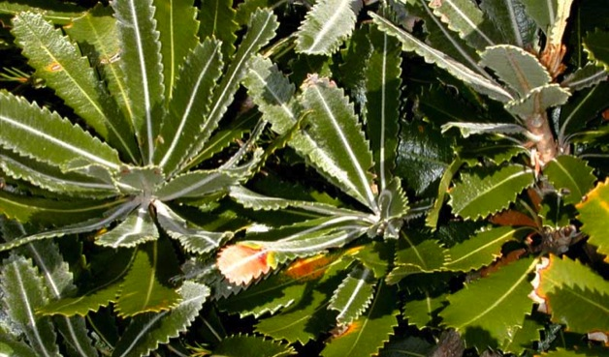
Banksia serrata
Gnarled, thick-trunked shrub or small tree 4–8 m high
Tough serrated leaves
Yellow cylindrical flower spikes
Flowers in December to March, but remain on the tree as they dry and reveal the woody seed follicles
Coastal Plants of RNP CD (APS Sutherland)

Slide 28
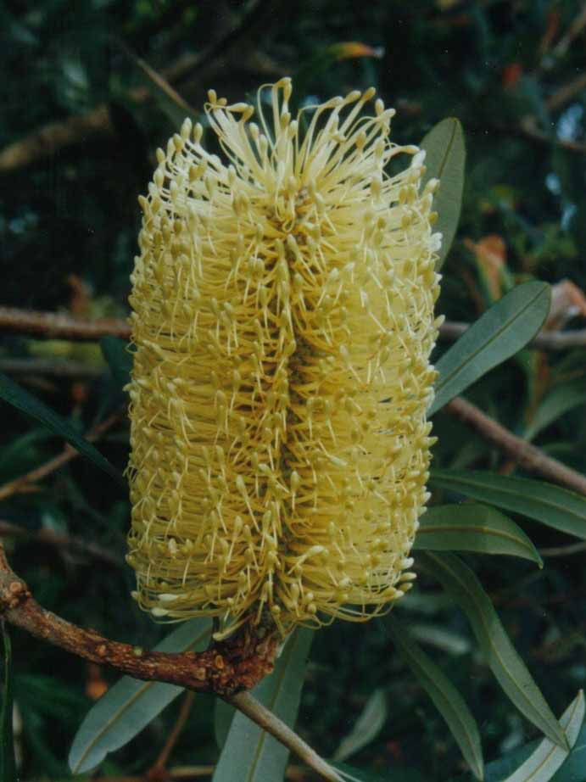
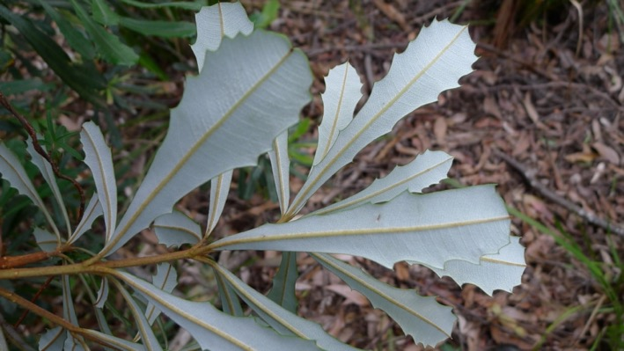
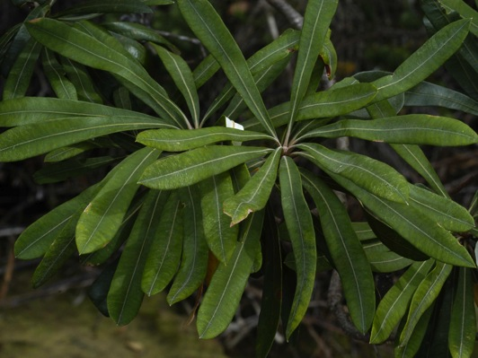
Banksia integrifolia
Coastal/sandy
Shrub or tree 6–16 m high, common in coastal scrubs and forests, with rough and light grey bark
Whole leaves (no serrations),
dark green on top and white underneath (juvenile different)
Pale yellow flower spikes to 12 cm, produced mainly in winter (January–June)
By John Tann

Slide 29

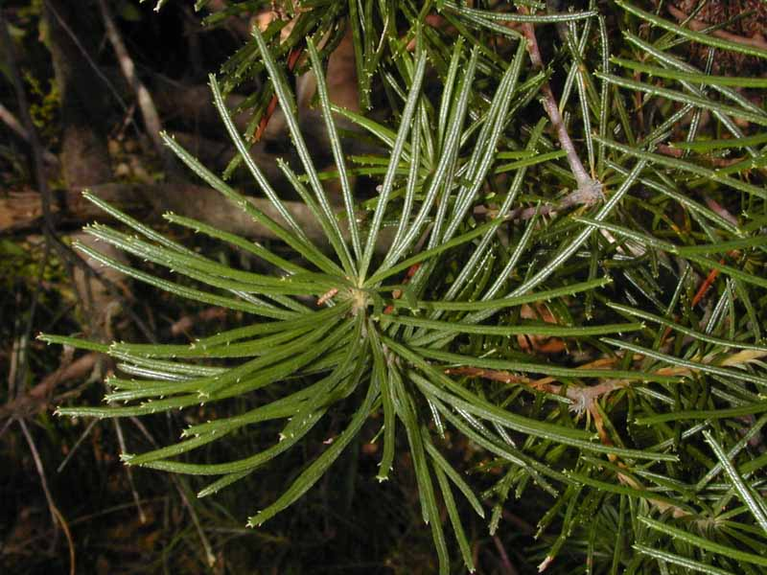
Banksia spinulosa
Erect, rounded shrub to 2 m high
Leaves are very narrow and stiff,
like spines
Golden yellow to orange flower spikes to 15 cm with hooked red or black styles, in winter (March–September)
Very common in sheltered woodland and is an indicator of moist conditions
Much variety

Slide 30
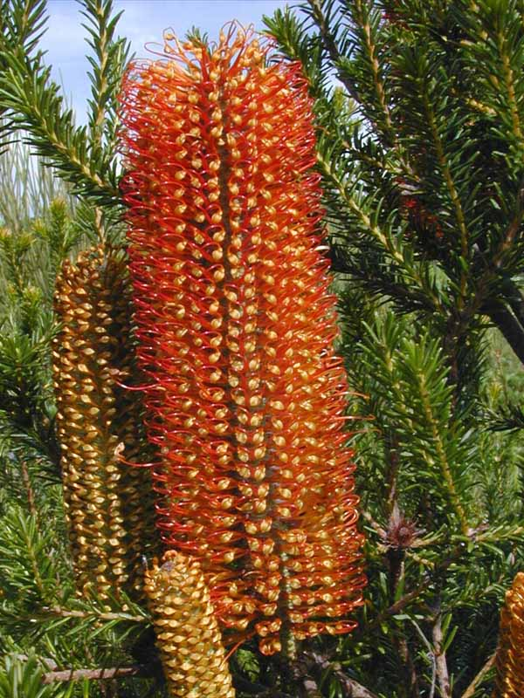
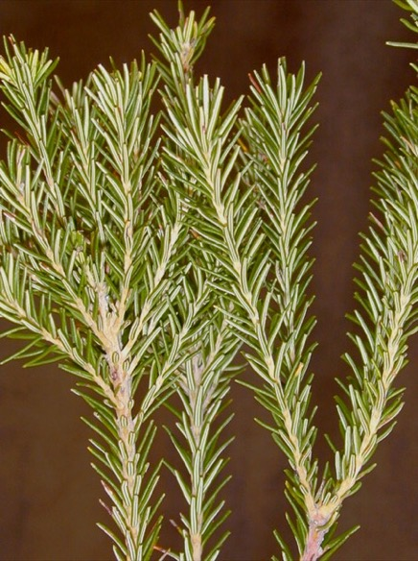
Banksia ericifolia
Rounded shrub to 2–5 m high, usually abundant in heaths and woodlands
Heath-like leaves – the leaves are tiny and crowded along the stems
Orange flower spikes to 20 cm with hooked red or black styles, in winter (April–August)
Important for nectar-feeding birds such as honeyeaters because it flowers in winter

Slide 31



Banksia robur
Low, spreading shrub to 3 m high
Huge, leathery, coarsely serrated leaves
Grey-green flower spikes to
15 cm high in January to July
Grows in marshy ground near creeks
in open heath, but also found in
well-drained conditions
Uloola swamps, RNP

Slide 32


Banksia marginata
Rounded shrub or small tree to 6 m high, with scattered distribution in heaths and woodlands in Sydney
Leaves are small, white and oblong, with variable number of teeth or serrations, and some leaves have down-curled leaf margins
Yellow flower spikes about 8 cm high, with straight styles, in February–June

Slide 33


Banksia oblongifolia
Spreading shrub to 0.5 m in heath
and 2 m in woodland, fairly common
Oblong leaves, young have rusty felt
Pale yellow flower spikes to 10 cm, with yellow styles, in March–July
www.gardeningwithangus.com.au
Banksia paludosa
Low shrub to 1 m, in wet heathland
Whorled leaves, no visible hairs
Yellowish flower spikes to 10 cm,
in April–August
Woronora Plateau, Maddens Plains
www.gardeningwithangus.com.au

Slide 34




WA banksias
Very showy but hard to grow on east coast
due to different soil, rainfall and humidity
Banksia coccinea
Banksia praemorsa
Banksia menziesii
Banksia prionotes

Slide 35

Banksia coccinea growing in wild in WA (W. Daniels)

Slide 36


WA banksias for Sydney
Banksia blechnifolia
Banksia petiolaris
Banksia repens
Banksia blechnifolia at Joseph Banks Reserve

Slide 37
Banksias in the garden
Growing banksias
Sandy soil, low nutrient soil, well drained, sunny spot
Choose a local east coast banksia for more success
Grow from mature seed
Can prune hard if has a lignotuber
– B. serrata, B. integrifolia and B. spinulosa
Buying banksias
Local: Sutherland Council Nursery, 345 The Boulevarde, Gymea
Cultivars: Sydney Wildflower Nursery, 9 Veno St, Heathcote
Many compact and low forms of local species available

Slide 38



Enjoying native plants in public gardens
Local
Joseph Banks Native Plants Reserve, Kareela
South
Sylvan Grove, Picnic Point
The Australian Botanic Garden, Mount Annan (+ Banksia garden)
Illawarra Grevillea Park, Bulli
North
Stony Range Botanic Garden, Dee Why
Ku-ring-gai Wildflower Garden, St Ives
Further south
Australian National Botanic Garden, Canberra
(+ Banksia garden)
Shoalhaven Heads Botanic Garden
Eurobodalla Botanic Garden, Batemans Bay
Booderee Botanic Garden, Jervis Bay
ANBG

Slide 39


Joseph Banks Native Plants Reserve,
Kareela
Established 1969 by Sutherland Council as a Cook bicentenary project 1770–1970
Named after Sir Joseph Banks
Similar reserves at similar time:
  Sylvan Grove at Picnic Point
  Stony Range at Dee Why
50th anniversary in 2020 (COVID-affected)
See 50th history ppt on APS NSW YouTube

Slide 40

Cook’s map of Botany Bay,
with Cape Banks
Joseph Banks Native Plants Reserve and Botany Bay
JBNPR

Slide 41





Enjoy our beautiful banksias
More information
Rhonda Daniels: rhdaniels@bigpond.com
Australian Plants Society: www.austplants.com.au
Banksia Study Group of the Australian Native Plants Society (Australia): www.anpsa.org.au

