Slide 1
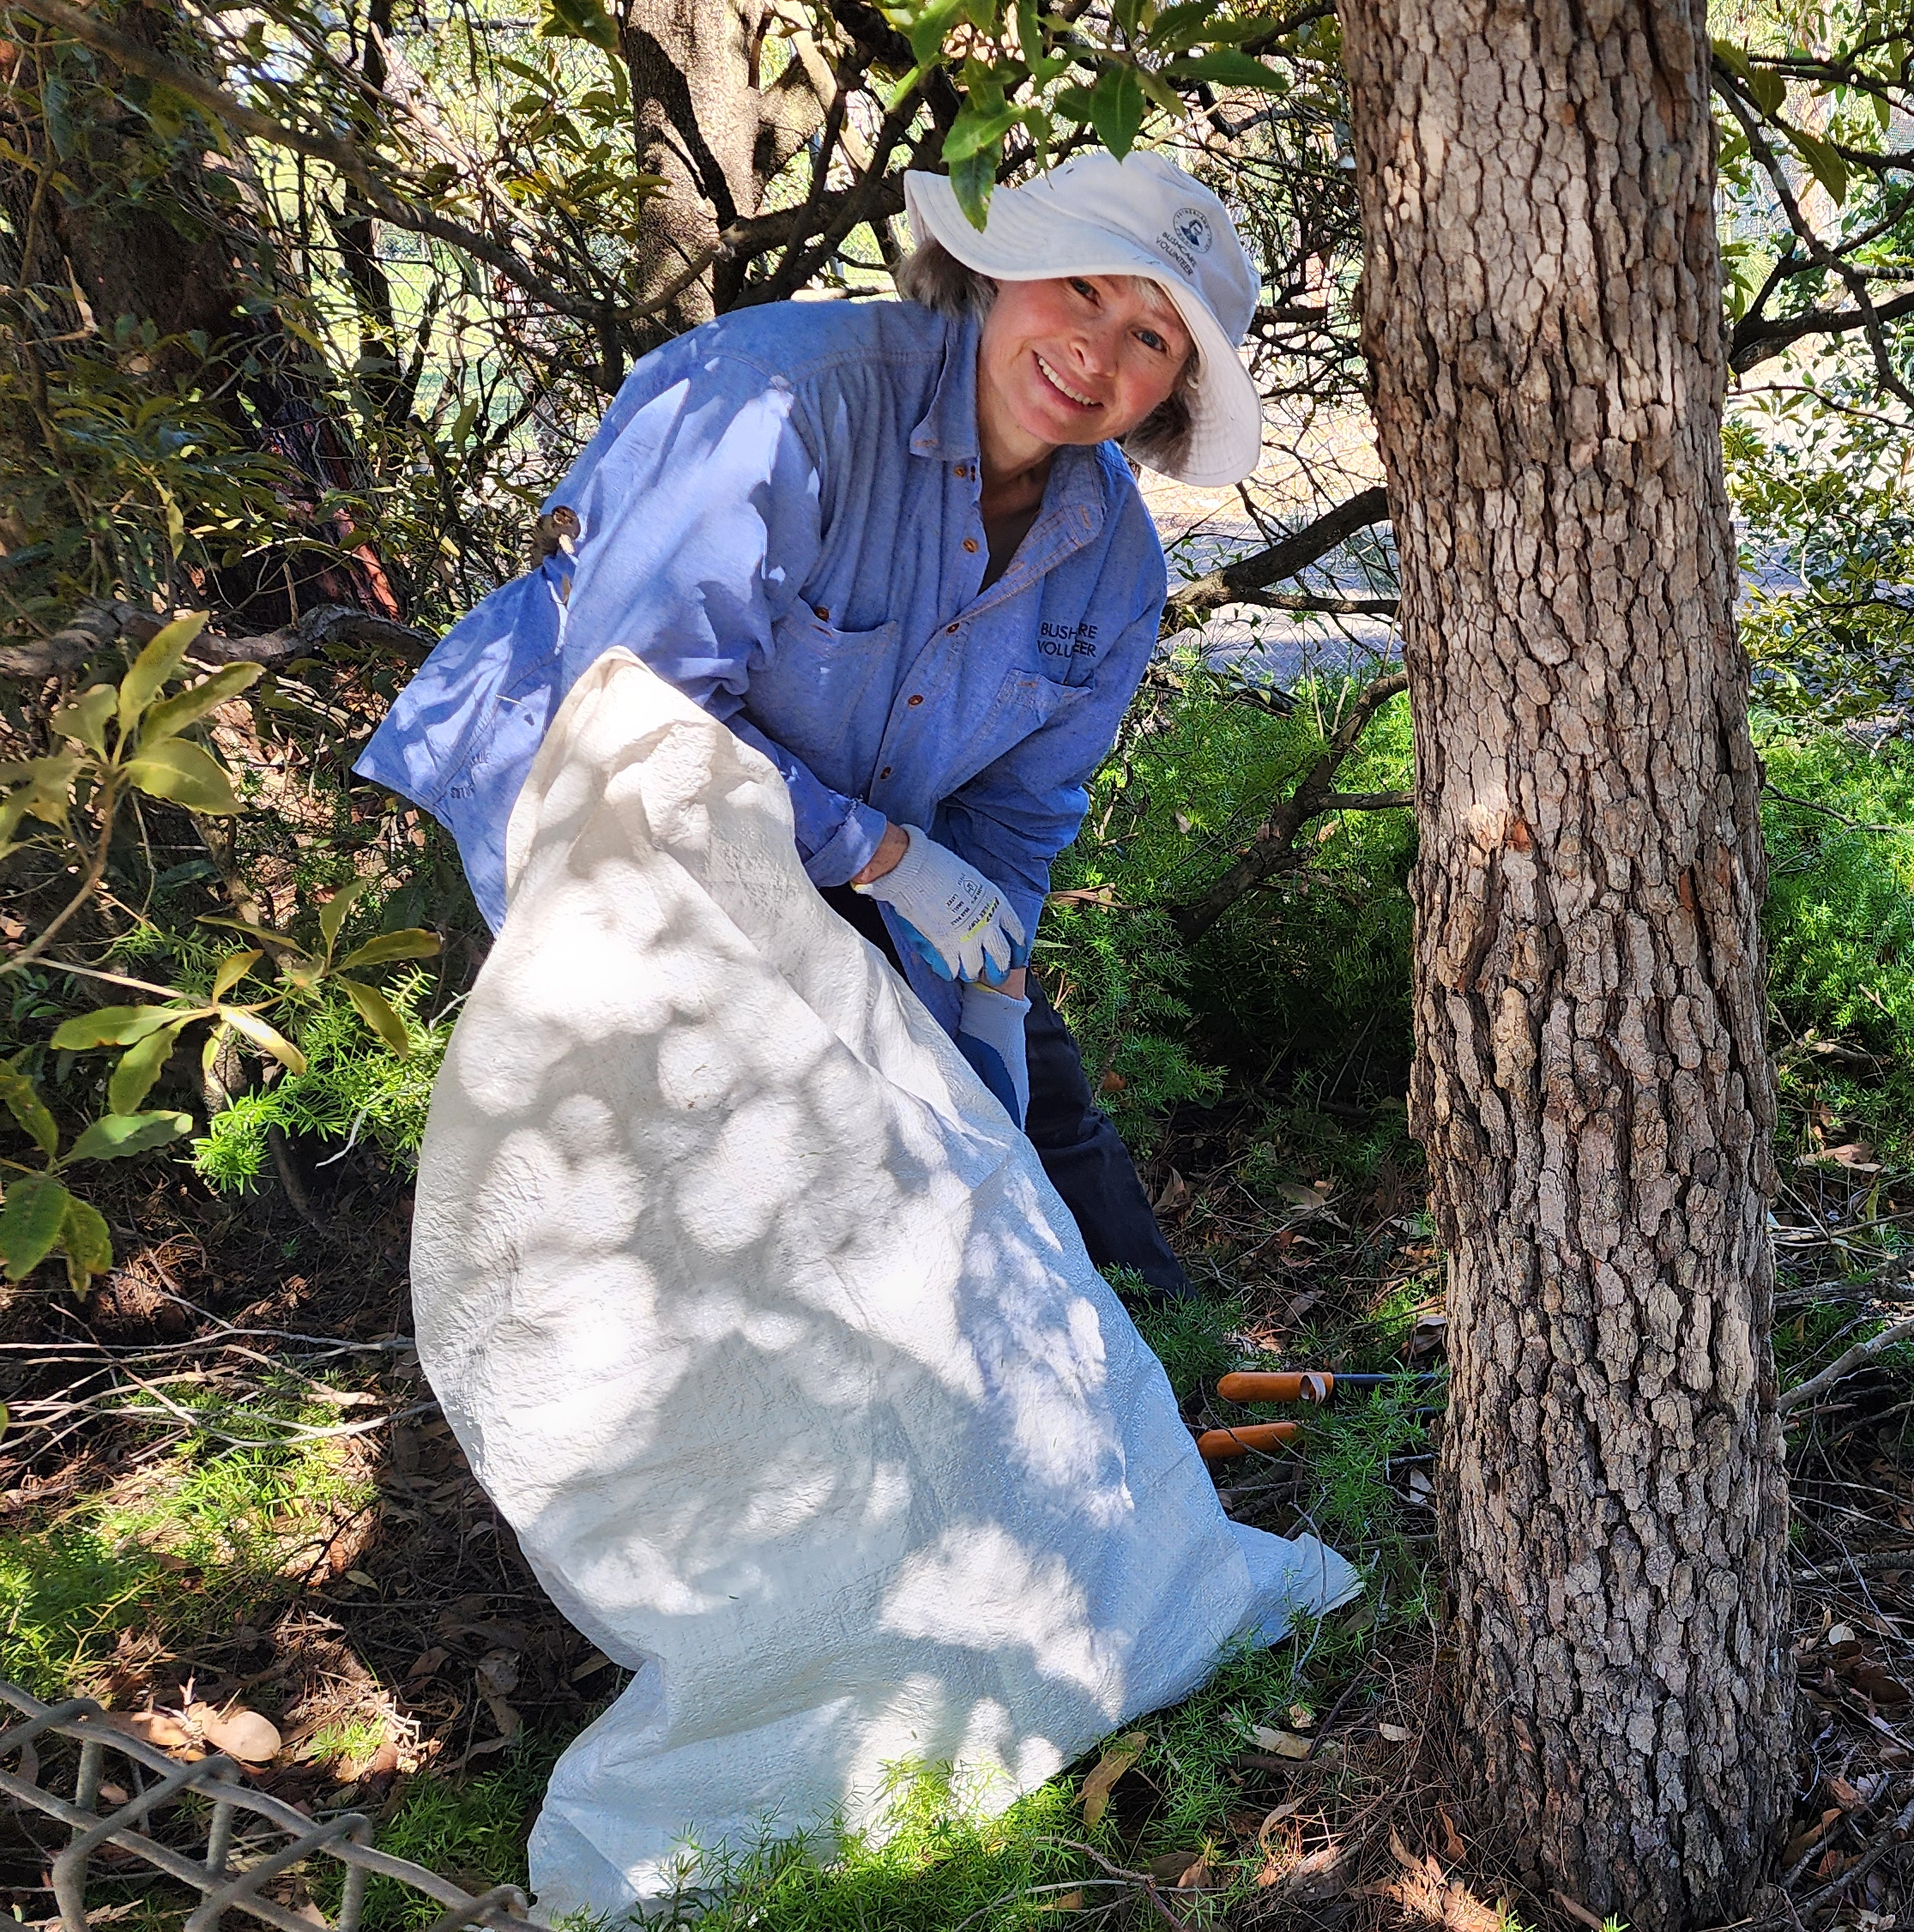
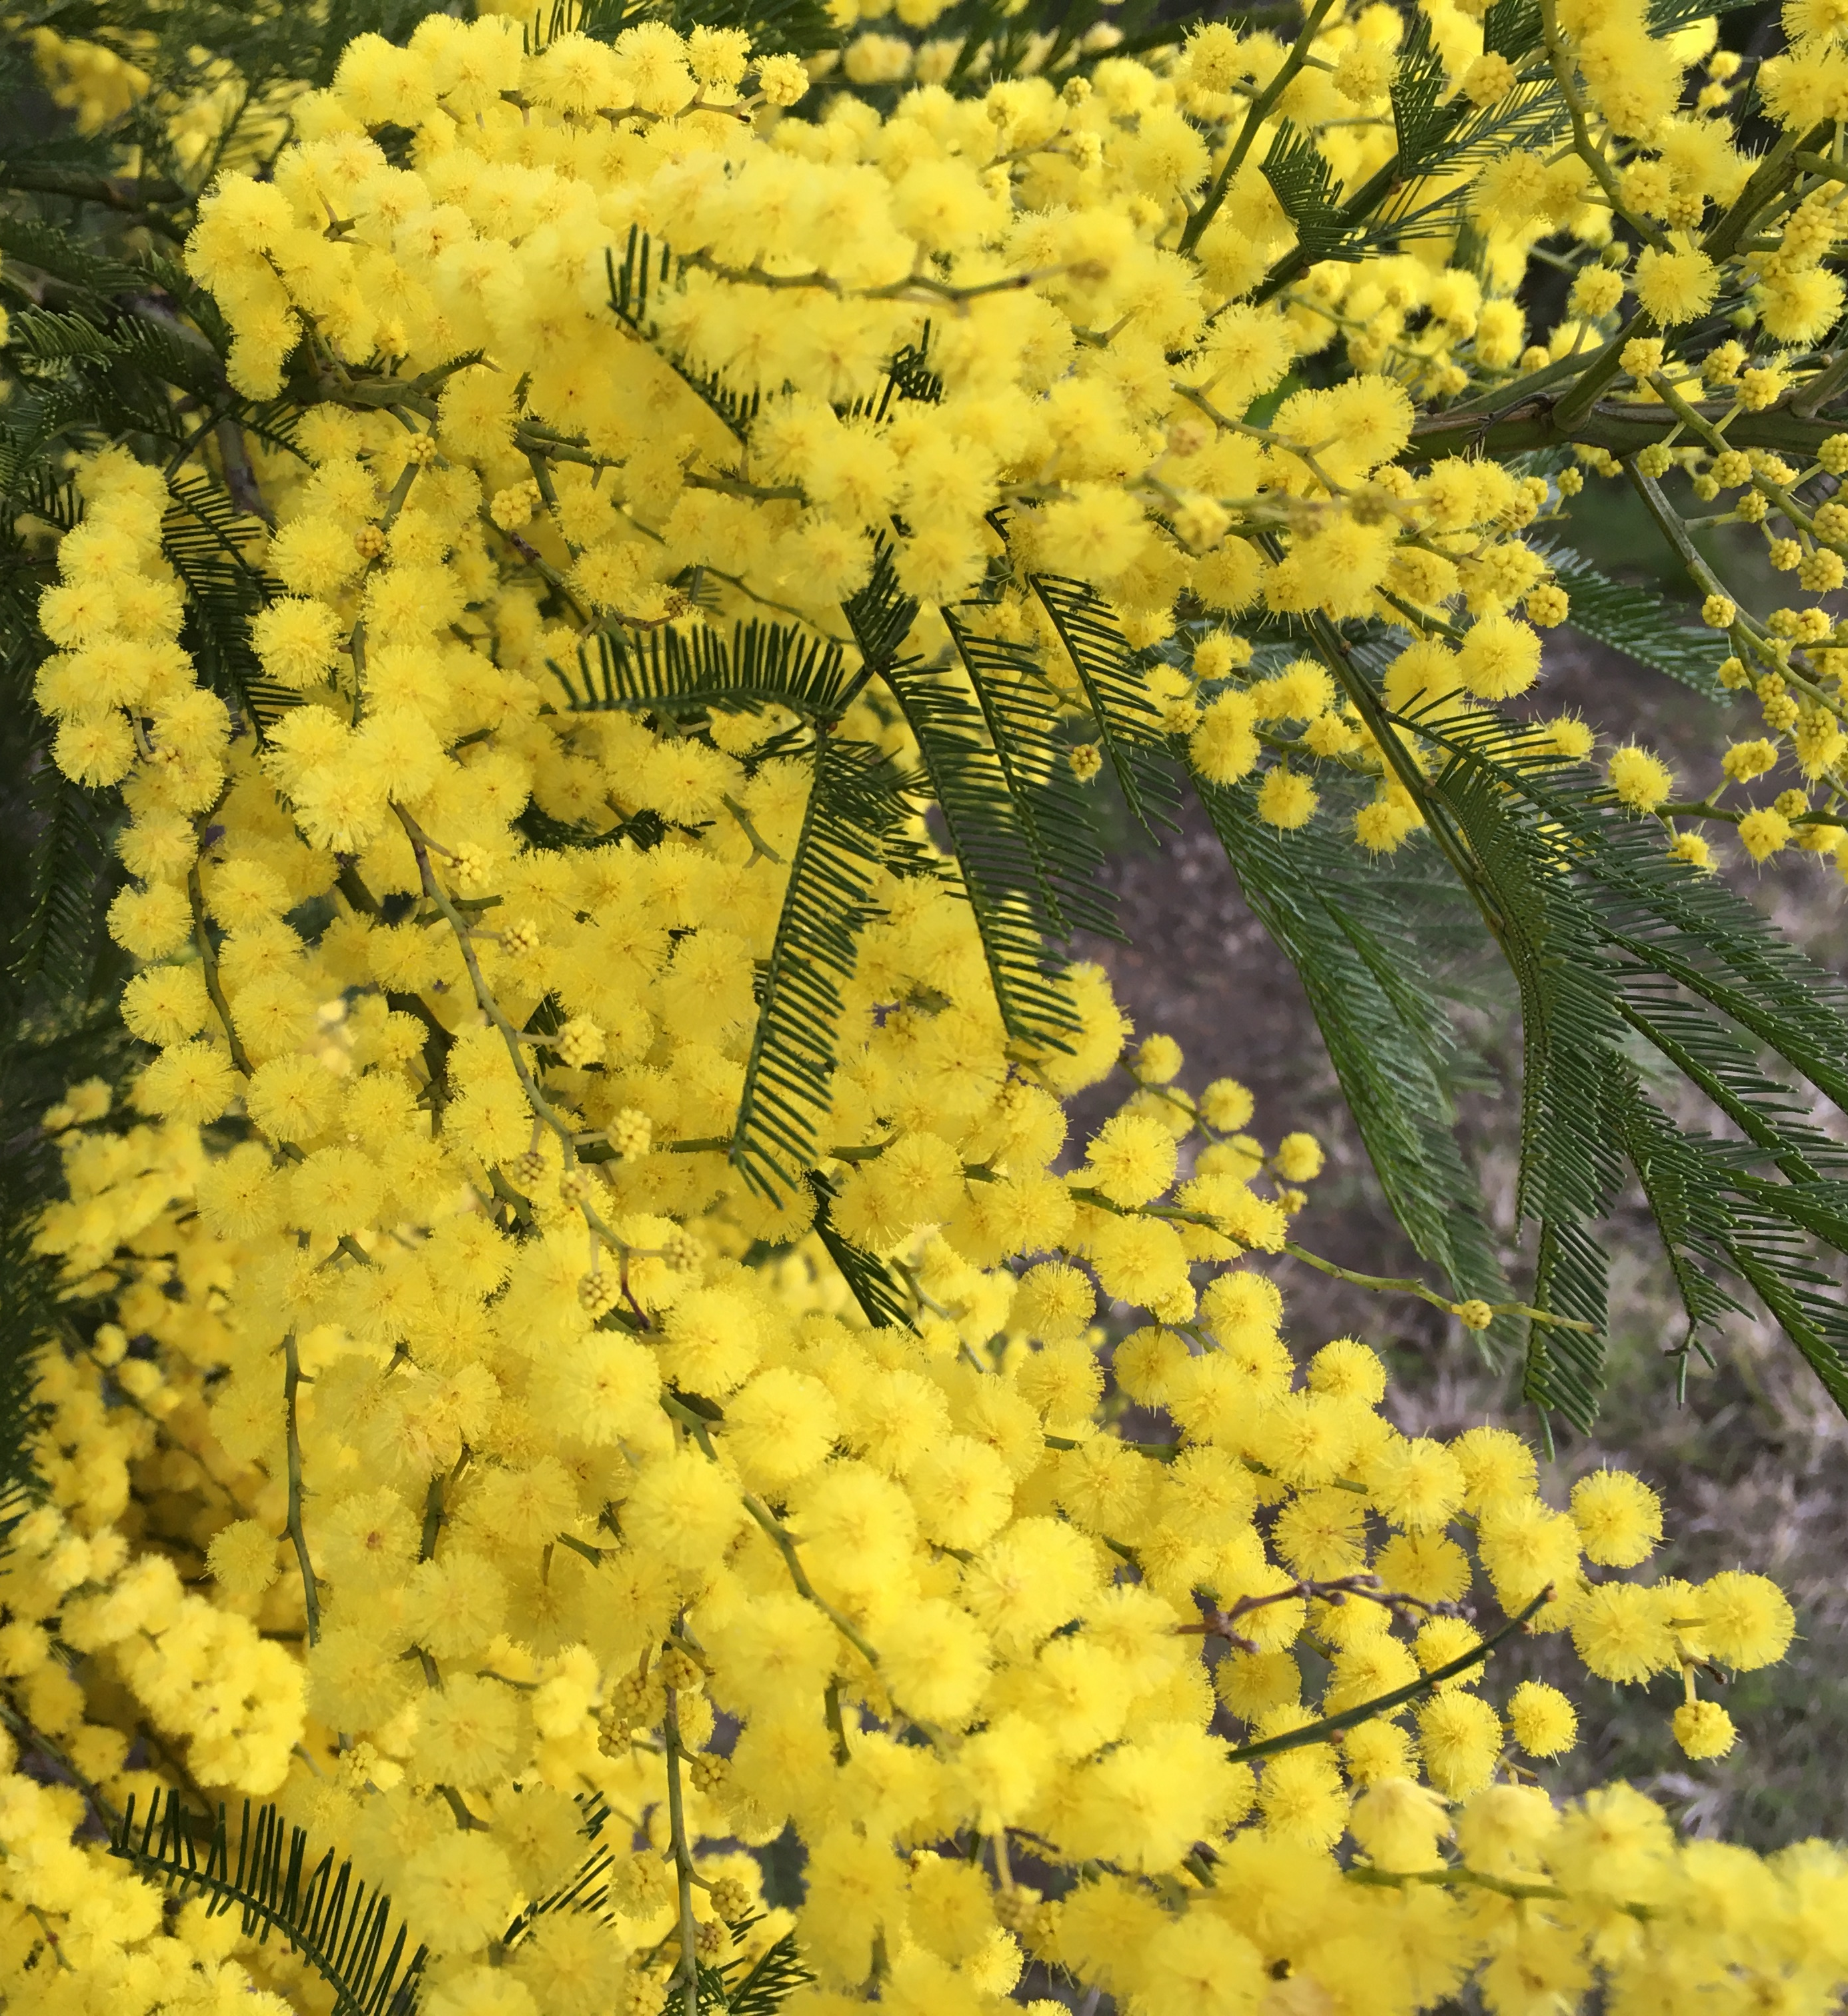
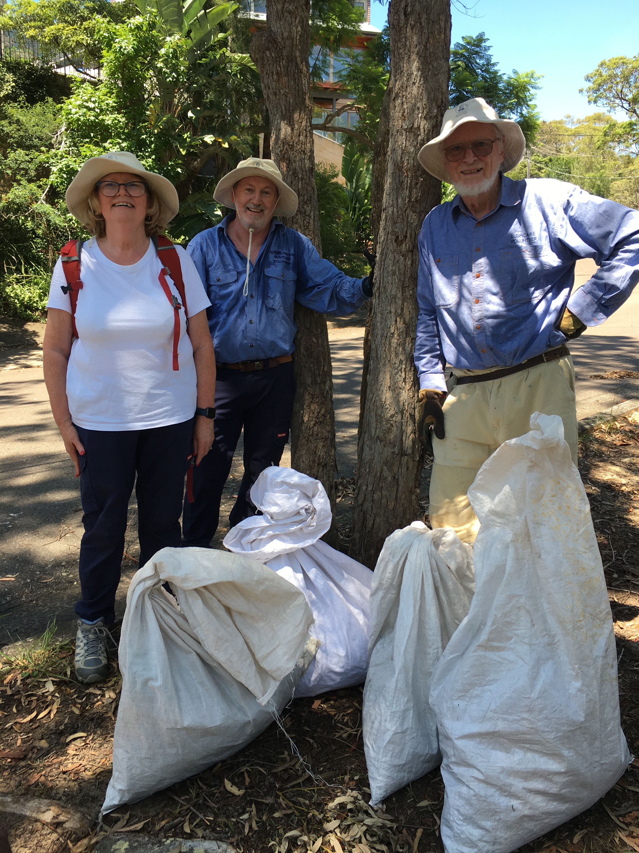
Thoughts on Bushcare volunteering
Rhonda Daniels
Sutherland Shire Environmental Citizen of the Year 2025
rhdaniels@bigpond.com

Slide 2
Outline
A/typical volunteer
What works well – the basics and extras
Issues
Improving recruiting
Improving retention
The future
Callicoma serratifolia CD

Slide 3
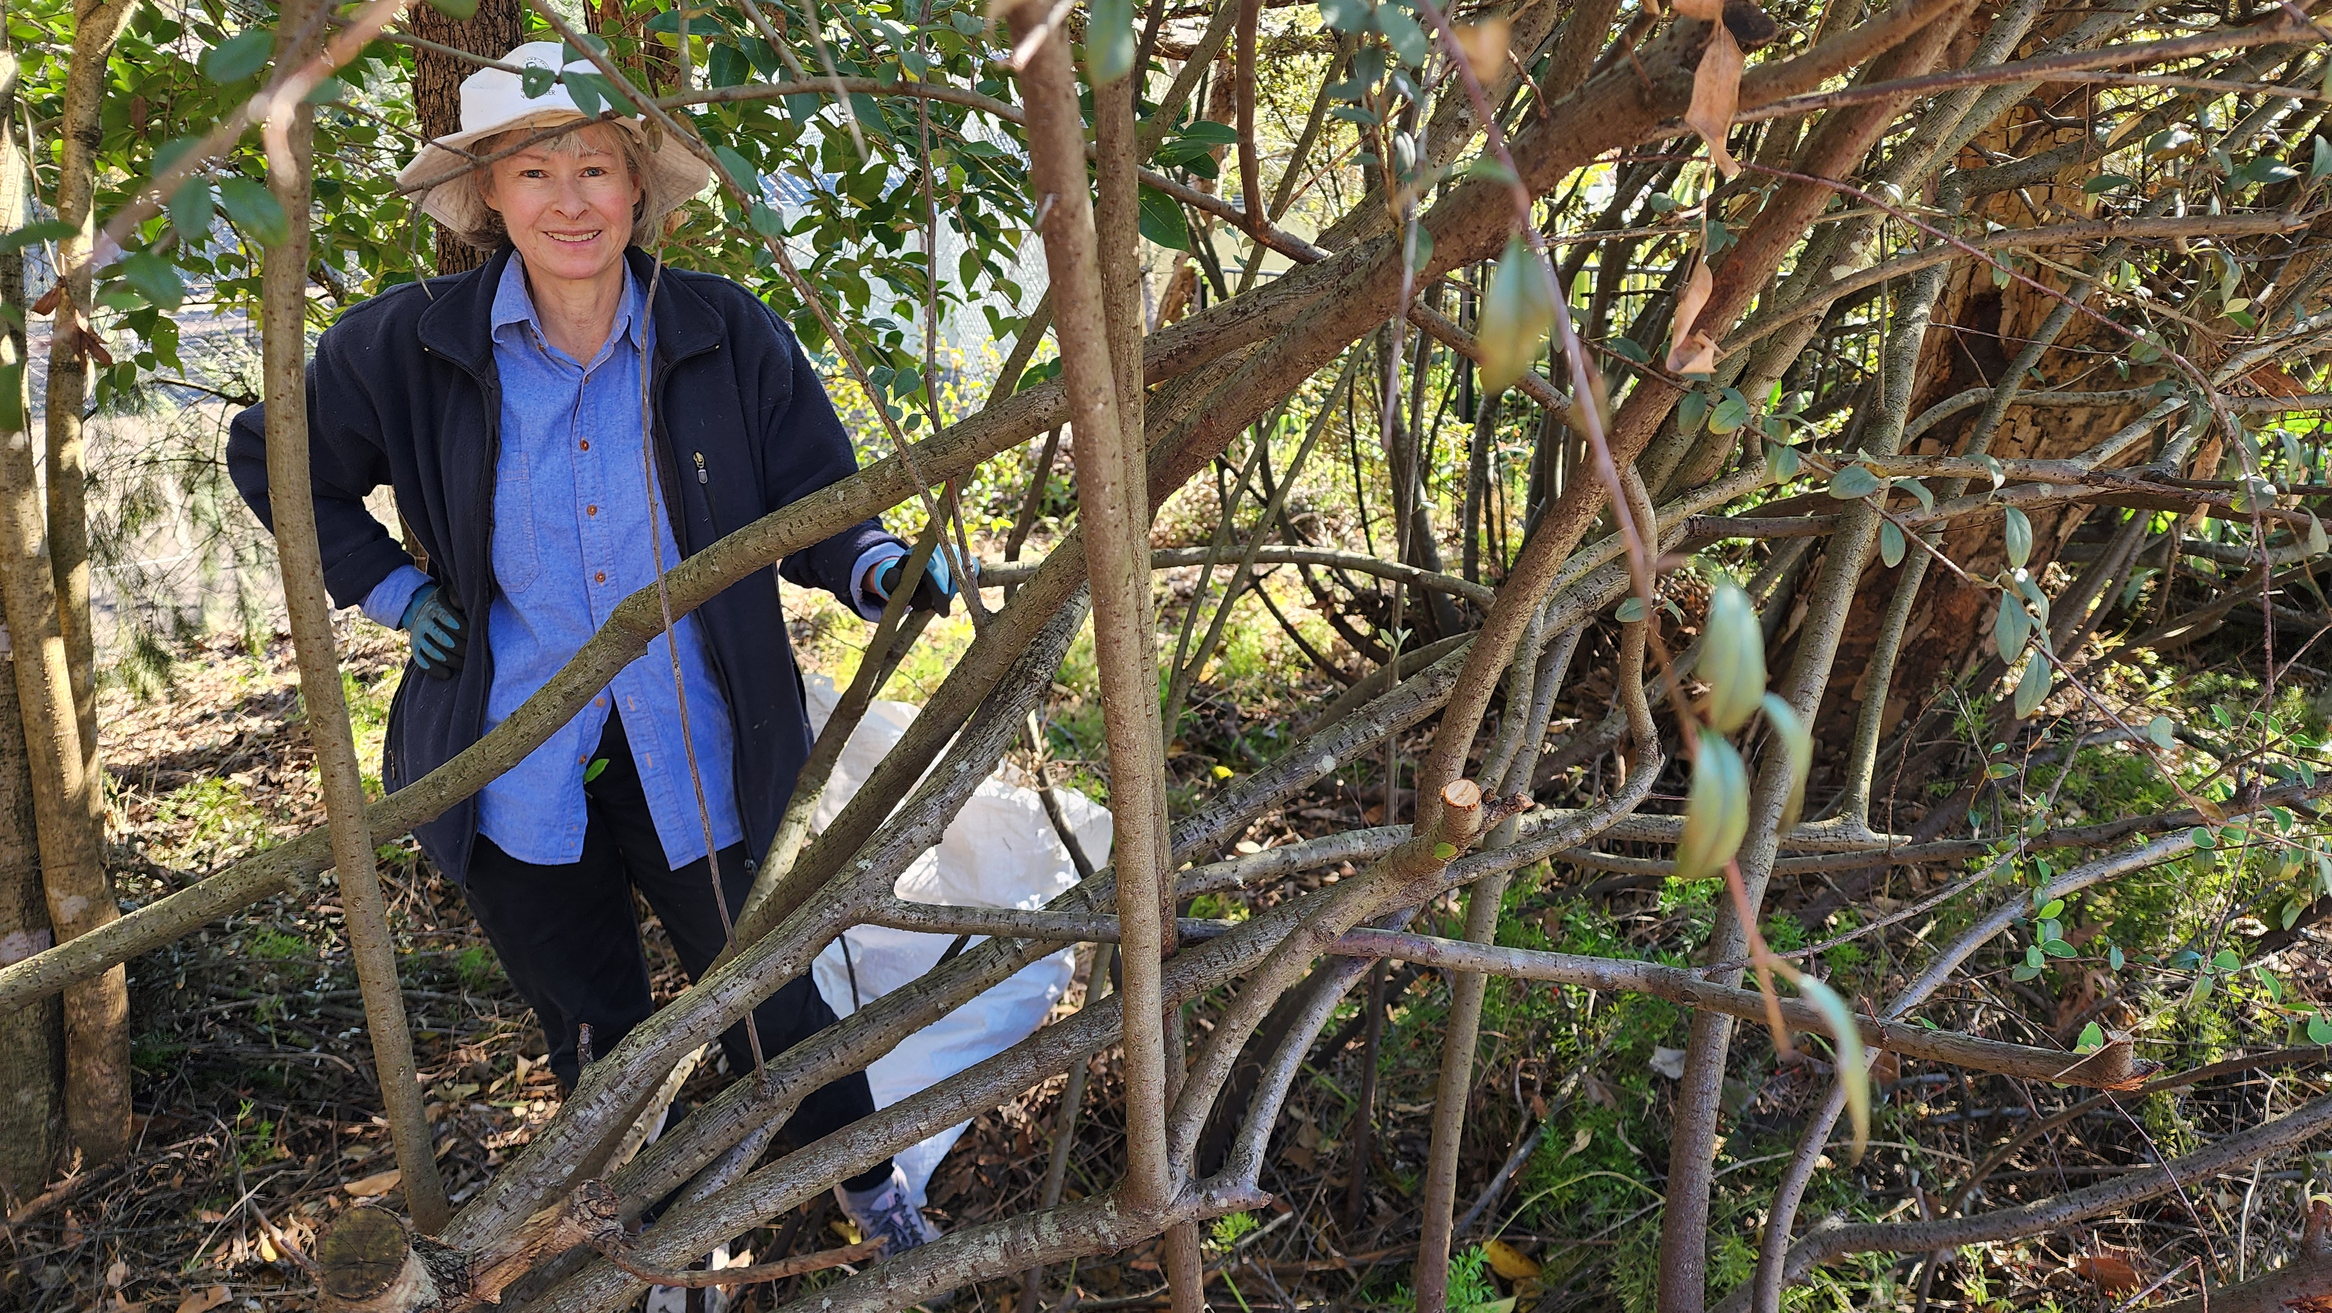
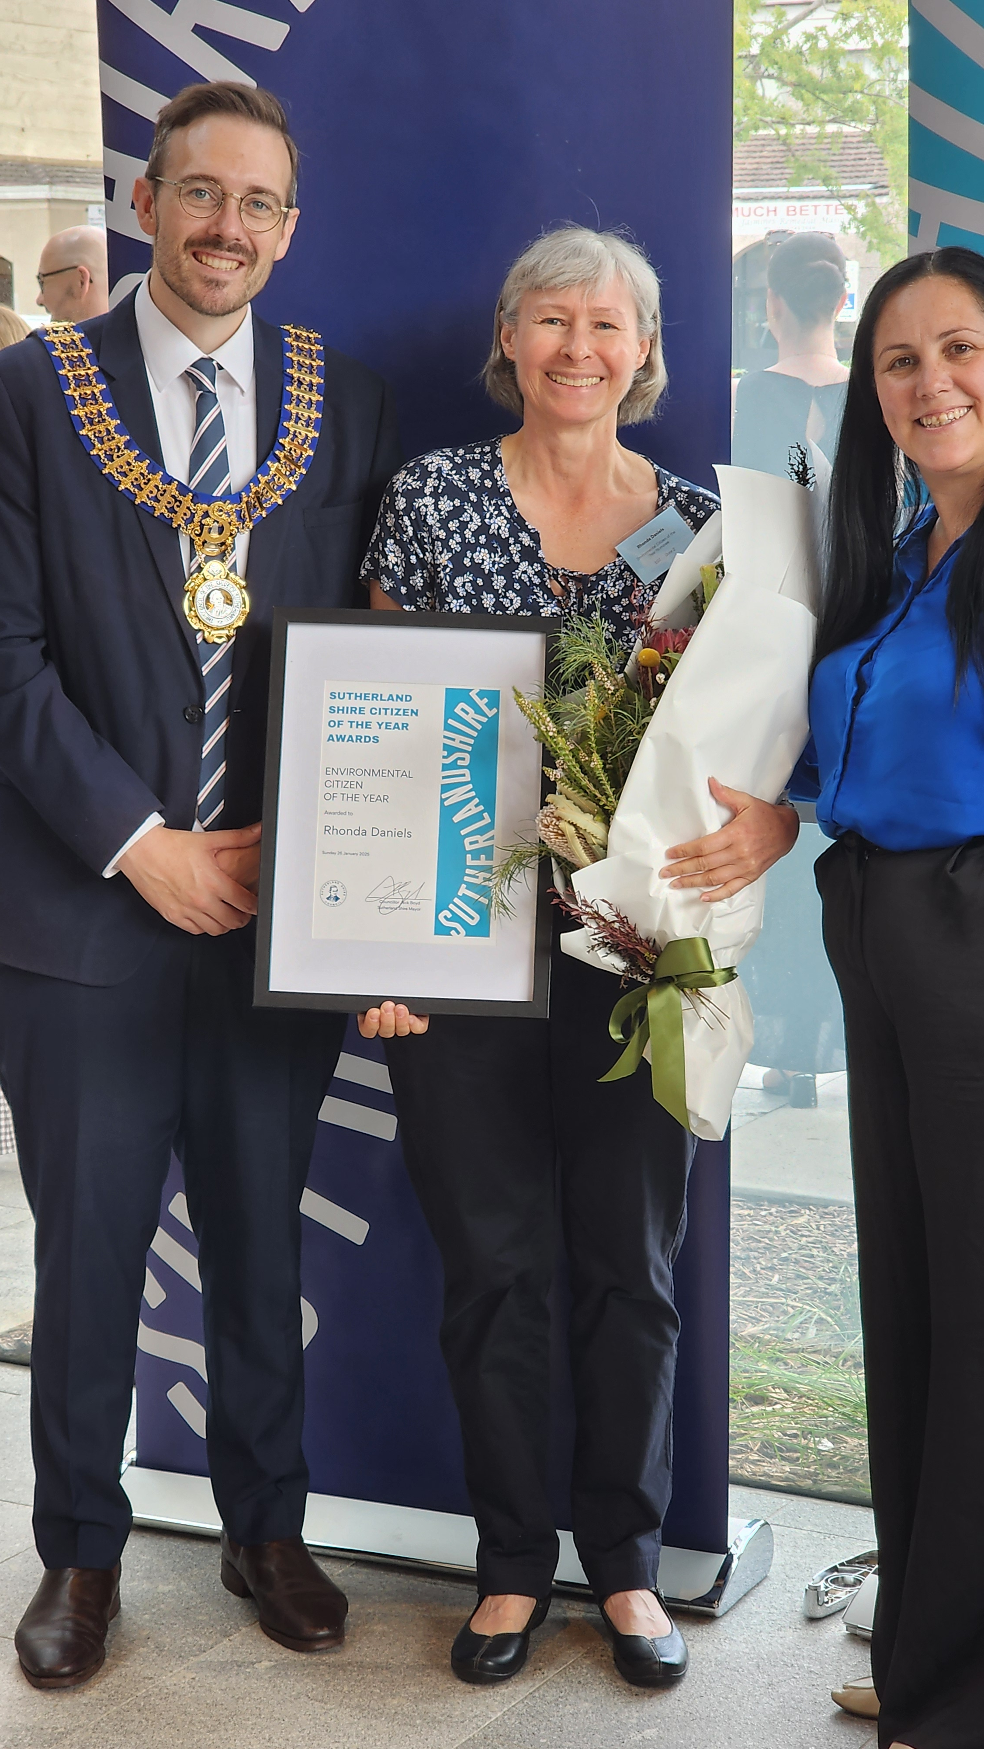

A/typical volunteer?
Parents
Australian Plants Society
Bushcare and Nursery
Training: Cert 2 CLM, Cert 4 Hort
Honours: Sutherland Council and APS

Slide 4
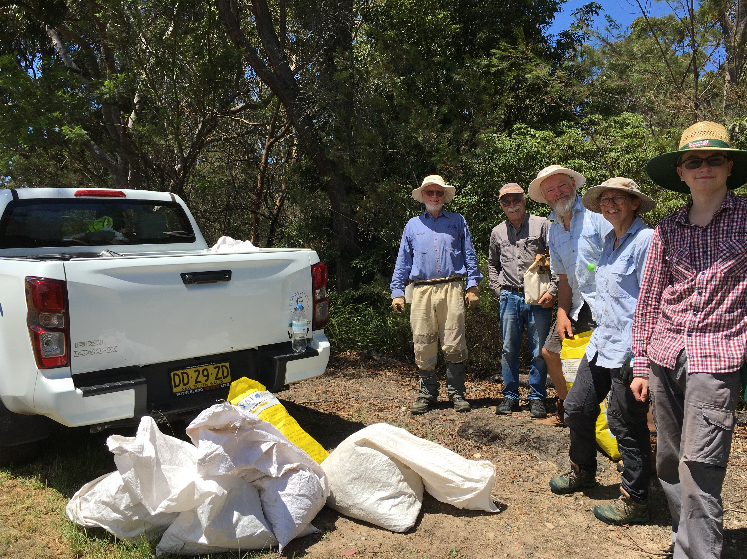
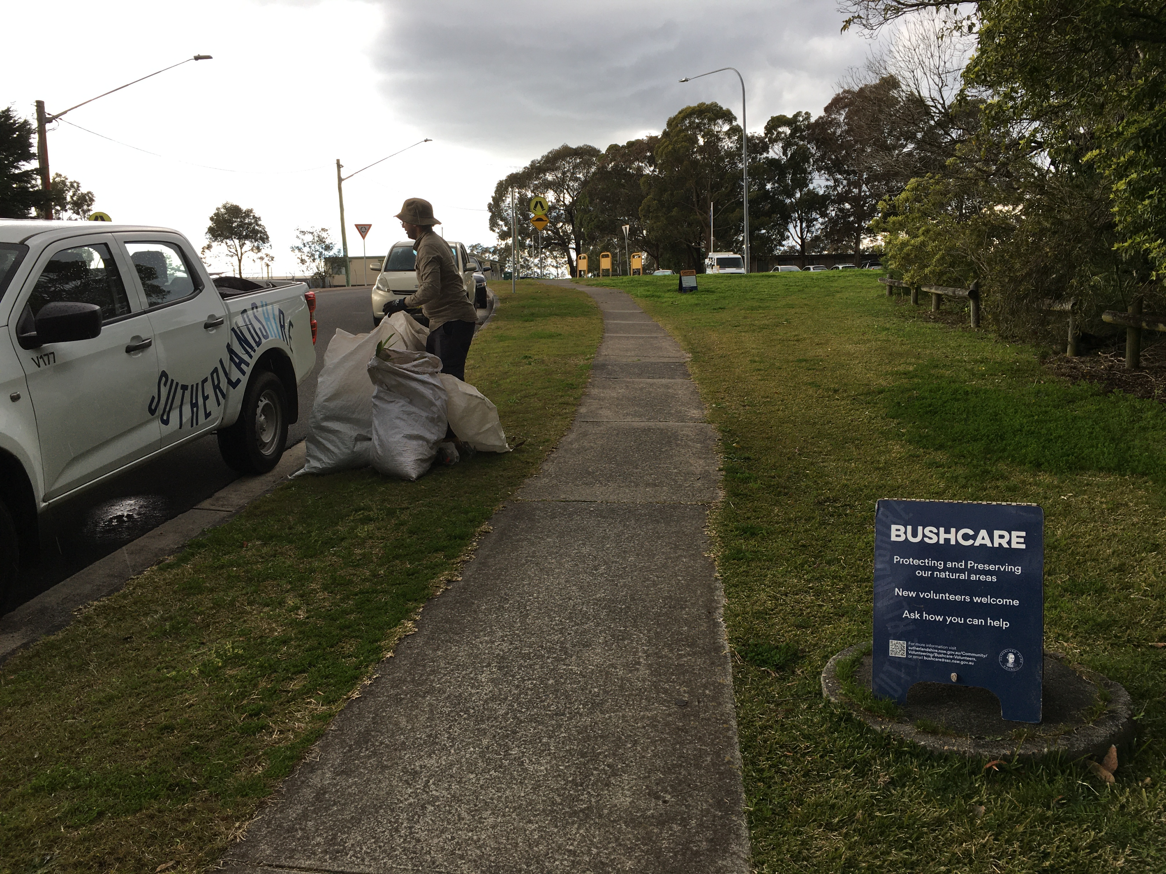
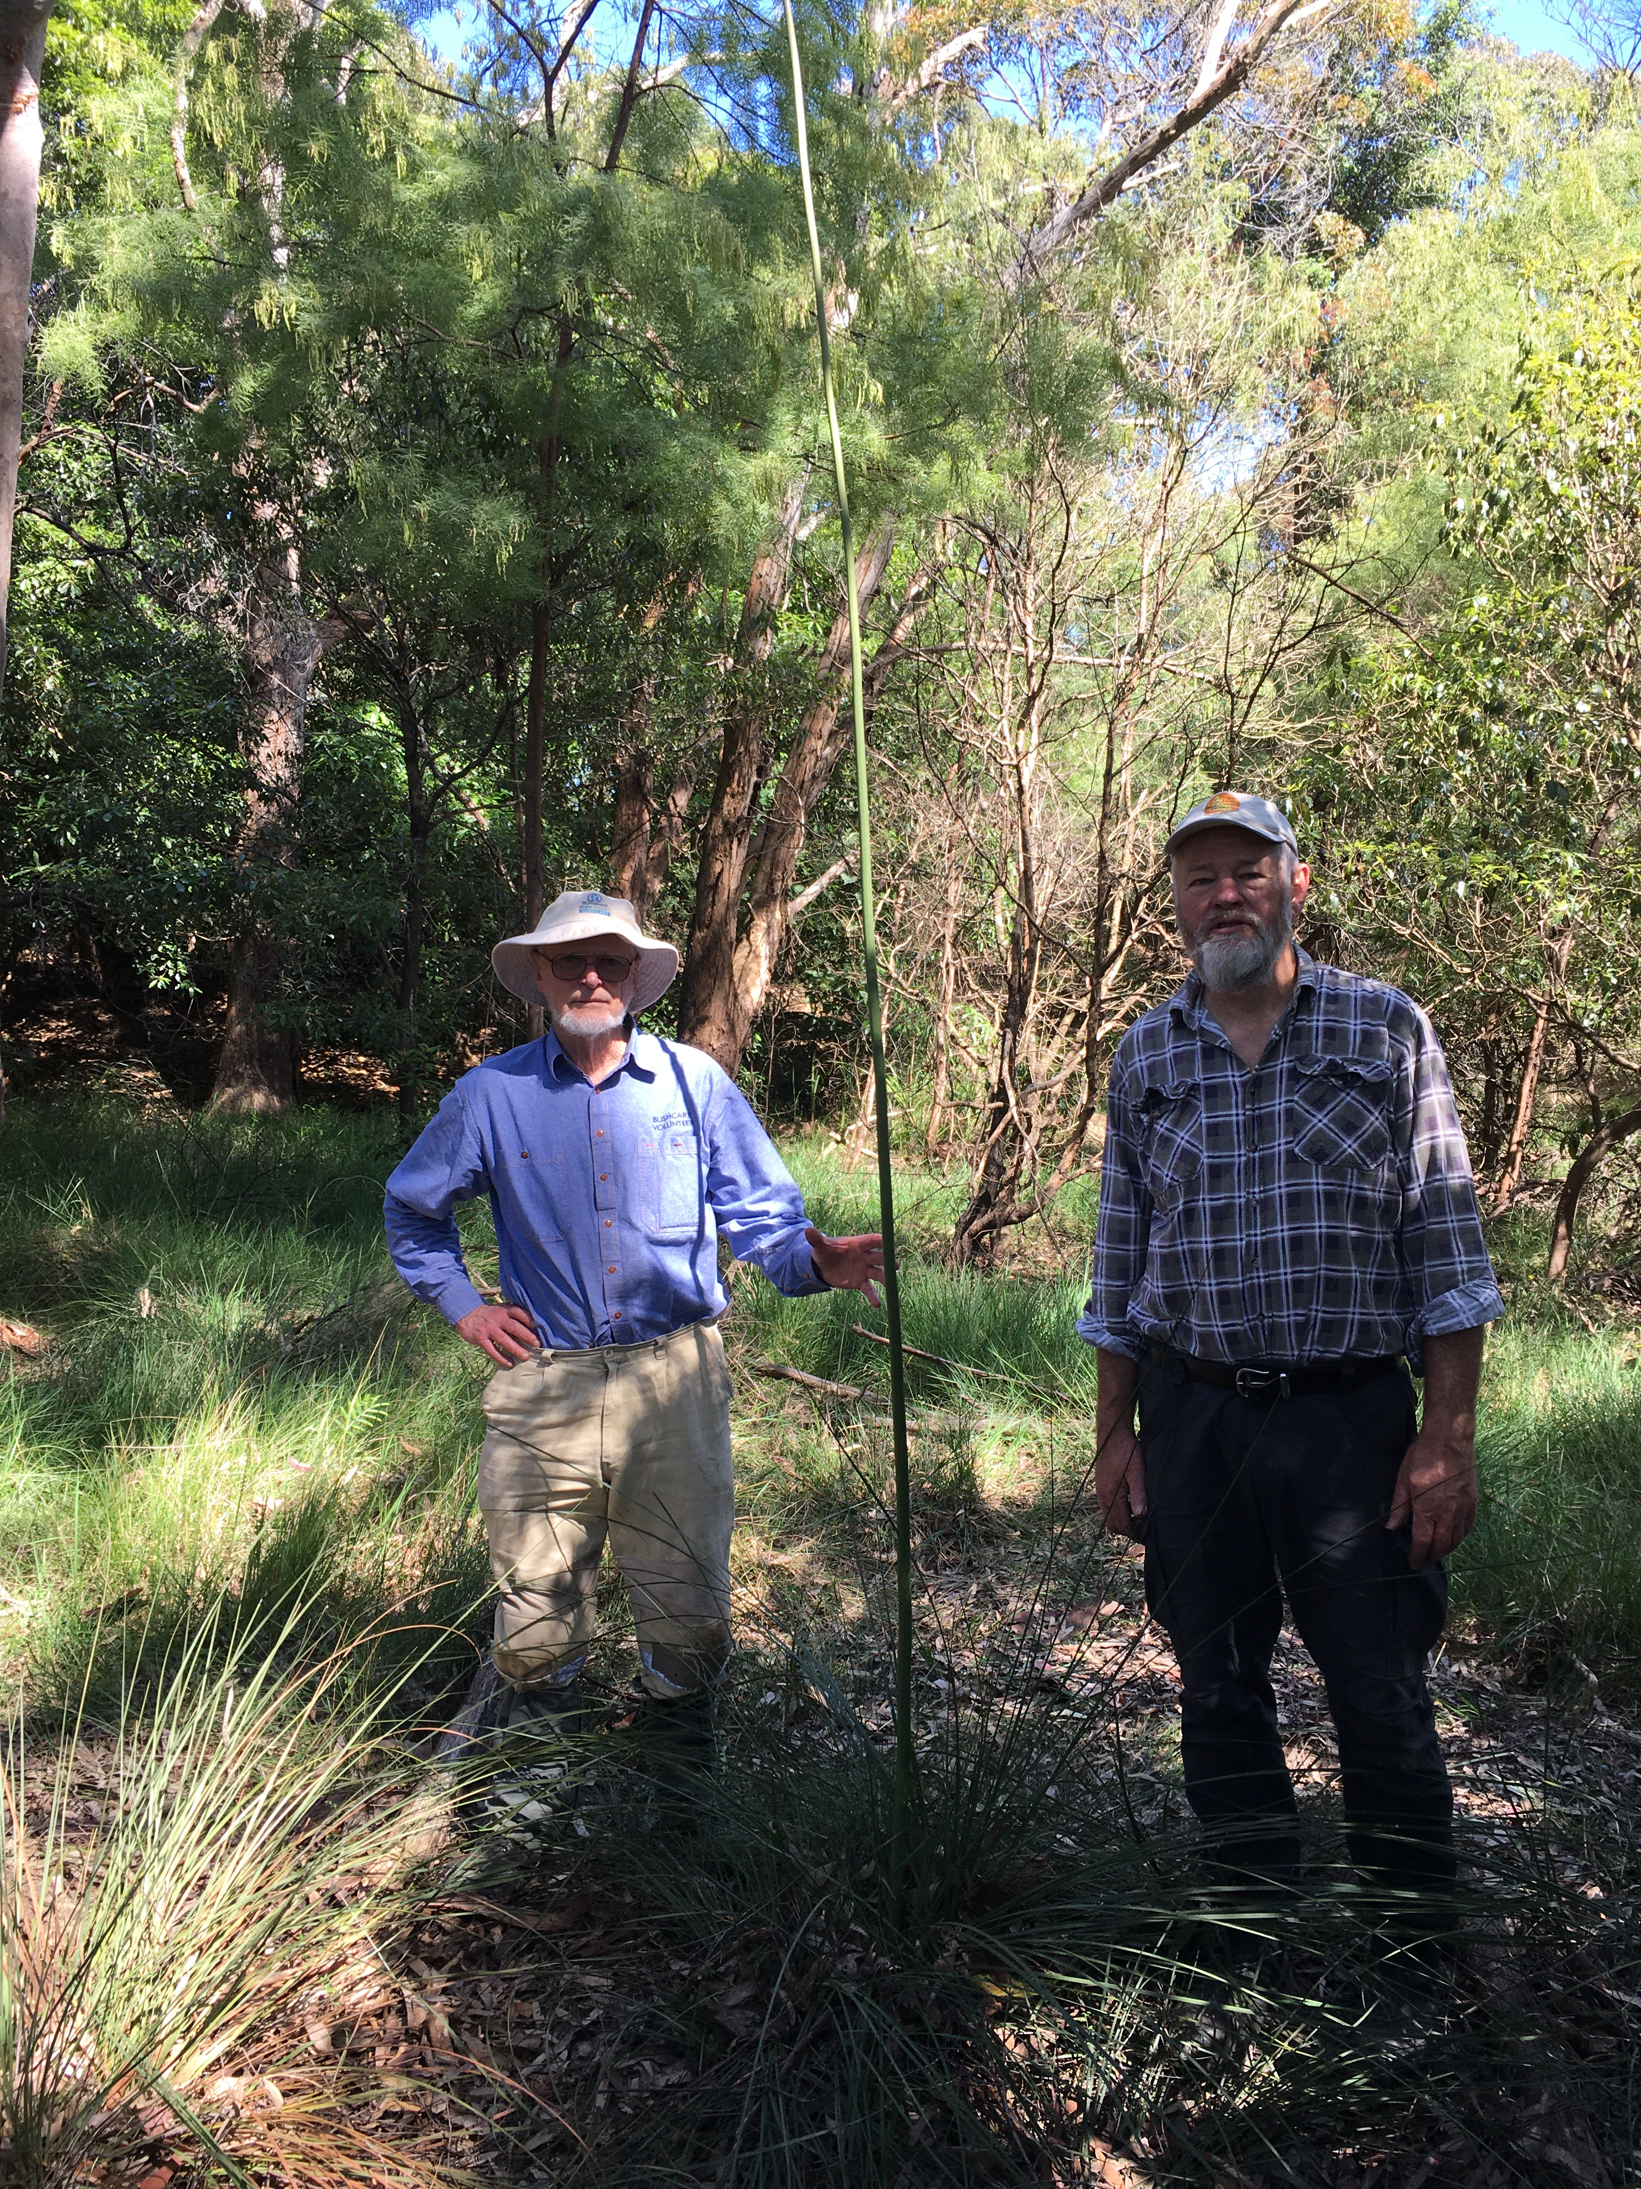
What works well at Sutherland
The basics
regular sessions with well prepared and informed staff, tools and bags
providing PPE to volunteers: hat, shirt and gloves
providing morning tea (hot drink, biscuits!)
communicating about changes, weather and cancellations
being safe, welcoming and inclusive

Slide 5
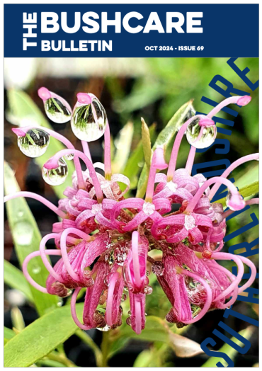
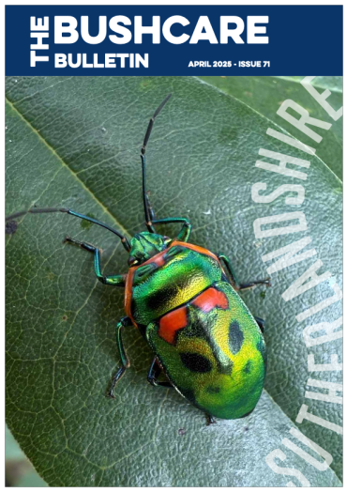

What works well at Sutherland
Extras
Autumn and Spring gatherings with speakers, Xmas BBQ
Related events: walks, birds, training, seed collecting
Quarterly Bushcare Bulletin with great information
Council Nursery – for full lifecycle

Slide 6
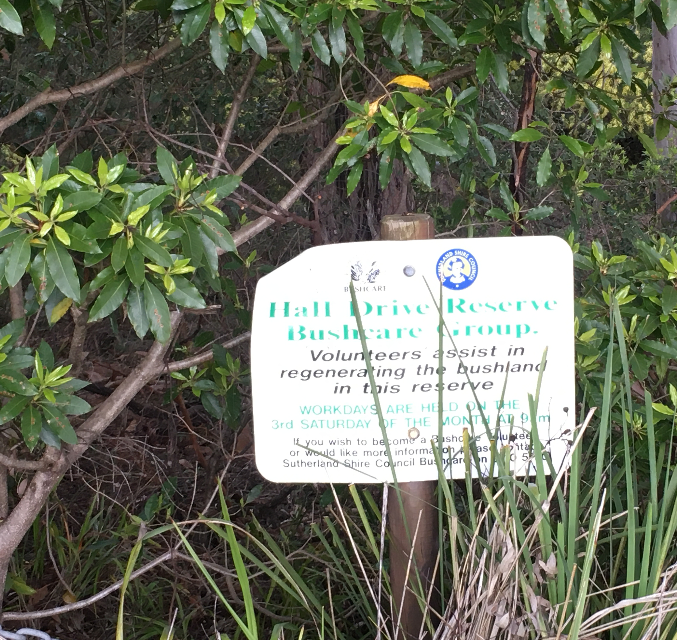
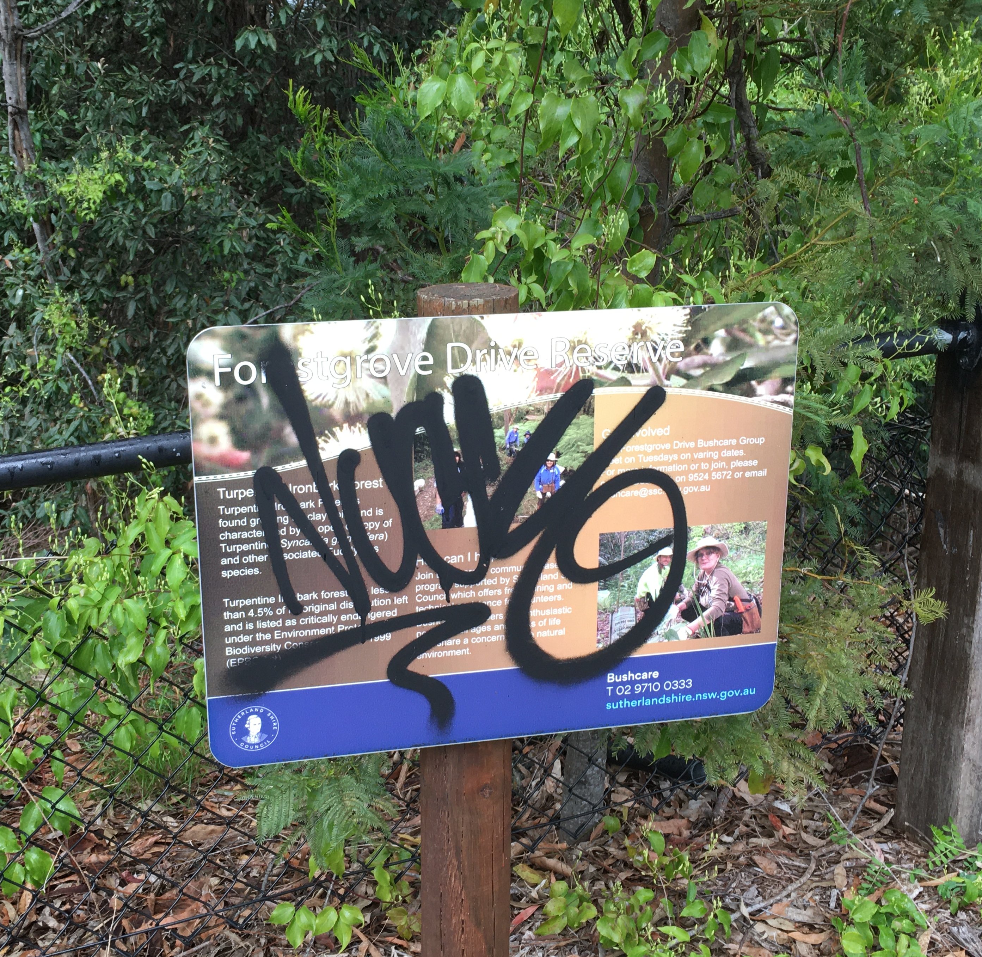
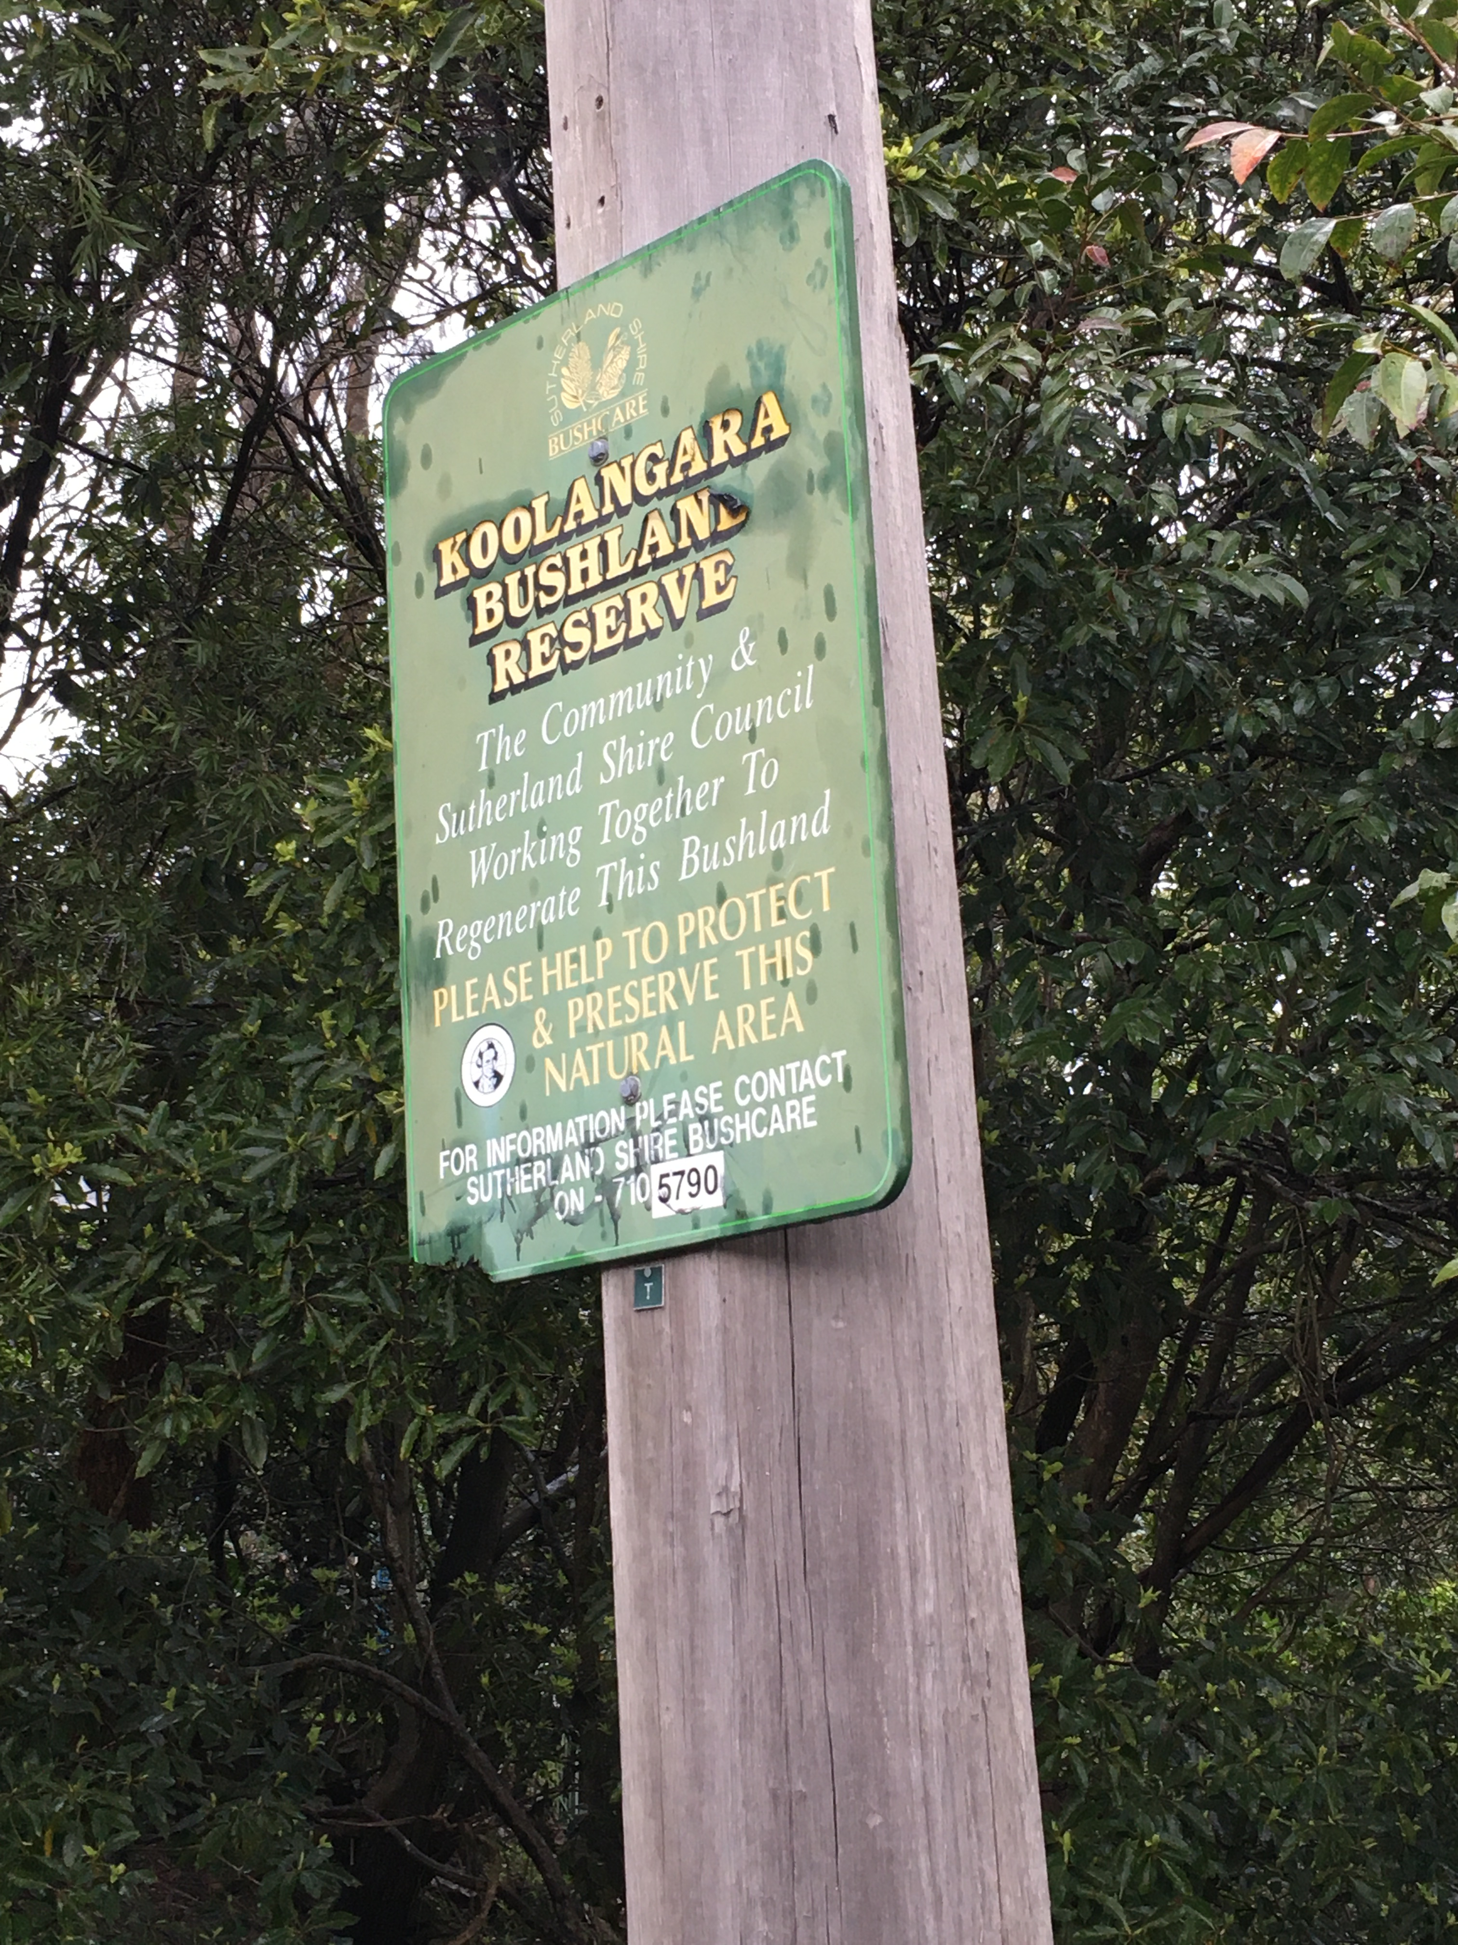
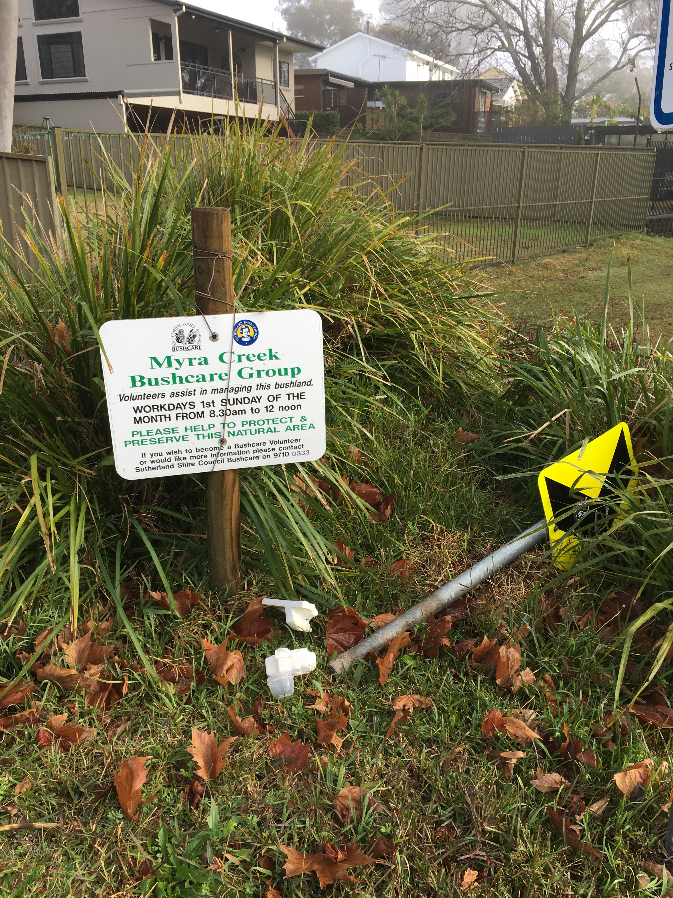
Issues
Planning and purpose – could be clearer
Conservation vs high visual impact
Spraying (vs role of volunteers)
Planting: natural regen best but plant on edges and degraded areas
Signage and information

Slide 7
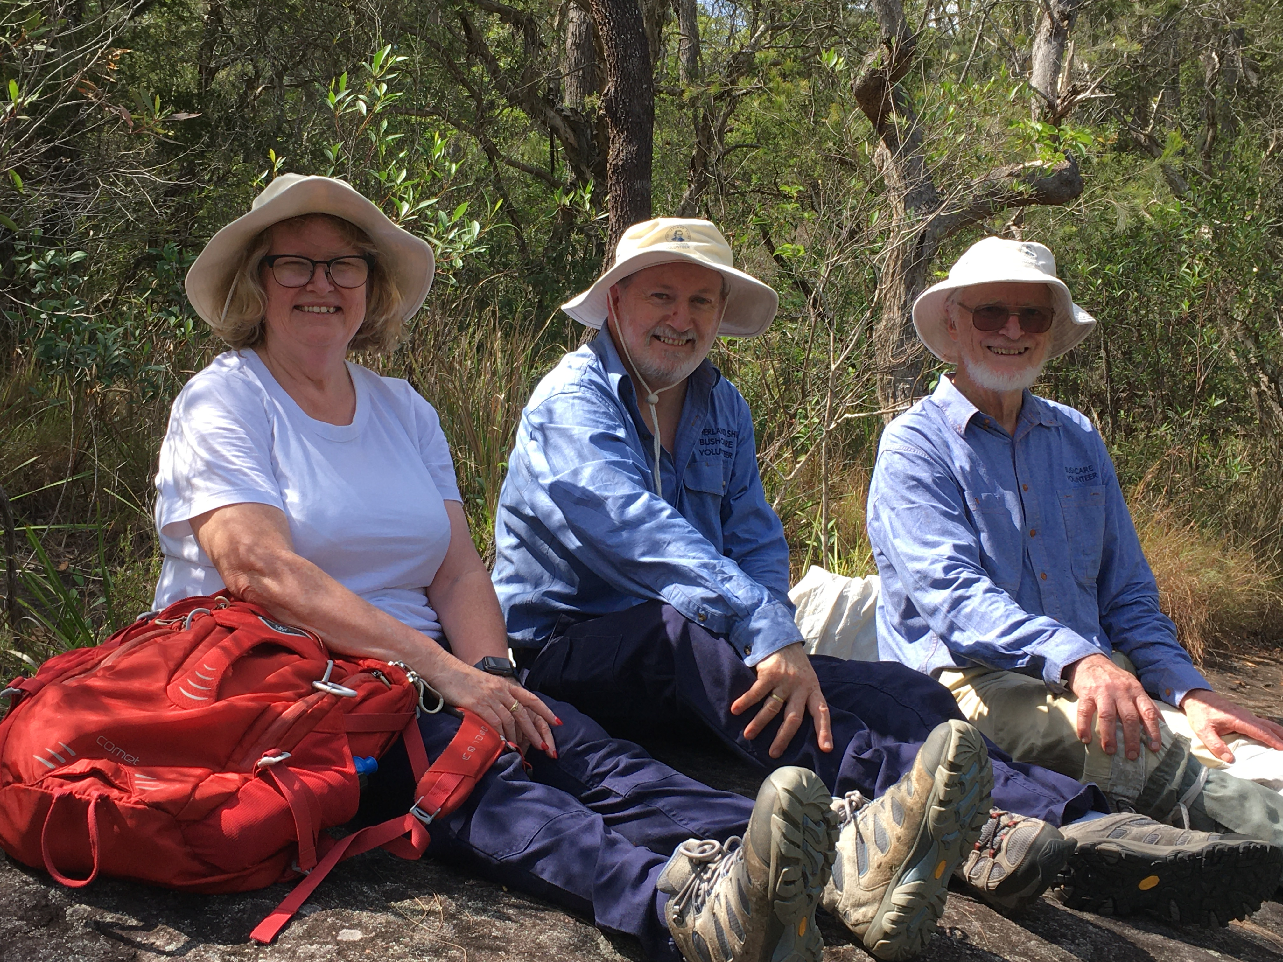
Improving recruitment 1
Recognise different reasons for volunteering and promote those benefits
  Live nearby: property values, amenity, fire
  Social: get out of house, meet other people
  Environment: do something for the environment
  Volunteering: do something, anything
  Physical health: cheaper than gym
  Mental health: benefits of being in nature
  Training or studying in bush regen or related: get a job
  New residents: learn about area and nature
  Duke of Edinburgh scheme
Role of location?
  Near vs far volunteers
  One site vs multi-site enthusiasts

Slide 8
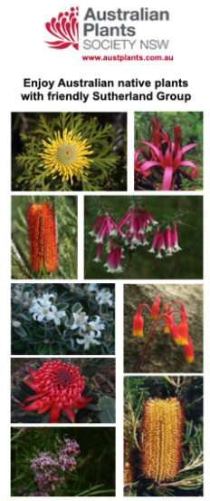
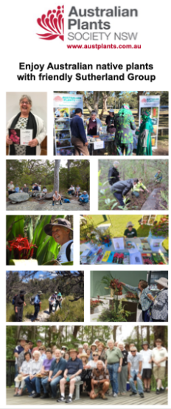
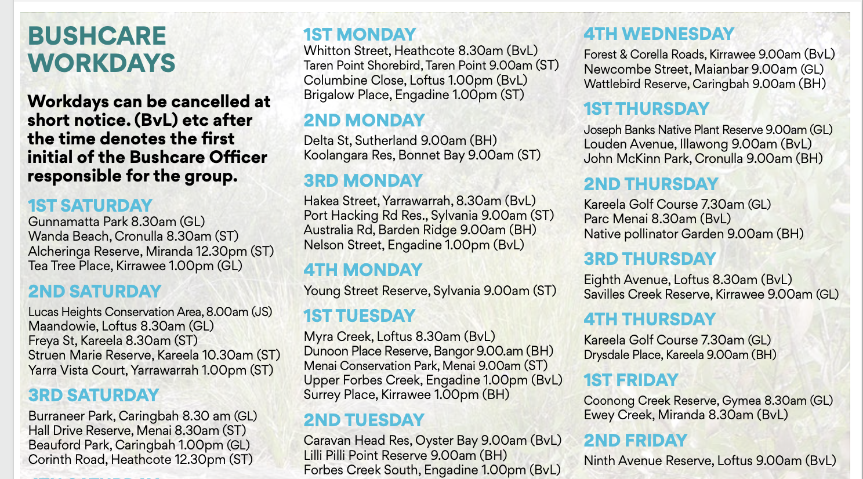
Improving recruitment 2
Provide before and after photos of sites = “you can make a difference”
Focus on people – site signs, brochures and website
Encourage “Bring a friend or neighbour”
Provide information about what to expect on first day
eg video on website and social media
Provide clear information inc site locations
Choose right site for you, have “starter sites”
Convert from one-off events: quarterly Bushwhackers at different sites
Be visible – on the ground and digital

Slide 9
Improving recruitment 3
Consider new approaches to volunteers:
  Existing social groups eg Probus
  Bushwalkers – already care about the bush
  Sports groups – to work near sports fields when events are on
  Schools – to work on nearby sites as alternative to sport
  Scouts – to work on bush near club houses
  Grandparents and kids
  TAFE and uni students seeking practical experience and knowledge
  Frustrated gardeners in units – to work in bush
  Walkers and dog owners – for sites near walkways and dog parks
Keep recruiting active retirees

Slide 10
Improving retention
Recognise different reasons for volunteering and meet those needs
Ensure good first-session experience, and follow up
“Right site for each person”: promote different types of sites
  flat vs steep, dry vs wet, open vs shady
  primary weeding vs hand weeding
Promote a group of sites in an area:
if miss one session, can go elsewhere
Work with site neighbours for common plan,
eg institutions like education, transport, other parts of Council
Recognise value of experienced volunteers: can work without staff
Develop Bushcare Ambassadors

Slide 11
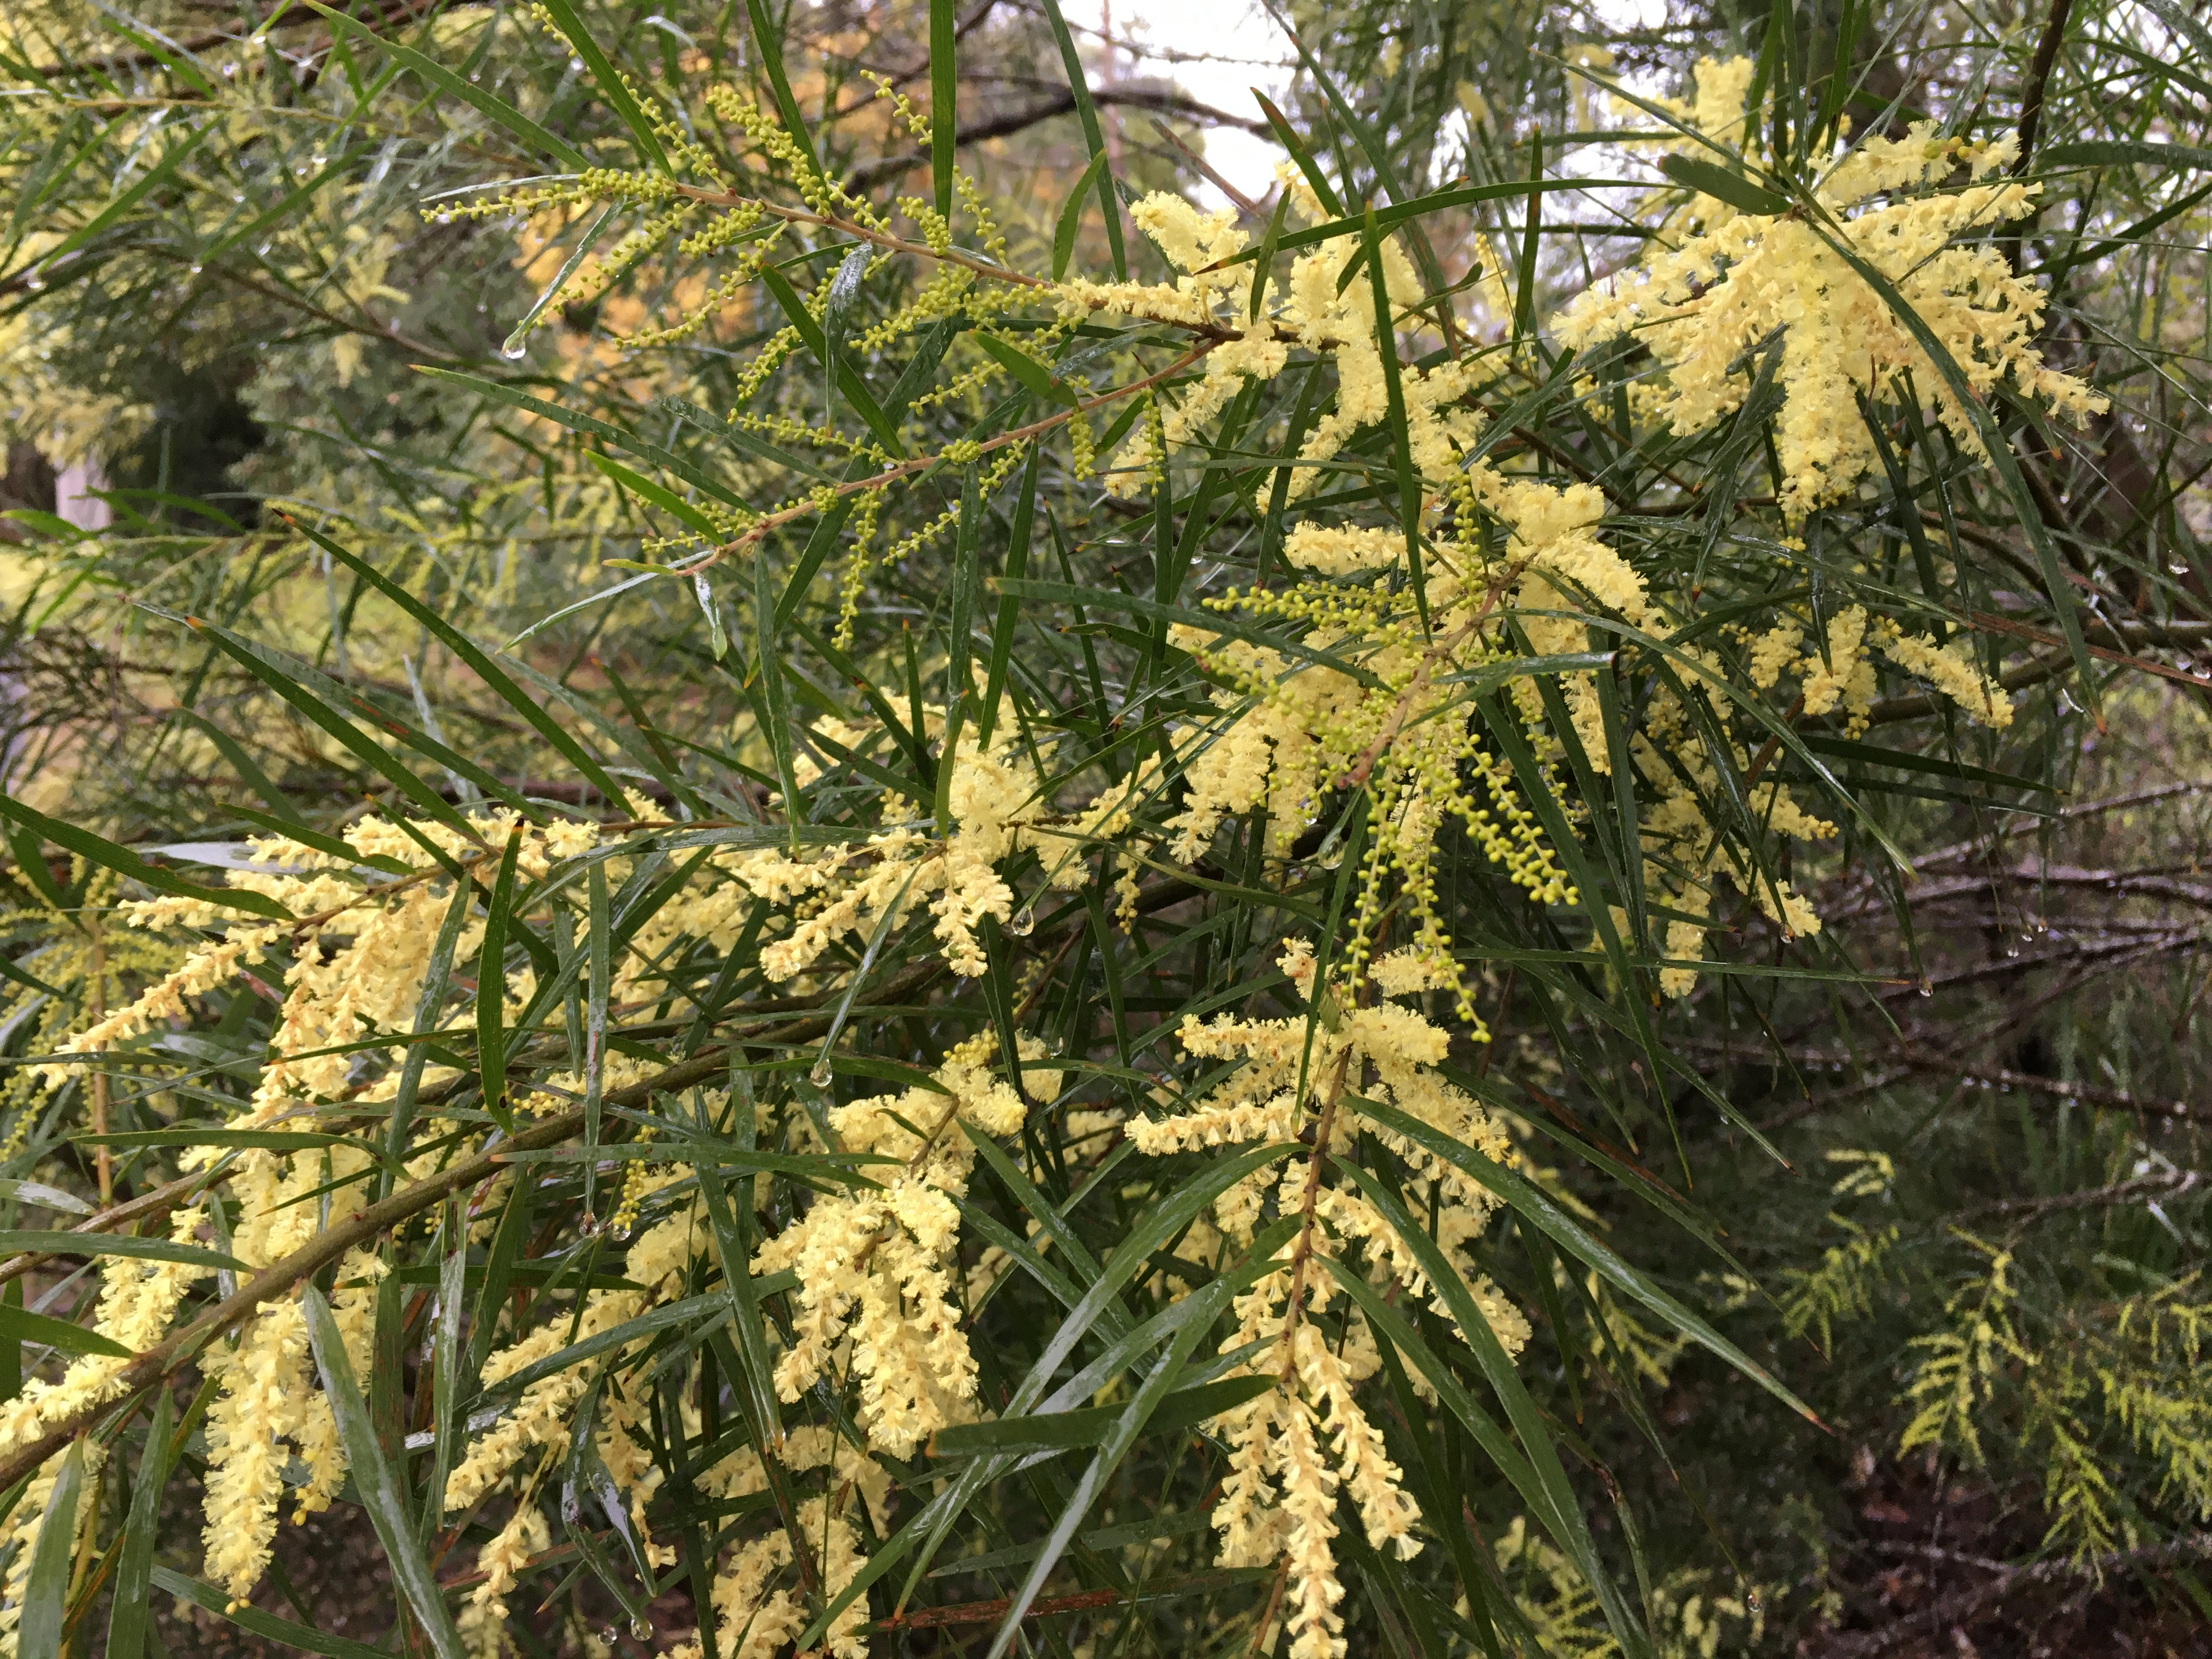
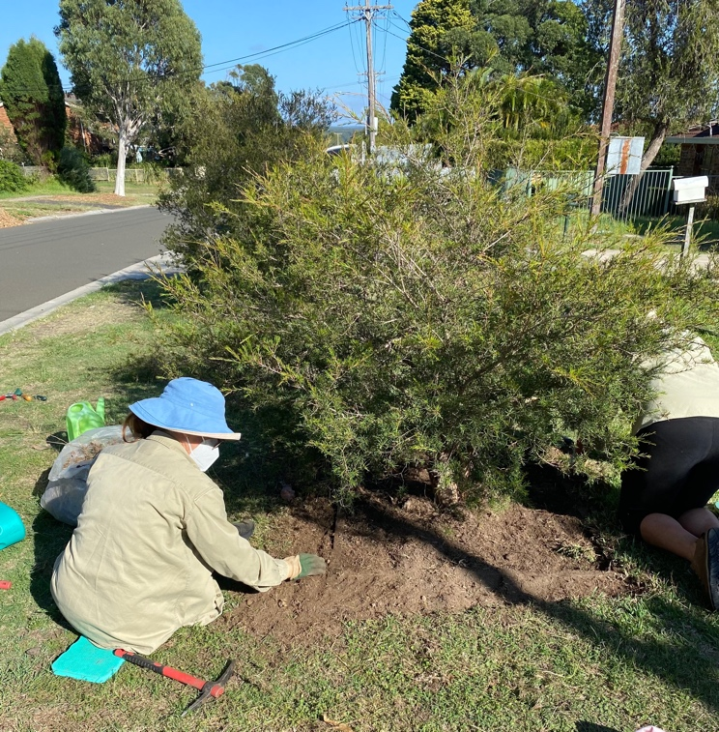

The future
Email me:
rhdaniels@bigpond.com
Challenging but AI-proof!
Changing demographics and aging population – staff and volunteers:
  more people in volunteering age group, but more things to do
  regular monthly commitment difficult – promote flexibility and one-offs
  health and safety – be aware of changing abilities
  using limited staff efficiently
Work with partners and site neighbours
Bushcare Plus: Greencare, Treecare, TreeKeeper to care for
other public green spaces including street trees and gardens
From Diane Townley, APS, March 2024

