Slide 1
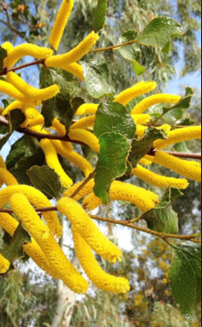
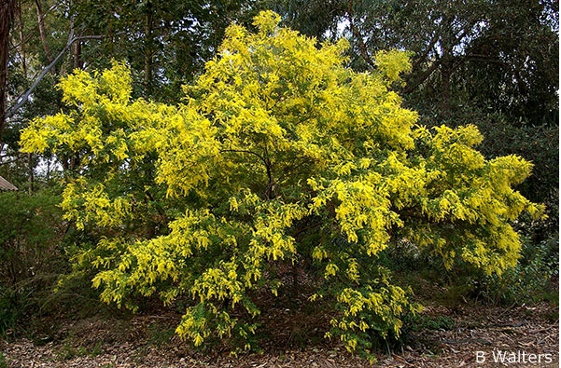
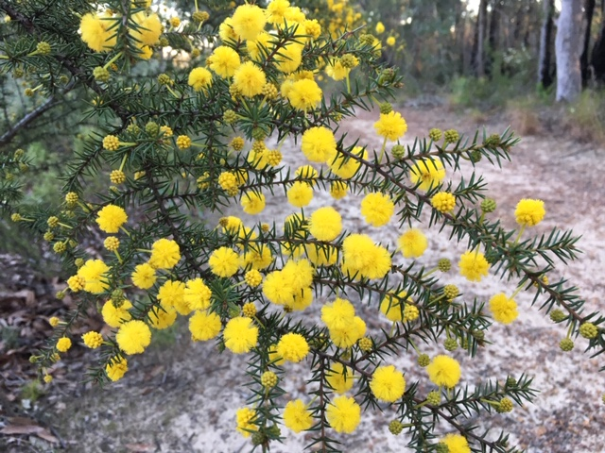

Wonderful world of wattles
Rhonda Daniels, Australian Plants Society
rhdaniels@bigpond.com

Slide 2
Outline
Acacias = wattles
Diversity of acacias
– flowers, foliage, fruit
Local acacias
Aboriginal and
cultural significance
Acacias in the garden
Myth busting!
Acacia brownii RD

Slide 3
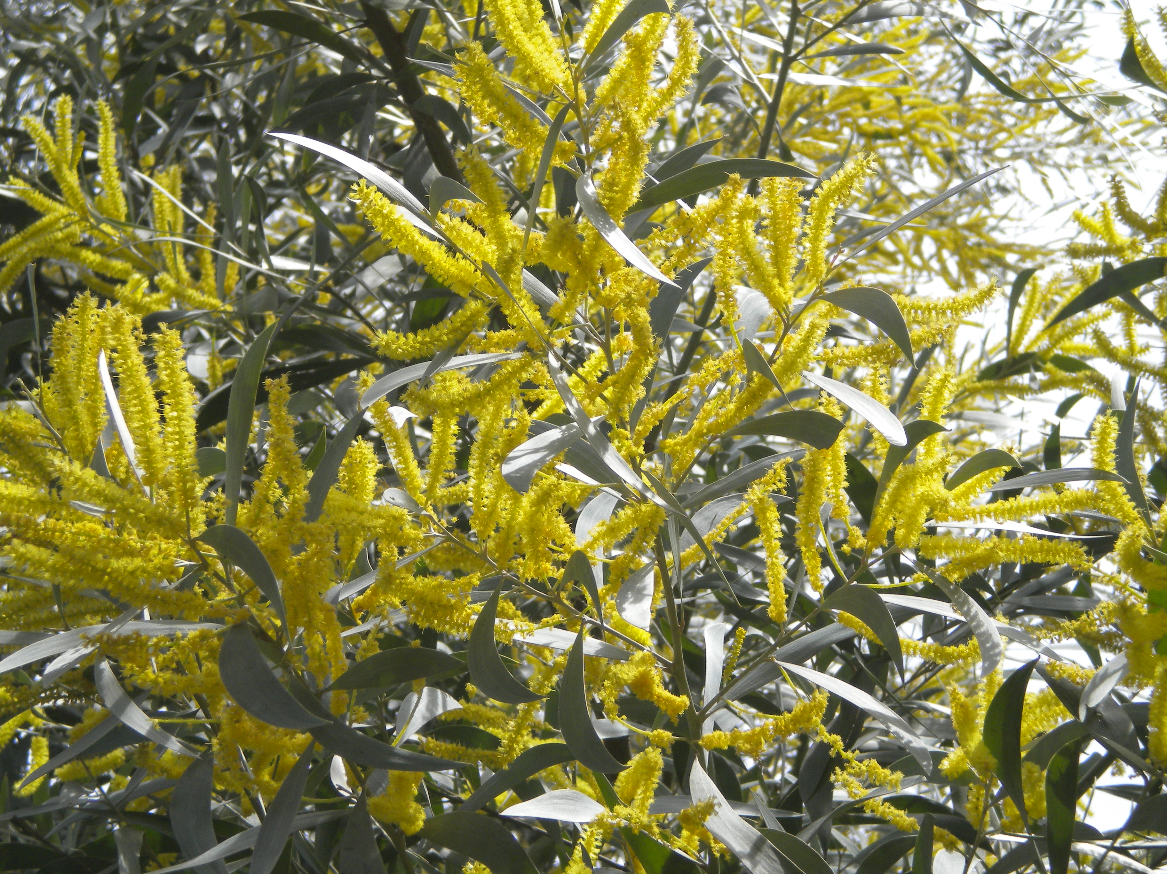
Wattles – why wonderful?
About 1,000 Acacia species in Australia
Found in most ecosystems including rainforest
Shrubs to trees
Tough, quick growing, opportunistic
Flower through the year inc winter
A blaze of bright colour
Food source
Fix nitrogen in the soil through
bacteria that inhabit and form
nodules on the roots
Acacia binervia RD

Slide 4
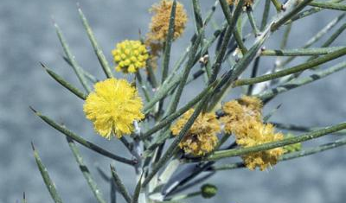
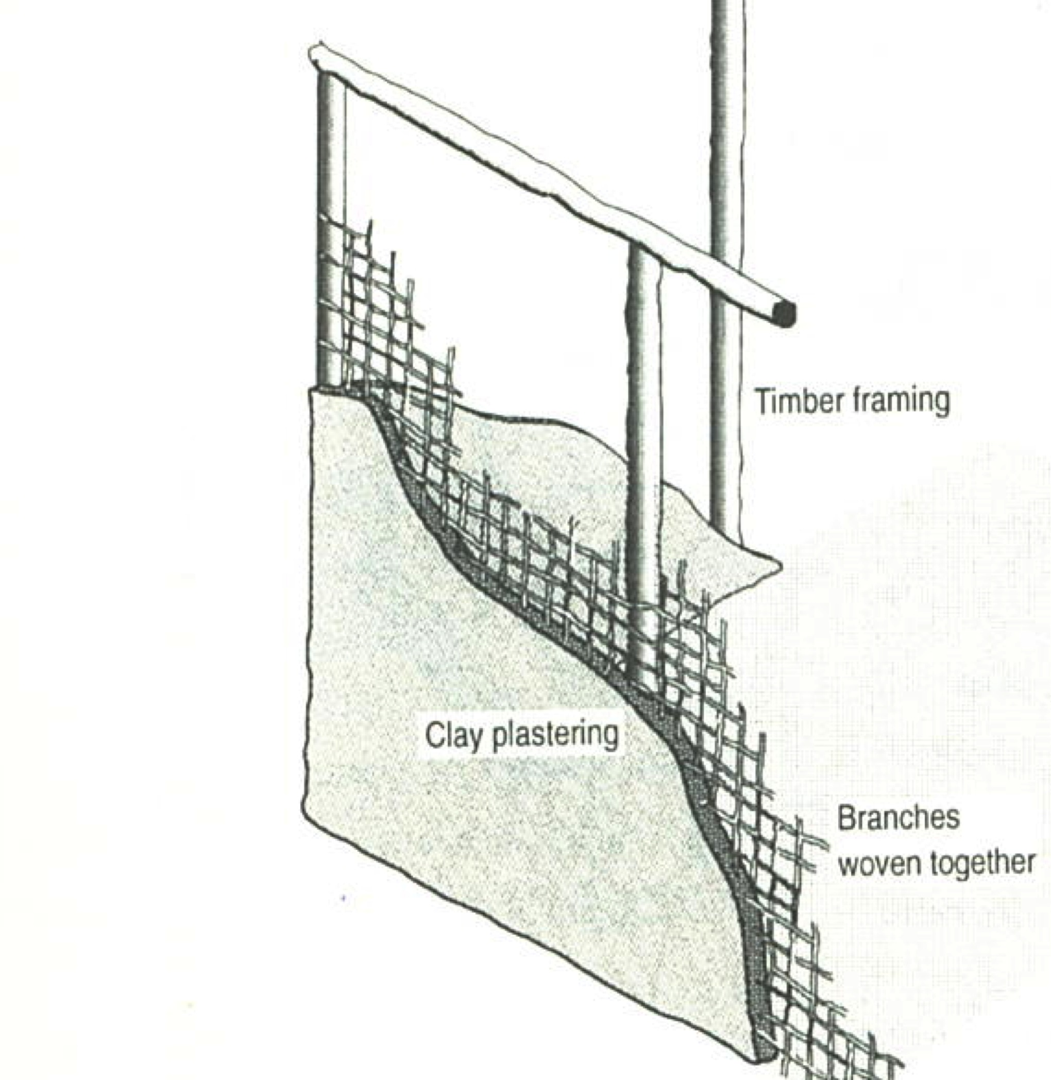
All about acacias
Acacia and wattle
Acacia genus has a complex history – genus and family
Acacia is in Fabaceae family (subfamily Mimosoideae),
related to peas and sennas
Wattle = Anglo-Saxon word
for interwoven saplings used
in clay/plaster walls for
“wattle and daub” huts
Acacia first adopted in 1754 for prickly African species
Acacia derived from Greek ‘ake’ or ‘akis’, a sharp point
Acacia carneorum www.anbg.gov.au
From wattle and daub to concrete and steel

Slide 5
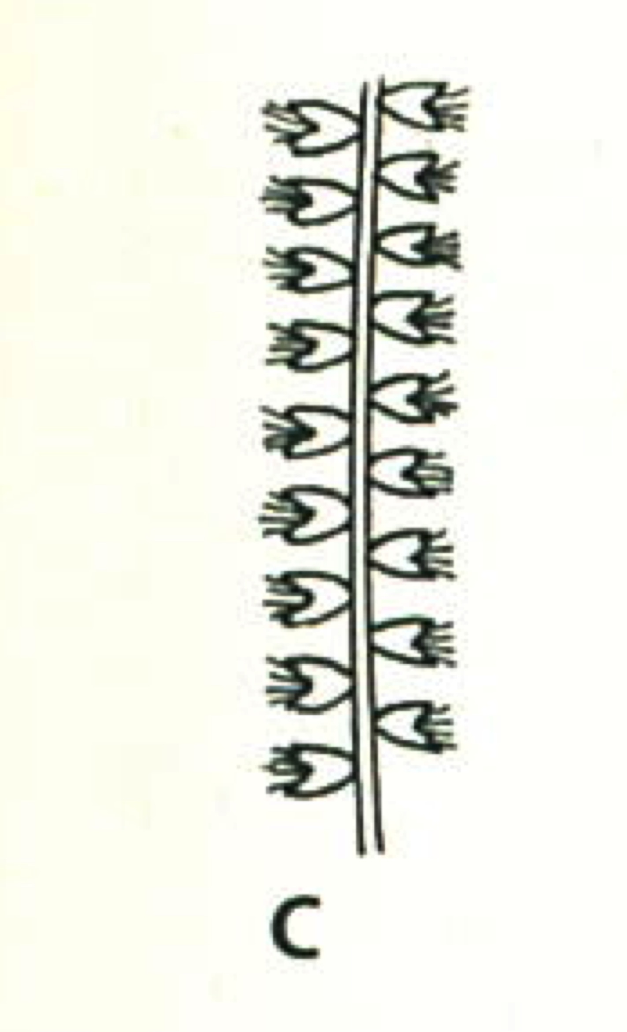
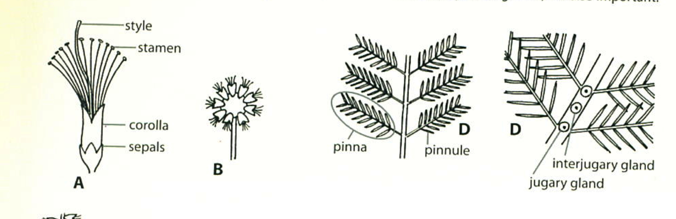
Diversity of flowers
Cream, lemon, yellow or gold flowers
Two types of inflorescence: ball or cylindrical rod/spike
Many flower in winter, some strongly scented
Pollinated by insects
Source: Fairley and Moore

Slide 6
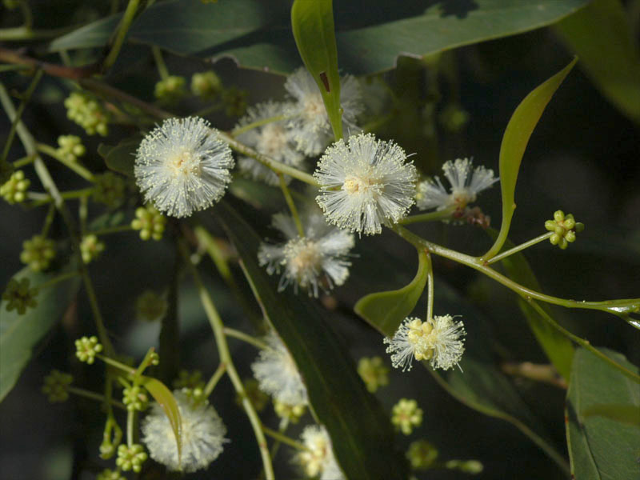
Acacia binervata Coastal Plants of RNP CD

Slide 7
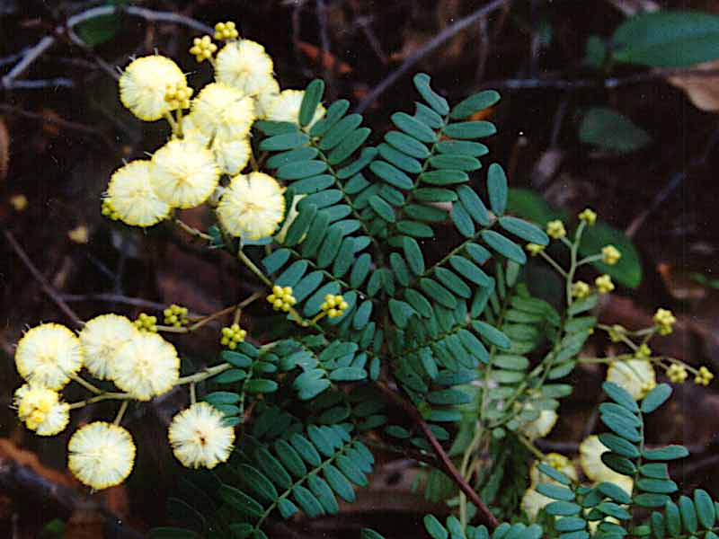
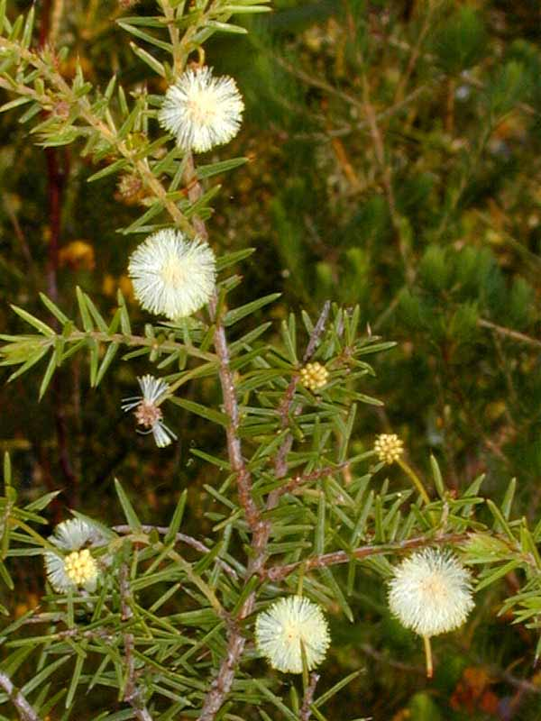
Inflorescence – ball
Acacia terminalis Coastal Plants of RNP CD
Acacia ulicifolia Coastal Plants of RNP CD

Slide 8
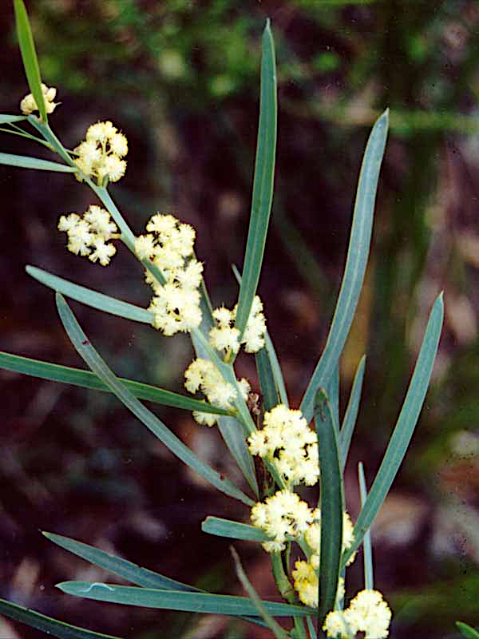
Acacia suaveolens Coastal Plants of RNP CD

Slide 9
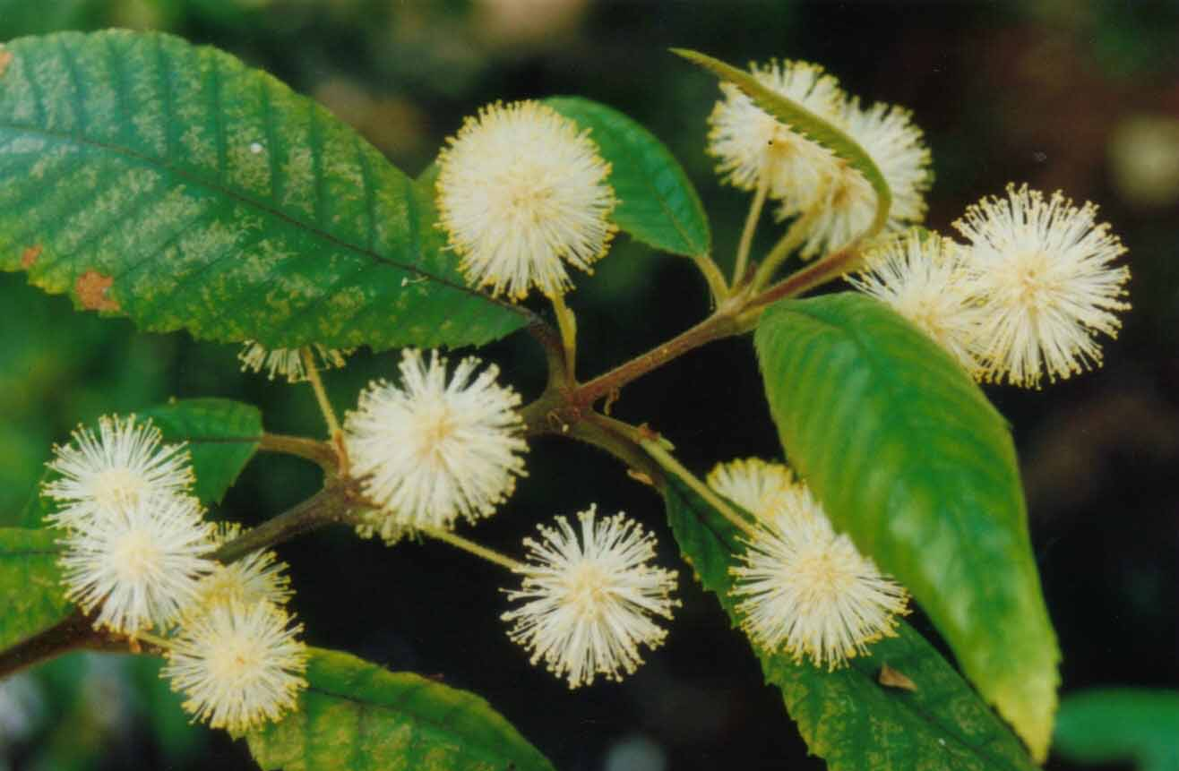
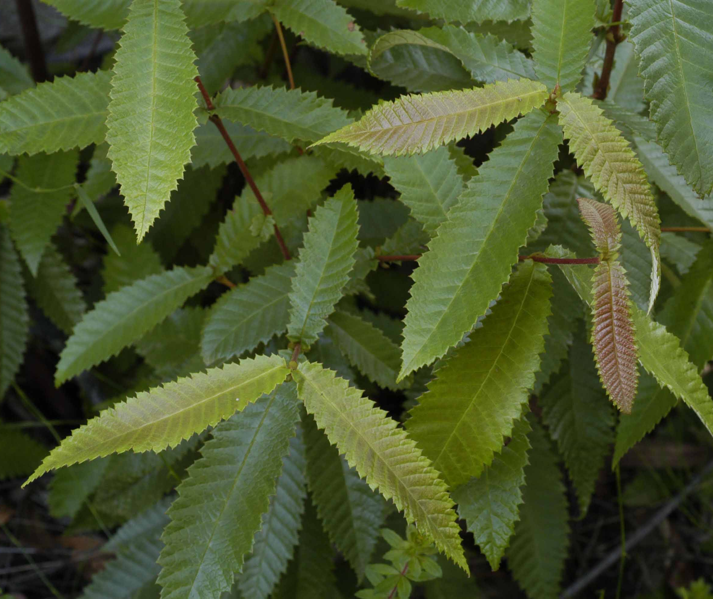
Not a wattle
Callicoma serratifolia Coastal Plants of RNP CD
(Black wattle, Cunoniaceae)

Slide 10
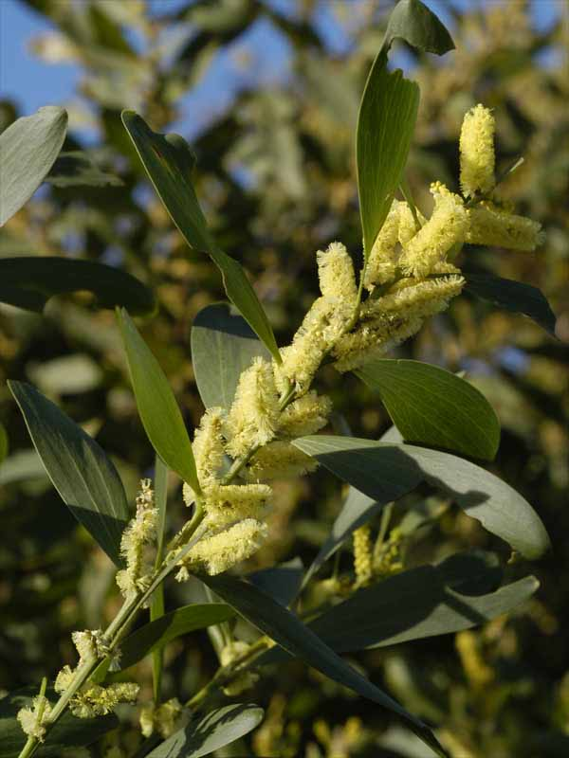
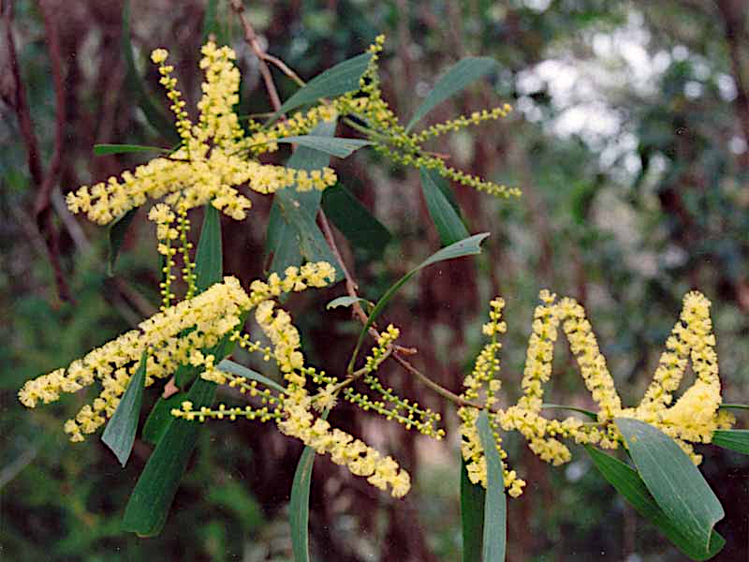
Inflorescence – rod
Acacia binervia RD
Acacia sophorae Coastal Plants of RNP CD
Acacia longifolia Coastal Plants of RNP CD

Slide 11
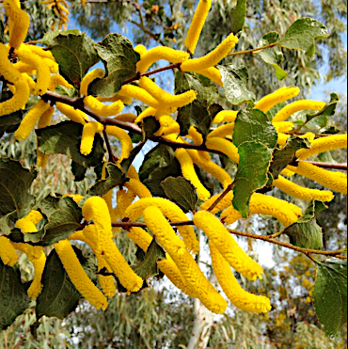
Acacia denticulosa (Sandpaper wattle)
Deskgram.net

Slide 12
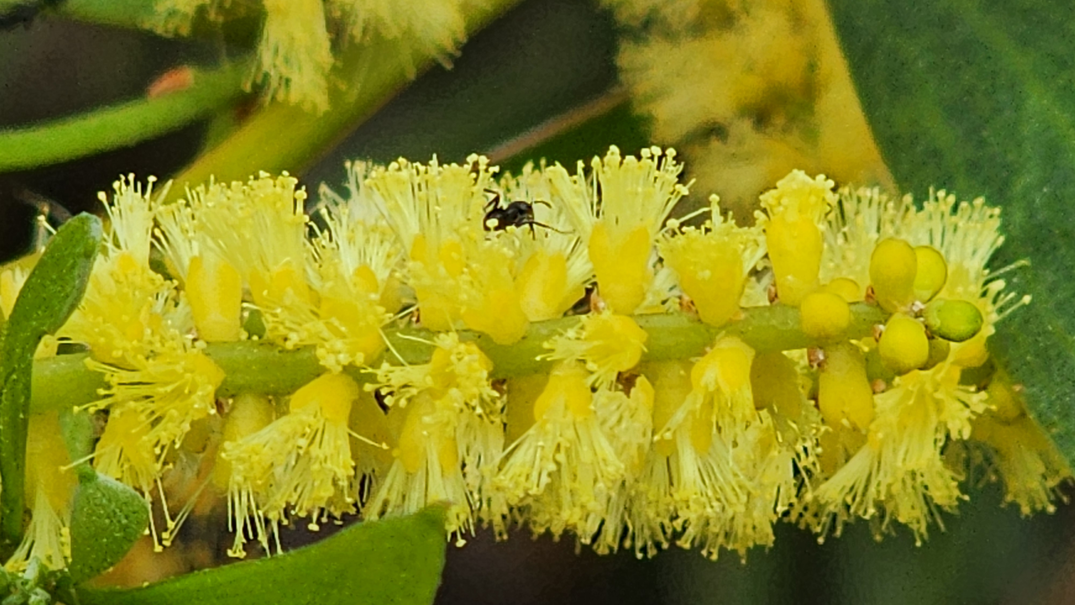
Flower colour
Yellow pigment of A. longifolia is a derivative of kaempferol,
a natural sunscreen which absorbs UV strongly
UV-absorbing pigments act to prevent UV-induced damage to genetic material in flowers
Stamens are yellow in normal light, but black in UV to insects
Source: Australian Plants, Autumn 2019
Acacia longifolia var. sophorae BS

Slide 13
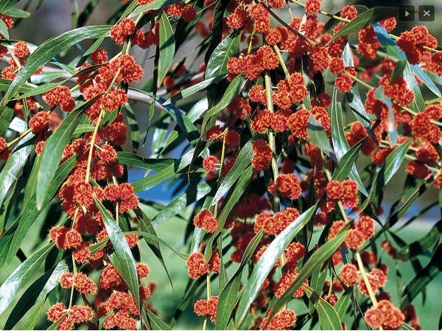
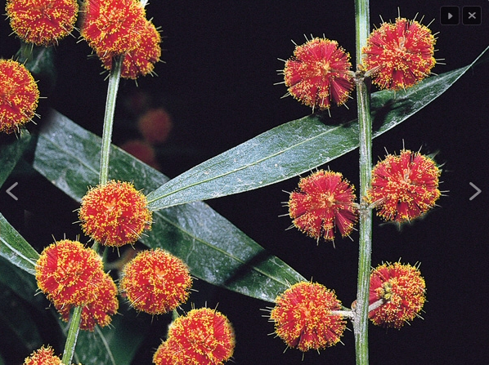
Flowers – red ball
Acacia leprosa
Acacia leprosa ‘Scarlet Blaze’
Acacia leprosa ‘Twilight Glow’
Acacia leprosa ‘Scarlet Blaze’ www.gardeningwithangus.com.au
Also
Acacia leprosa x howittii ‘Twilight Glow’

Slide 14
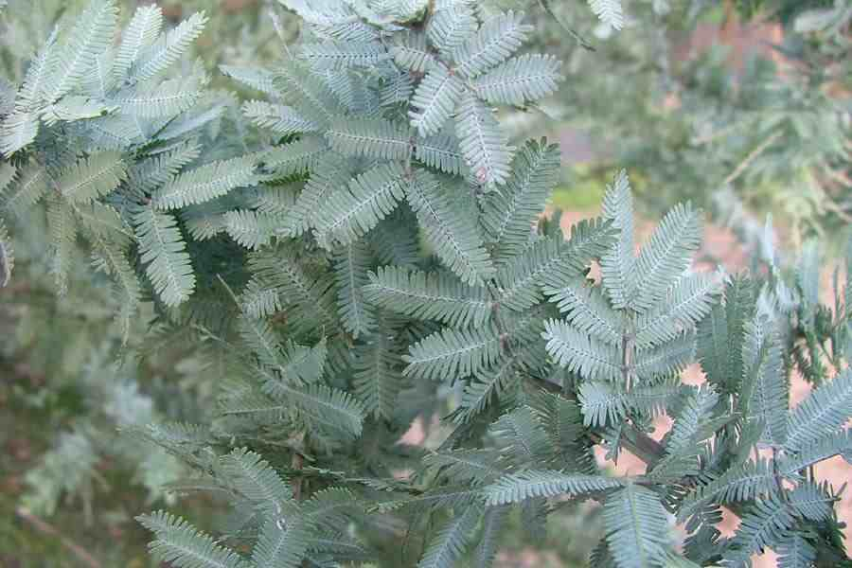
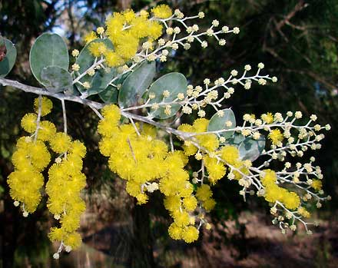
Diversity of foliage
Two groups of acacias:
  feathery bipinnate (fern-like) leaves
  leaves reduced to phyllodes which are flattened leaf stalks performing the function of leaves
All acacias have the bipinnate leaves as seedlings
Great diversity in phyllode form
Evolution
Bipinnate is ancestral form from Africa with
many glands, but vulnerable to heat and dryness
As Australia dried out, feathery wattles survived
in damp, sheltered habitat
Phyllode forms evolved in dry continent
Tough to reduce evaporation, with one gland
and aligned vertically
Acacia baileyana
Acacia podalyriifolia

Slide 15
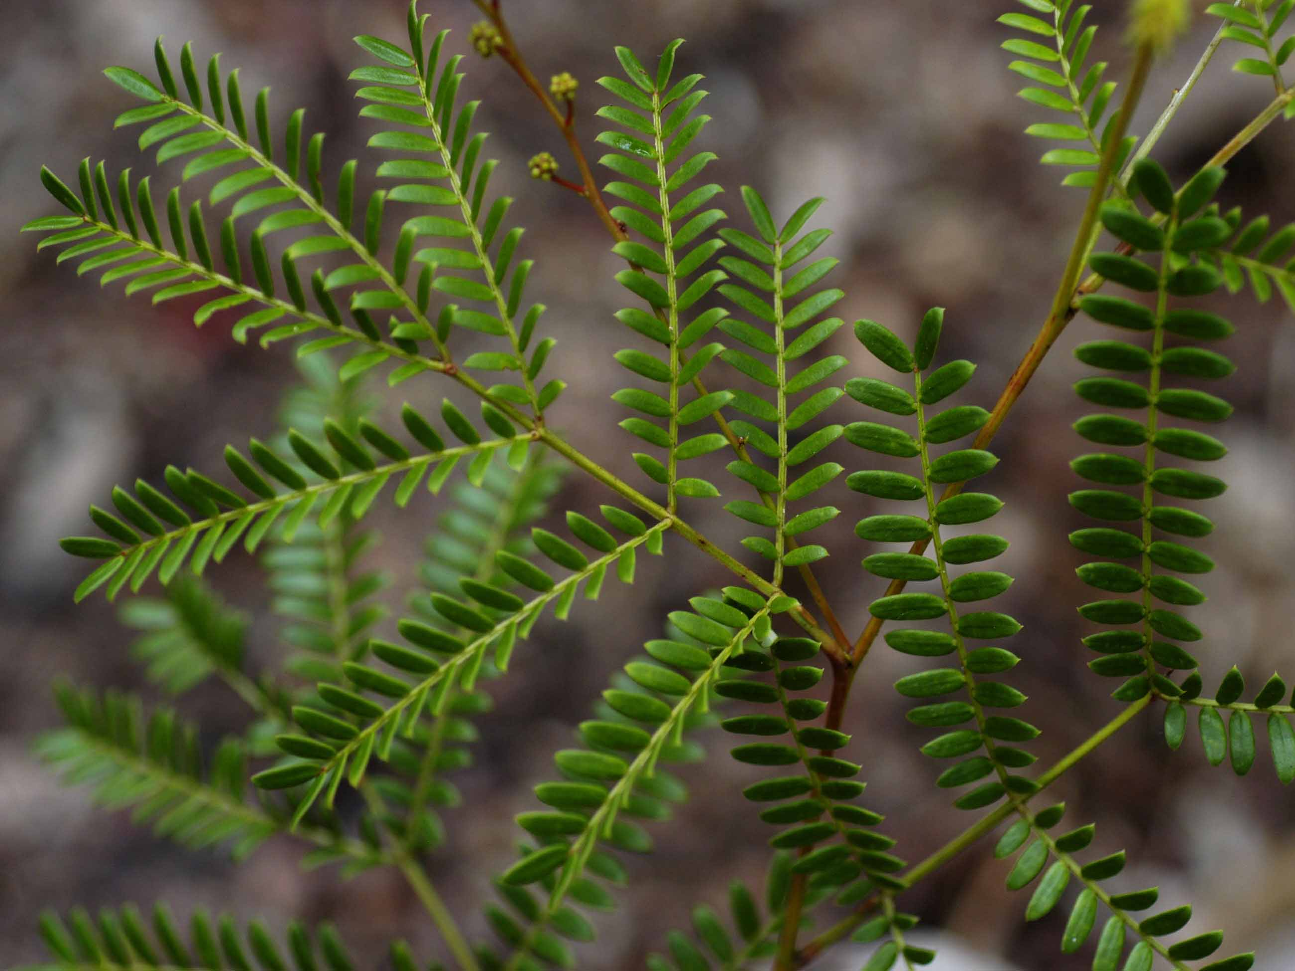
Foliage – bipinnate
Acacia terminalis Coastal Plants of RNP CD

Slide 16
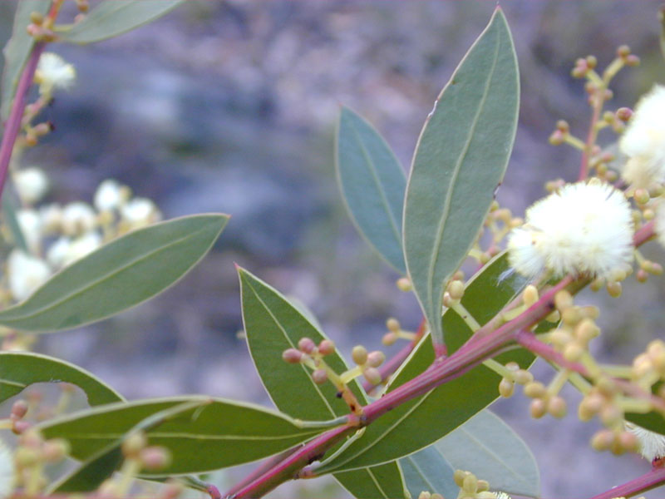
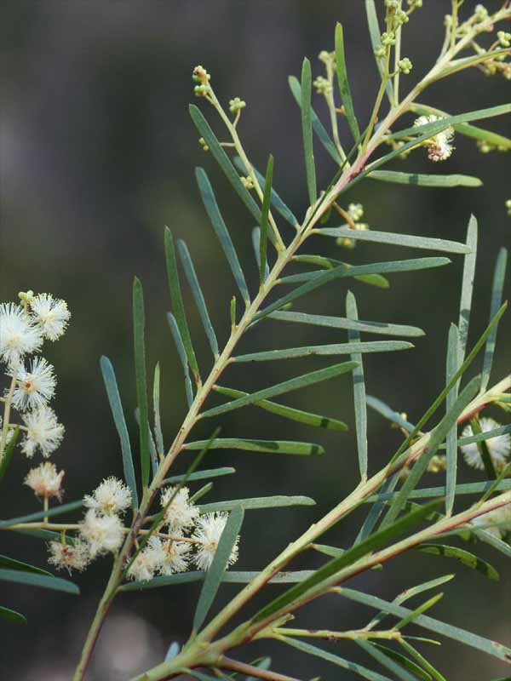
Foliage – phyllodes
Acacia ulicifolia
Coastal Plants of RNP CD
Acacia myrtifolia Coastal Plants of RNP CD
Acacia linifolia
Coastal Plants of RNP CD

Slide 17
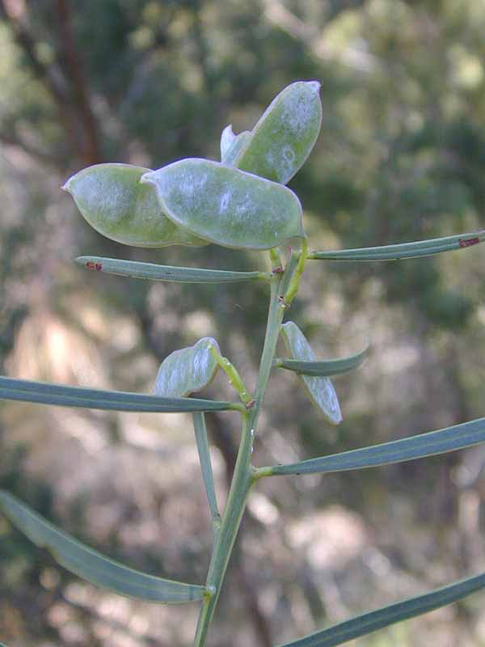
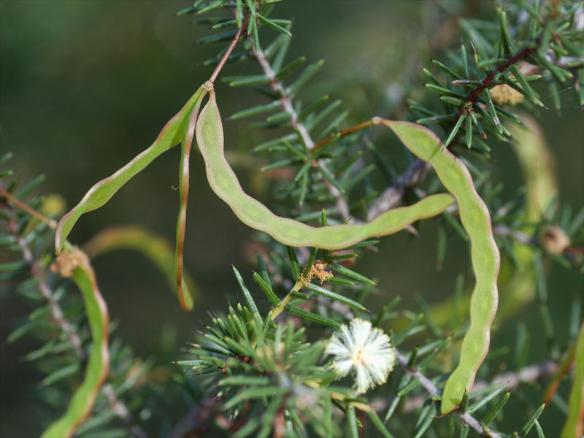
Fruit and seeds
Bean-like pods vary in size and shape
and split open when ripe
Single row of seeds
Seeds have tough coat
Seeds harvested by ants,
stored underground
Important food source for birds and people (not all seeds are edible)
Acacia suaveolens
Coastal Plants of RNP CD
Acacia ulicifolia Coastal Plants of RNP CD

Slide 18
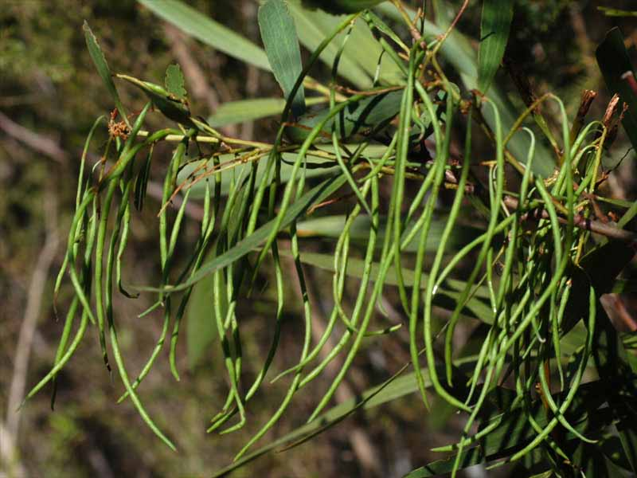
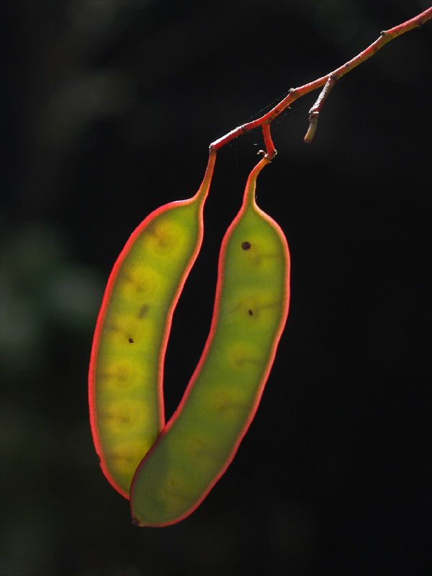
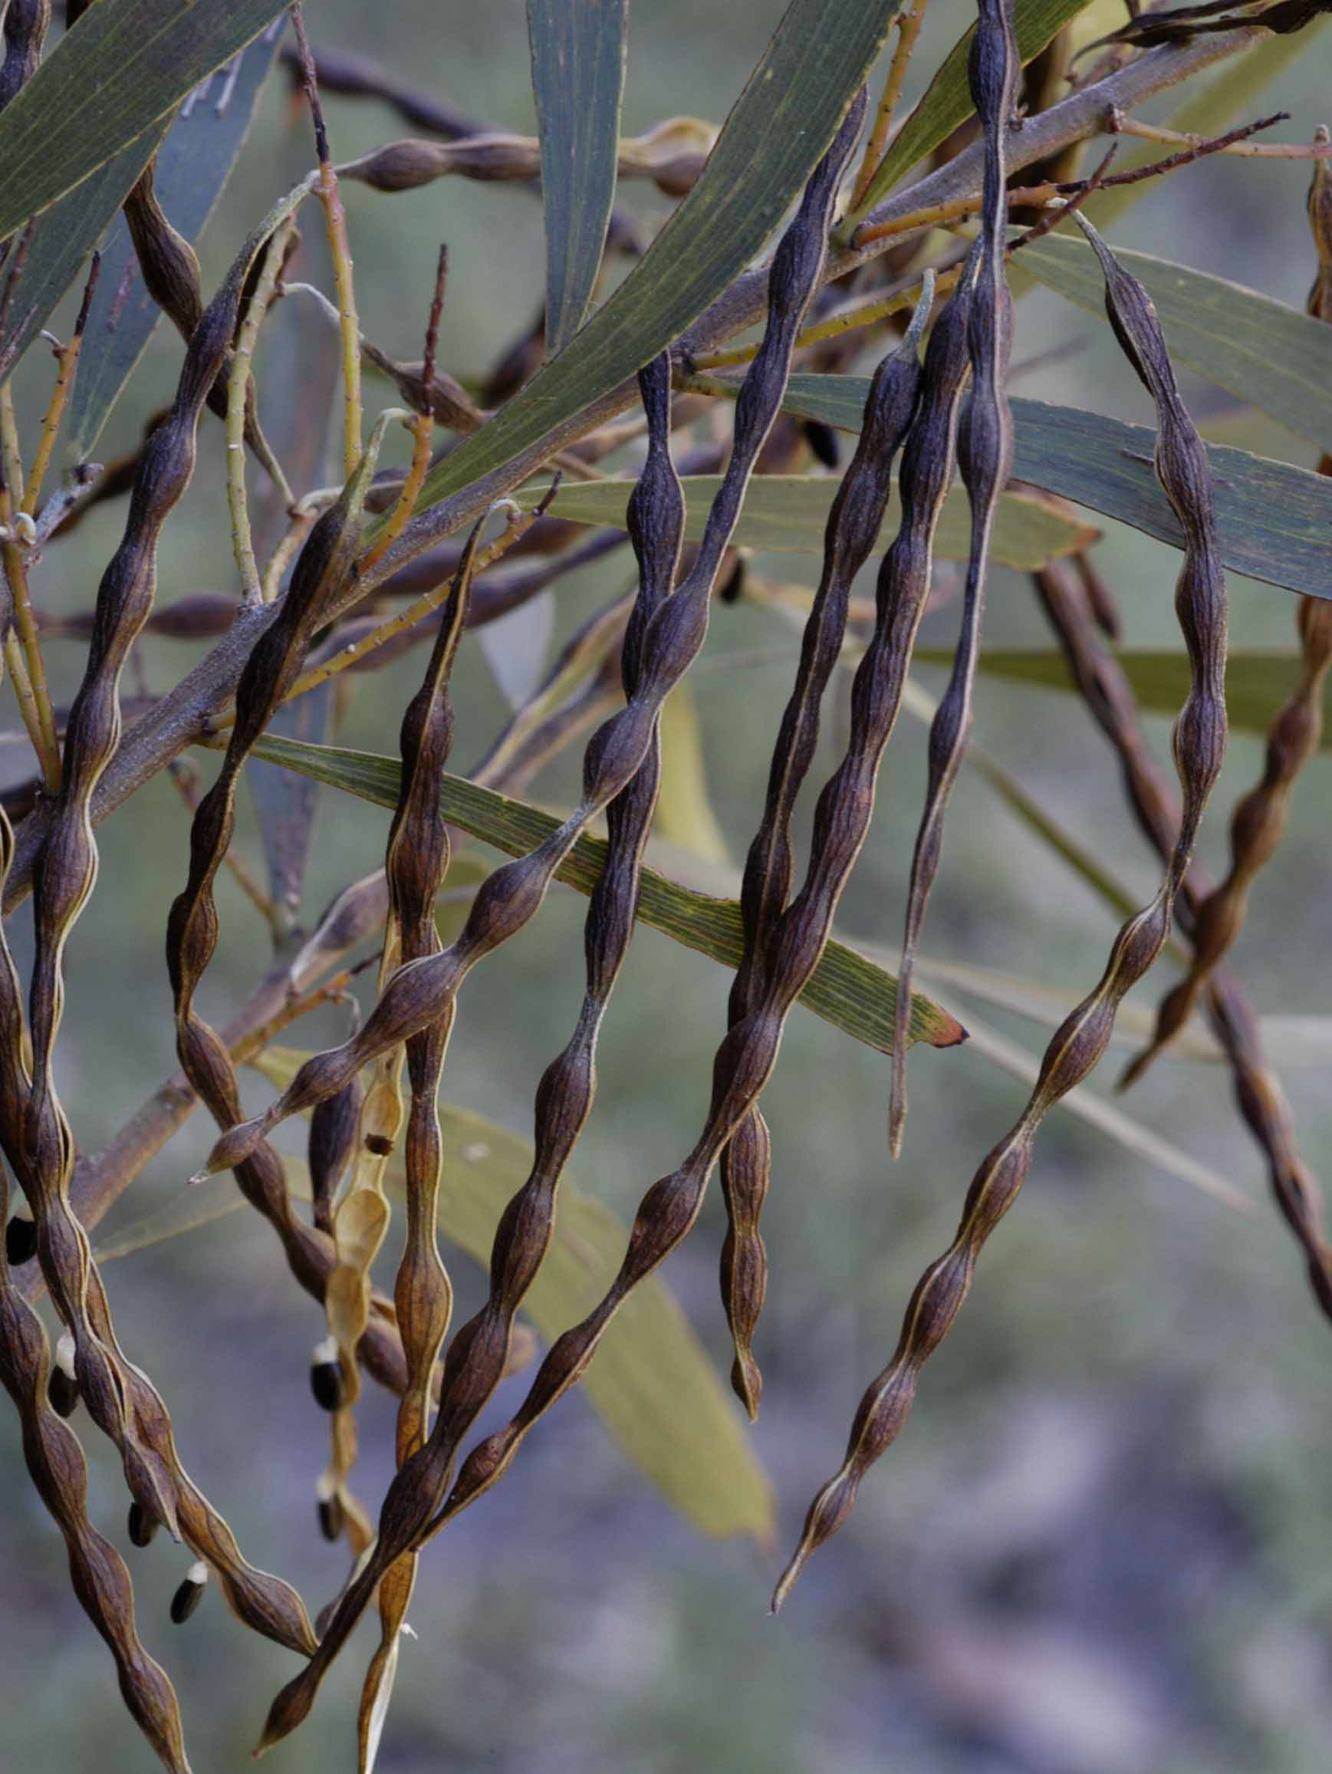
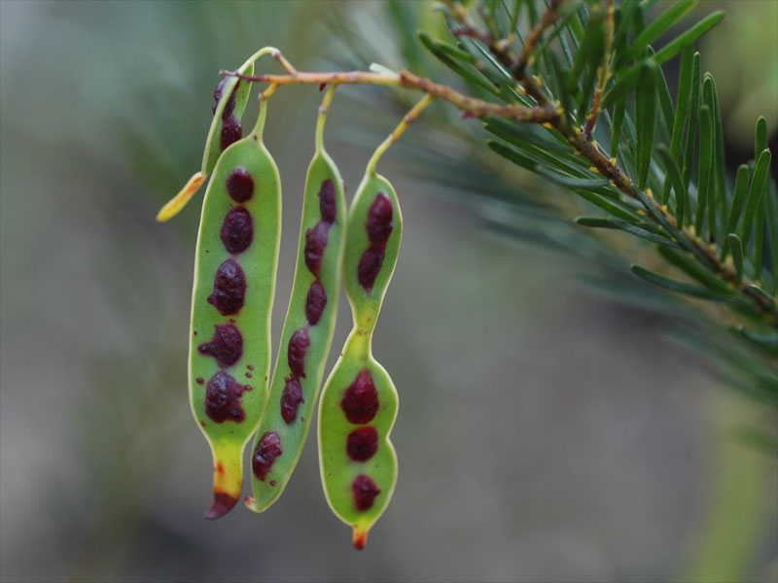
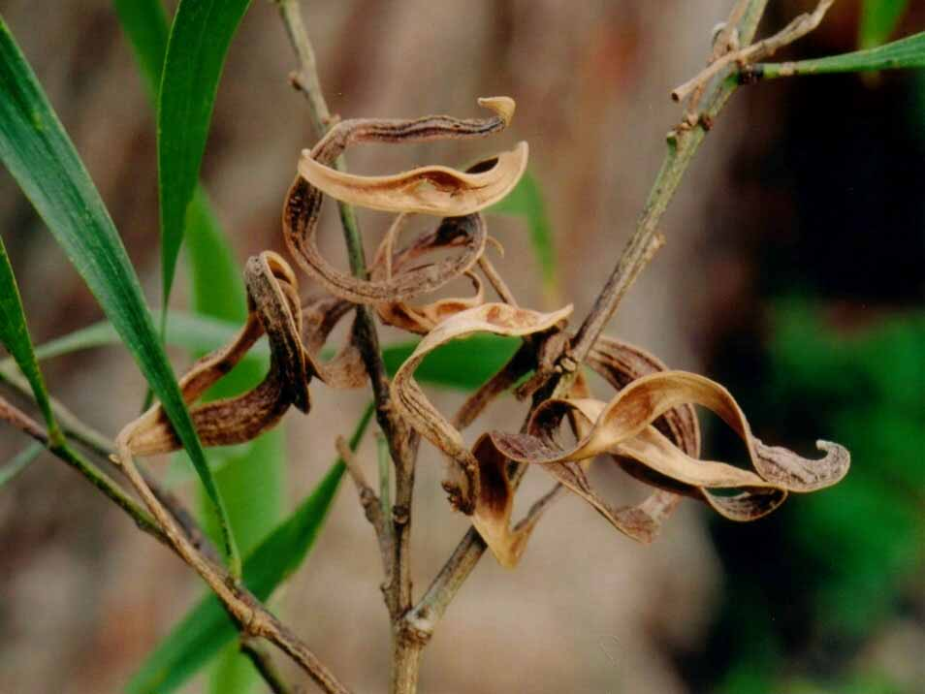
Acacia terminalis
Coastal Plants of RNP CD
Acacia floribunda
Coastal Plants of RNP CD
Acacia longifolia Coastal Plants of RNP CD
Acacia linifolia Coastal Plants of RNP CD
Acacia maidenii Coastal Plants of RNP CD

Slide 19
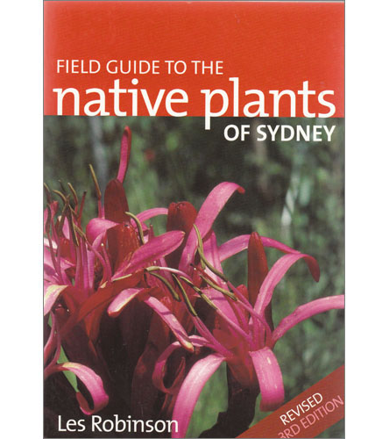
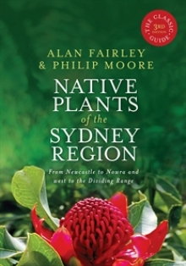
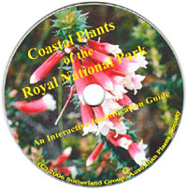
Identifying local Acacia species
Foliage: feathery or phyllode
Flower:
  Shape: ball or rod/spike
  Colour: cream/lemon or yellow
Pod: shape, colour, texture
36 species
60 species + 12
11 species

Slide 20
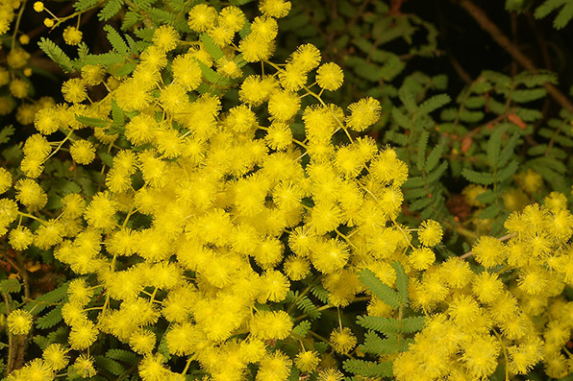
Acacia pubescens (Downy wattle)
Rare species found in open forest on clay soils
Found inner western Sydney
pubescens = finely hairy (branchlets)
Bushy shrub 1–3 m, bright yellow flowers, blueish pods
Acacia pubescens www.anpsa.org.au

Slide 21
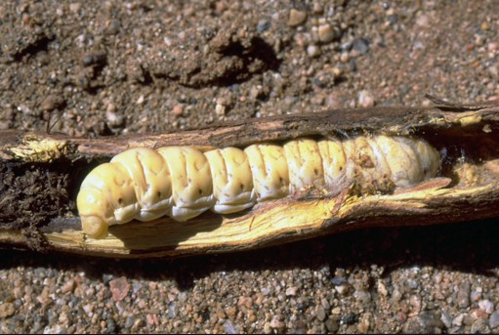
Aboriginal uses of acacias
Seeds extracted from pods ground into a flour and roasted
(check references before eating)
Gum from some species (eg Acacia decurrens) mixed with water and used for food (also gum arabic)
Bark and leaves thrown into water as fish poisons, with the tannins used to stupify fish
Bark and leaves used for medicinal purposes
Grubs under bark and roots eaten
– witchetty grubs (witjuri) under Acacia kempeana
Timber used for weapons and tools
www.worldwidewattle.com

Slide 22
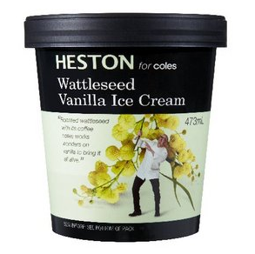
Cultural significance and uses
Early uses
Wattle saplings used for wattle and daub huts
Bark of pinnate-leaved trees used as a tea substitute
due to the tannins, plus hops substitute
Tannins from acacias used in the leather industry:
  A. pycnantha has almost 50% tannic acid
  A. decurrens and A. mearnsii have 20–30% tannic acid
  150 kg of bark from 1 tree
Wood (eg Acacia melanoxylon) used in furniture making
Now
wattleseed flavouring for biscuits, icecream, drinks

Slide 23
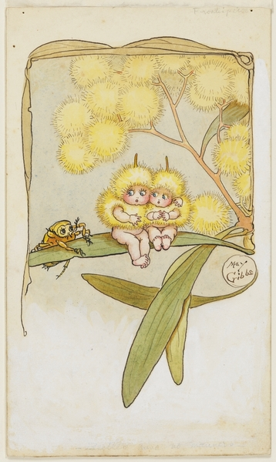
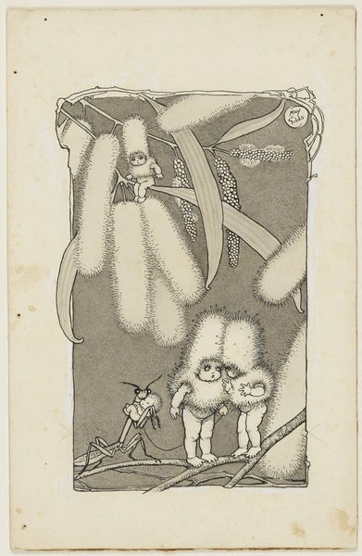
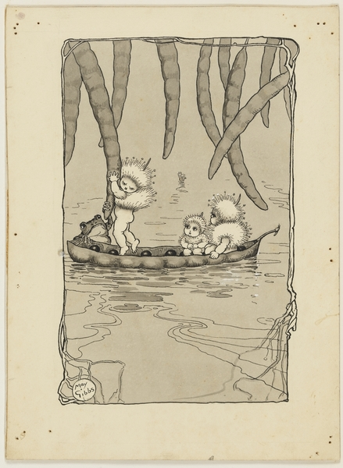
May Gibbs’ wattle babies
From State Library of NSW
Copyright: The Northcott Society and Cerebral Palsy Alliance

Slide 24
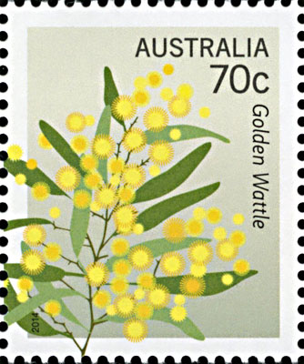
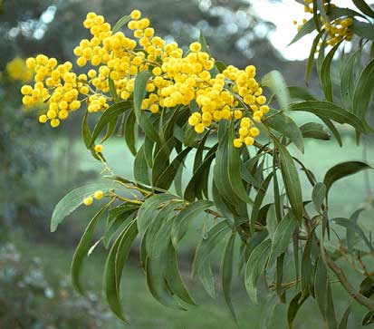
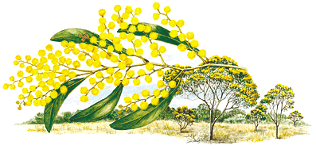
Our national emblem
Our national floral emblem is Acacia pycnantha
(Golden wattle), proclaimed in 1988
pycnantha from the Greek words
pyknos (dense) and anthos (flowers)
Widespread and important in tanning industry

Slide 25

Symbols – Order of Australia
Designed by Stuart Devlin AO in 1975,
inspired by individual wattle blossom

Slide 26



Symbols and colours
Possibly Acacia buxifolia
www.worldwidewattle.com
www.who.com.au, Matildas Olympic qualifiers

Slide 27

National Wattle Day – 1 September
Floral emblem gazetted in 1988
Wattle Day declared in 1992
Wattle Day Association founded in 1998 to raise awareness of the day:
“a celebration of Australia – its land and its people”
www.wattleday.asn.au
Celebrate!
Wear a sprig of wattle
Go for a walk to enjoy local wattles
Have a picnic, lunch, tea or BBQ
Read a poem
Banksia coccinea
Banksia praemorsa
Banksia menziesii
Banksia prionotes

Slide 28
Acacias in the garden
Growing acacias
Acacias are fast growing, but look out for borers
Prune after flowering
Propagating acacias
Seeds have a very hard coat and need fire or abrasion to germinate
Scarify (wear away) the seed coat with sandpaper or
pour boiling water over and soak to soften the coat
Harder to grow by cutting
Roots smell like garlic (nitrifying root bacteria nodules)
Buying acacias
Local: Sutherland Council Nursery, 345 The Boulevarde, Gymea
Cultivars: Sydney Wildflower Nursery, 9 Veno St, Heathcote

Slide 29
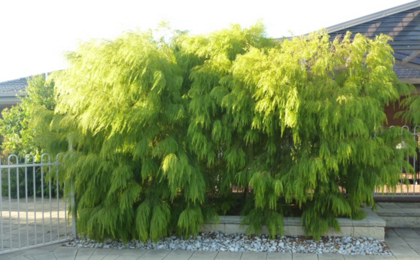
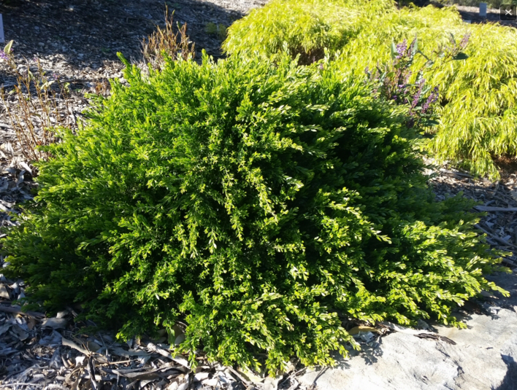
Acacias in the garden – cultivars
Acacia cognata ‘Lime Magik’
www.gardeningwithangus.com.au
Acacia howittii ‘Honey Bun’
www.gardeningwithangus.com.au
Shrubs
Acacia cognata
‘Limelight’, ‘Mini Cog’, ‘Fettucine’, ‘Green Mist’, ‘Bower Beauty’
Groundcover / Standard
Acacia cognata ‘Waterfall
Groundcover
Acacia howittii ‘Green Wave’

Slide 30
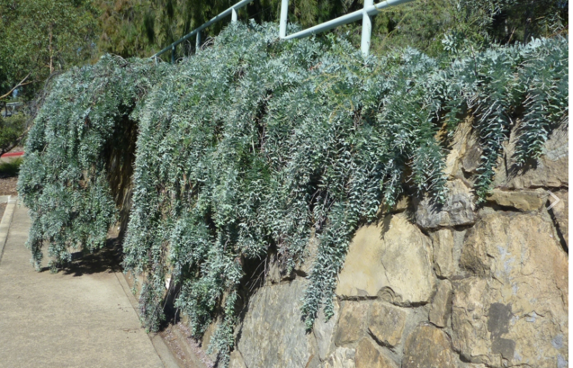
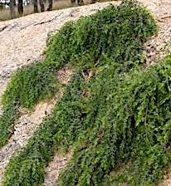
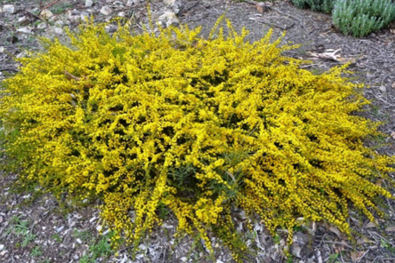
Acacia baileyana prostrate
www.gardeningwithangus.com.au
Acacia howittii ‘Green Wave’
www.bushlandflora.com.au
Groundcovers
Acacia saligna ‘Springtime Cascade’
Acacia cultriformis ‘Cascade’
Acacia amblygona www.austplants.com.au

Slide 31
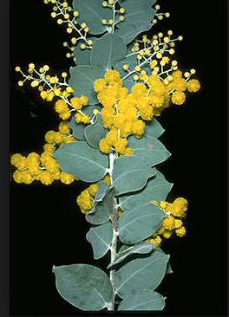
Too common!
Banksia coccinea
Acacia baileyana
(Cootamundra wattle)
Acacia podalyriifolia www.anbg.gov.au
(Queensland silver dollar wattle)
Banksia praemorsa
Banksia menziesii
Banksia prionotes

Slide 32

Myth busting
False: Acacias cause allergies
Fact: Acacias have large, sticky, heavy pollen which is dispersed by insects, not blown by wind, and is unlikely to cause allergies
People may be sensitive to fragrant oils
False: Acacias are too short-lived for gardens
Fact: Fast-growing, provide canopy and ecosysem, subject to borers
Fact: Acacia aneura (mulga) is very long lived
Acacia aneura (mulga wattle)

Slide 33

Seeing acacias in public gardens
Joseph Banks Native Plants Reserve, Kareela
  Established in 1969 as a Cook bicentenary project 1770–1970
  50th anniversary in 2020
  Acacia garden plus natural areas
  with labelled plants
Similar reserves
  Sylvan Grove at Picnic Point
  Stony Range at Dee Why
  Ku-ring-gai Wildflower Garden
The Australian Botanic Garden, Mt Annan

Slide 34



Acacia garden at JB
Acacia triptera (spurwing wattle)
wikipedia
From APS East Hills newsletter May 2018
Acacia aphylla (leafless wattle) wikipedia
2014
Acacia macradenia (zig-zag wattle)

Slide 35




Acacia fimbriata
Acacia podalyriifolia
Acacia macradenia
35

Slide 36

Acacia glaucoptera RD

Slide 37
Acacia binervia RD

Slide 38

Acacia fimbriata RD

Slide 39


More on acacias
Acacia Study Group of the Australian Native Plants Society (Australia) with regular newsletter FREE www.anpsa.org.au
Hitchcock, M. (2012) A Celebration of Wattle: Australia’s National Emblem.
Robinson, L. (2003) Field Guide to the Native Plants of Sydney, Kangaroo Press.
WATTLE version 3 (2023)
interactive identification online + app $9.95, https://apps.lucidcentral.org/wattle
www.worldwidewattle.com (WA Herbarium)

Slide 40
Amazing acacias!
1,000 species in Australia + cultivars = there’s one for every spot
2 types of flower arrangements and 2 types of foliage
Our national floral emblem is Acacia pycnantha
Celebrate Wattle Day on 1 September
Acacias unlikely to cause allergies as pollen is dispersed by insects
Acacias are fast growing and good for gardens
Have a closer look at an amazing acacia near you!

