Slide 1
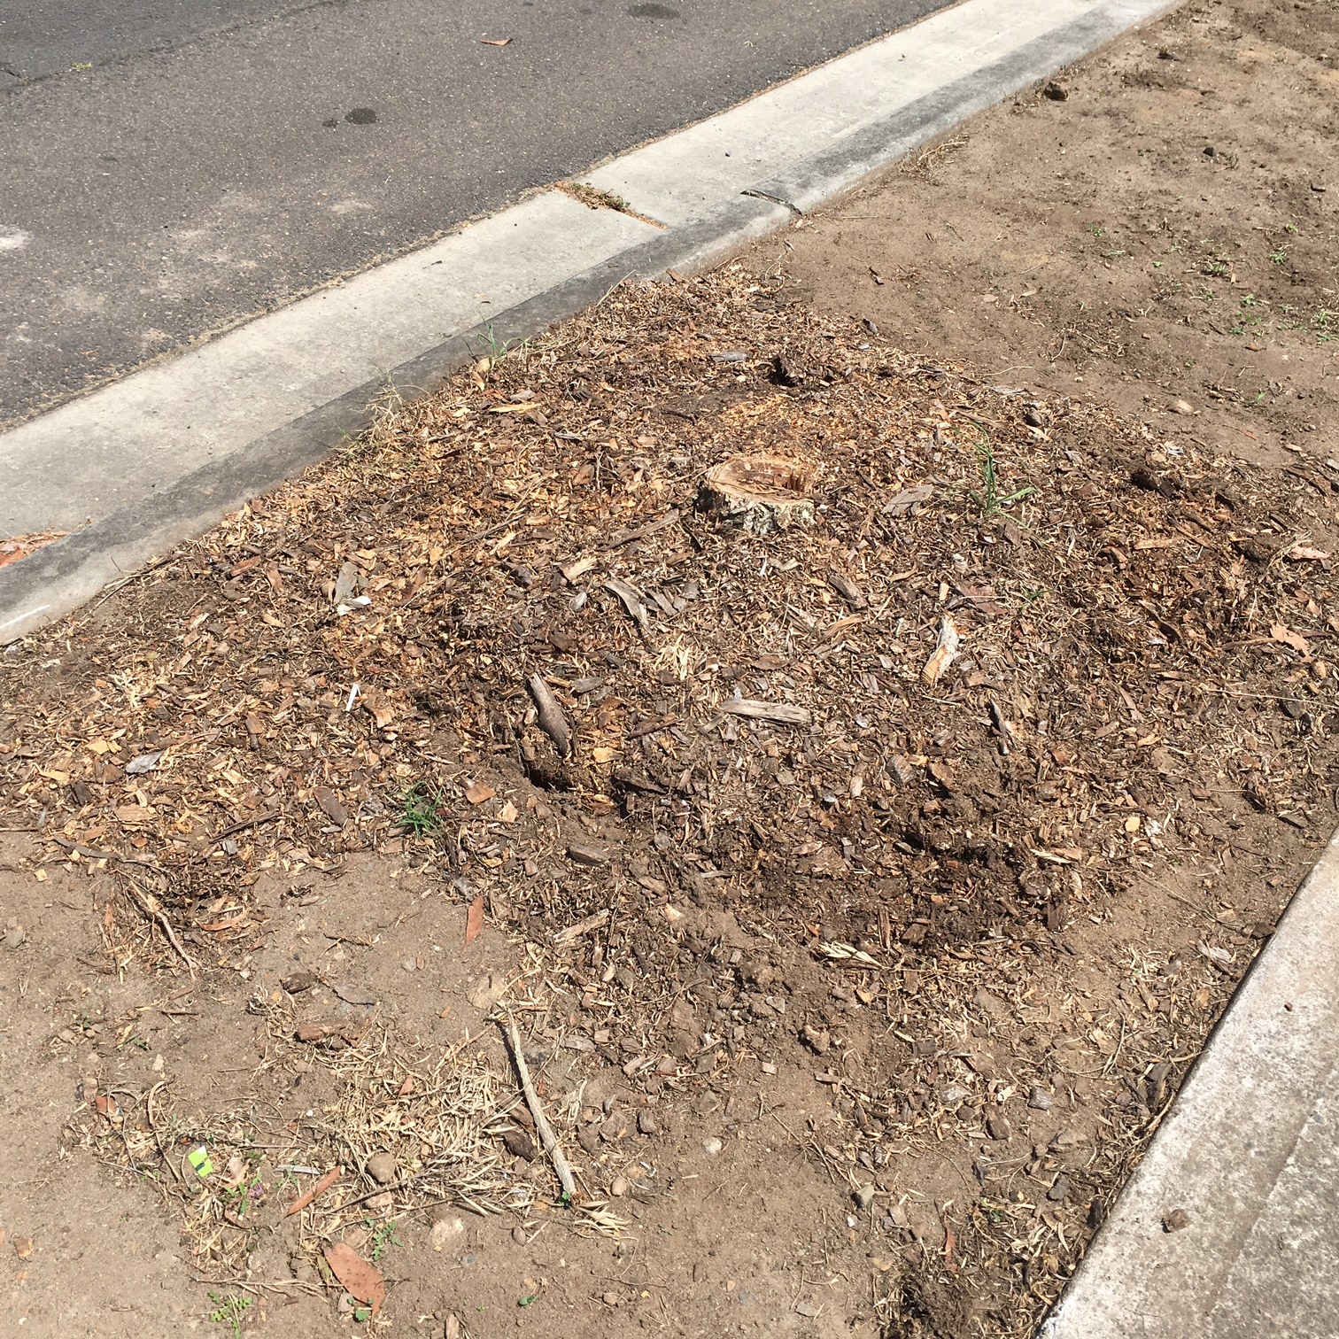
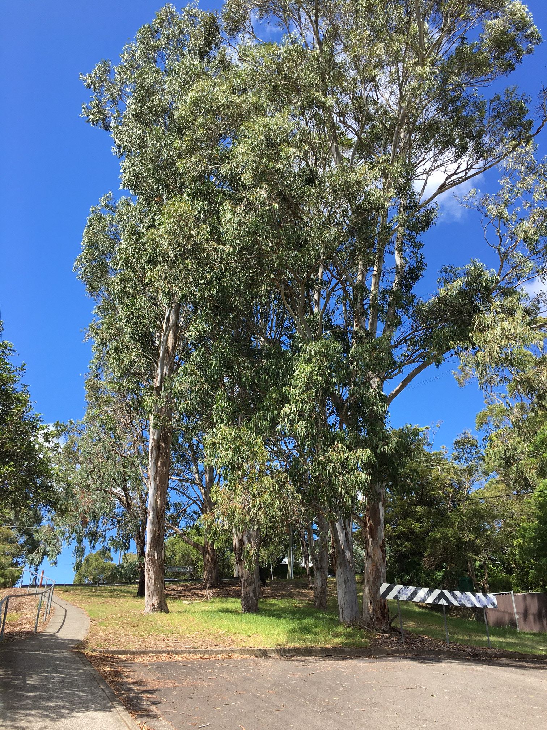
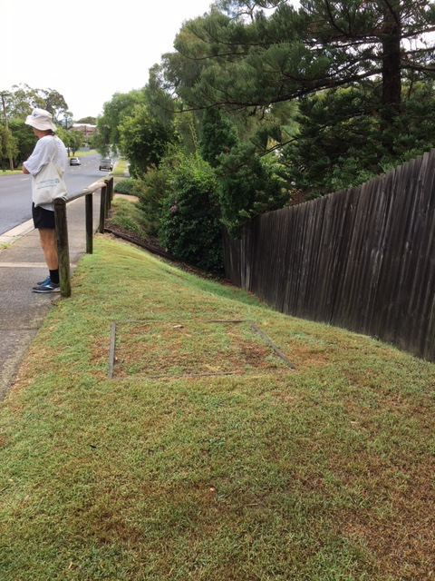

Saving our street trees: what’s going on and what we can do
Rhonda Daniels, Australian Plants Society
rhdaniels@bigpond.com

Slide 2
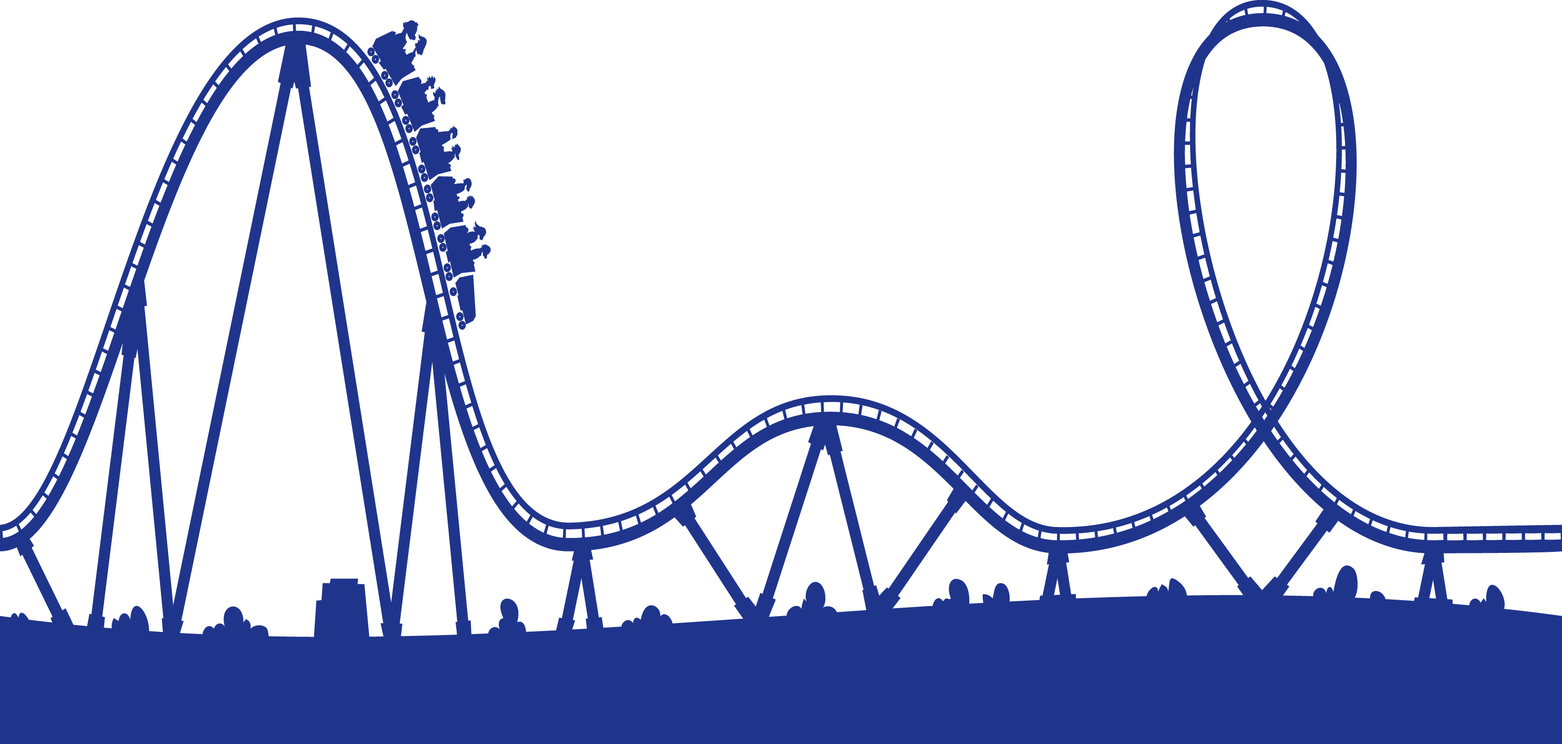
Outline
Add roller coaster
Why our street trees are important
Challenges and threats
Govt policy – state and local
Taking action – What we can do
Callicoma serratifolia CD

Slide 3
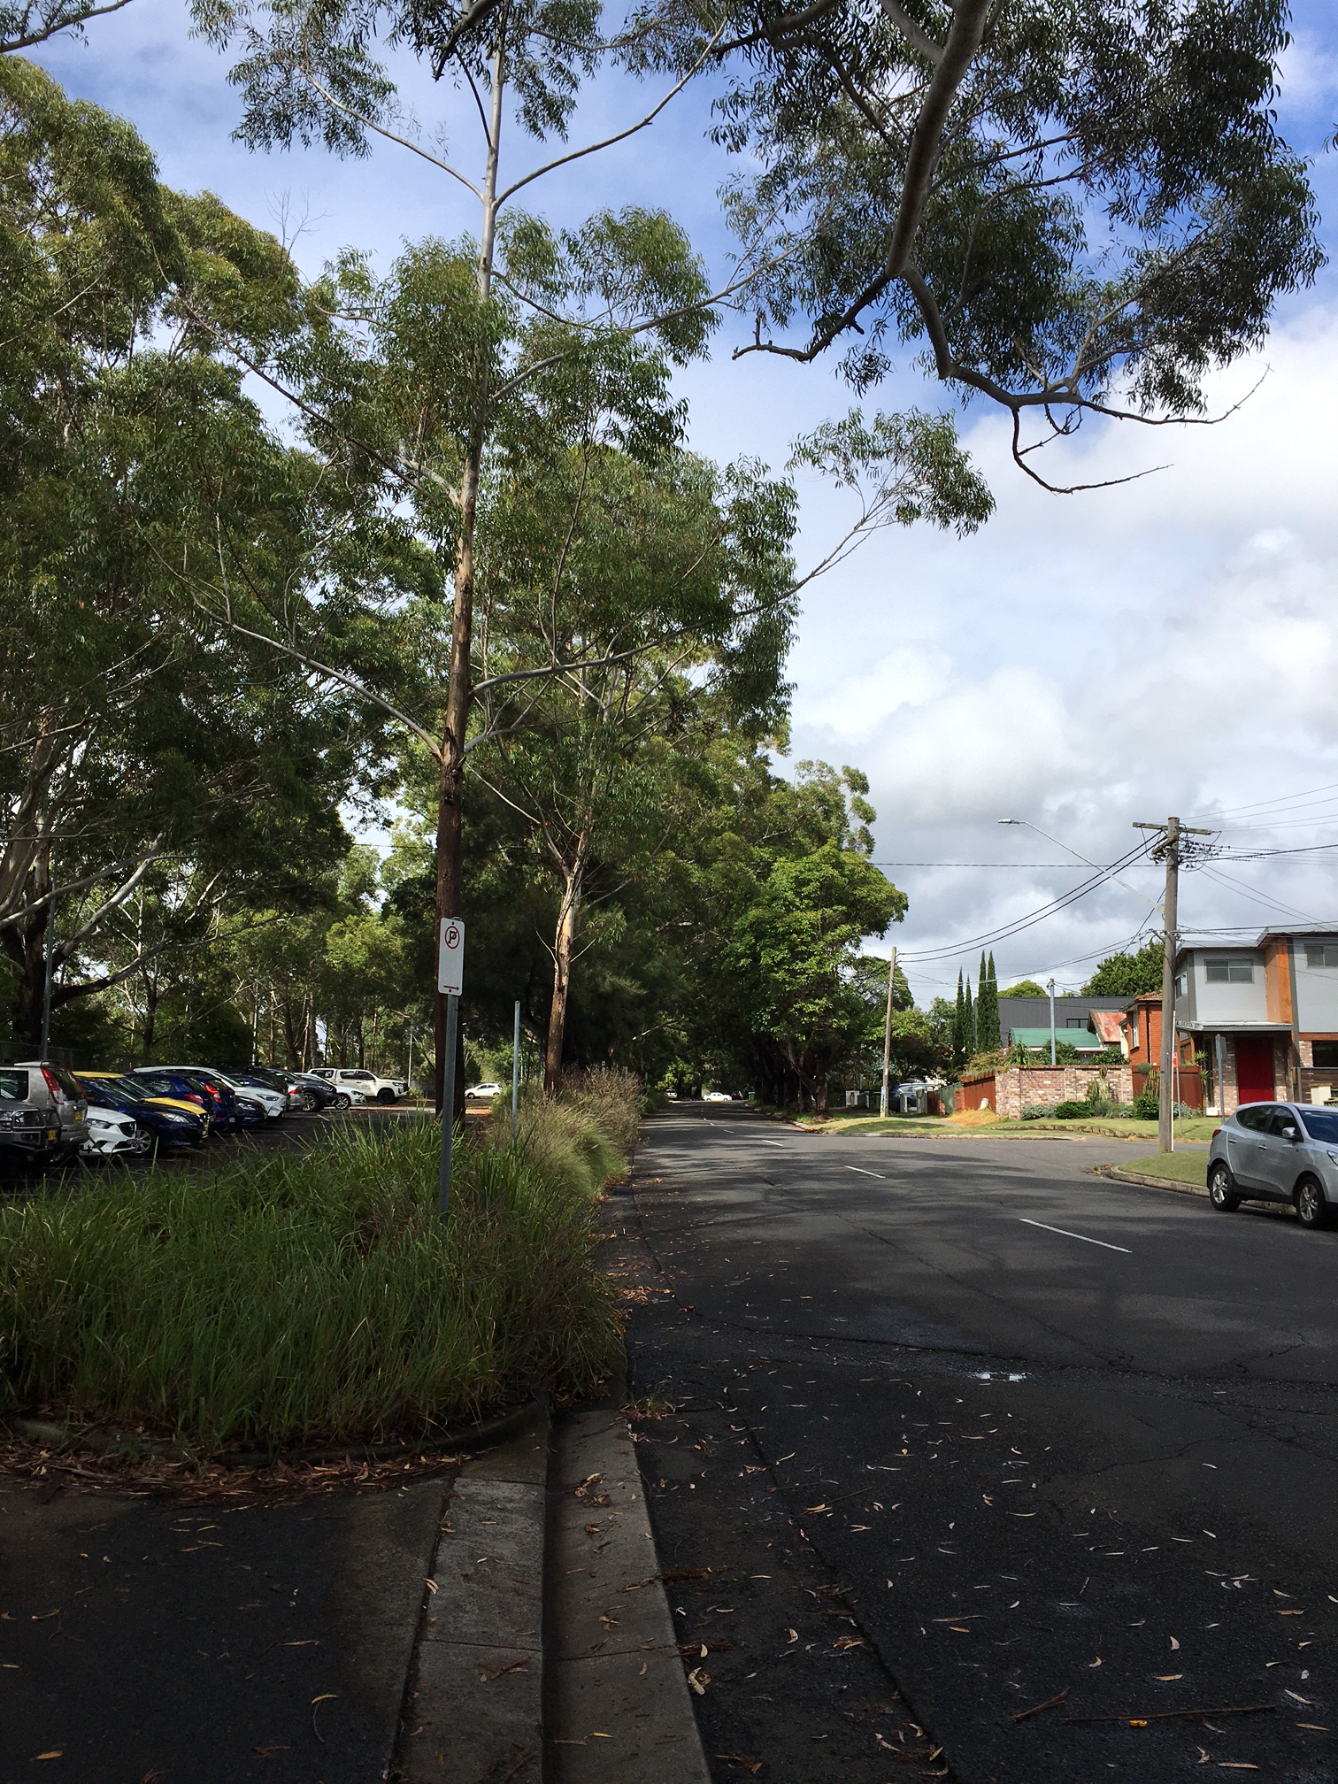
Why street trees are important
For our health
Physical health
  Provide shade
  Reduce air and surface temperatures
  Encourage walking
Mental health
  Improve amenity and aesthetics
  Contribute to local character
  Provide privacy and screening
Environmental health
  Provide habitat for range of fauna
  Clean the air
  Store carbon
  Reduce runoff
Jannali Ave, Jannali

Slide 4
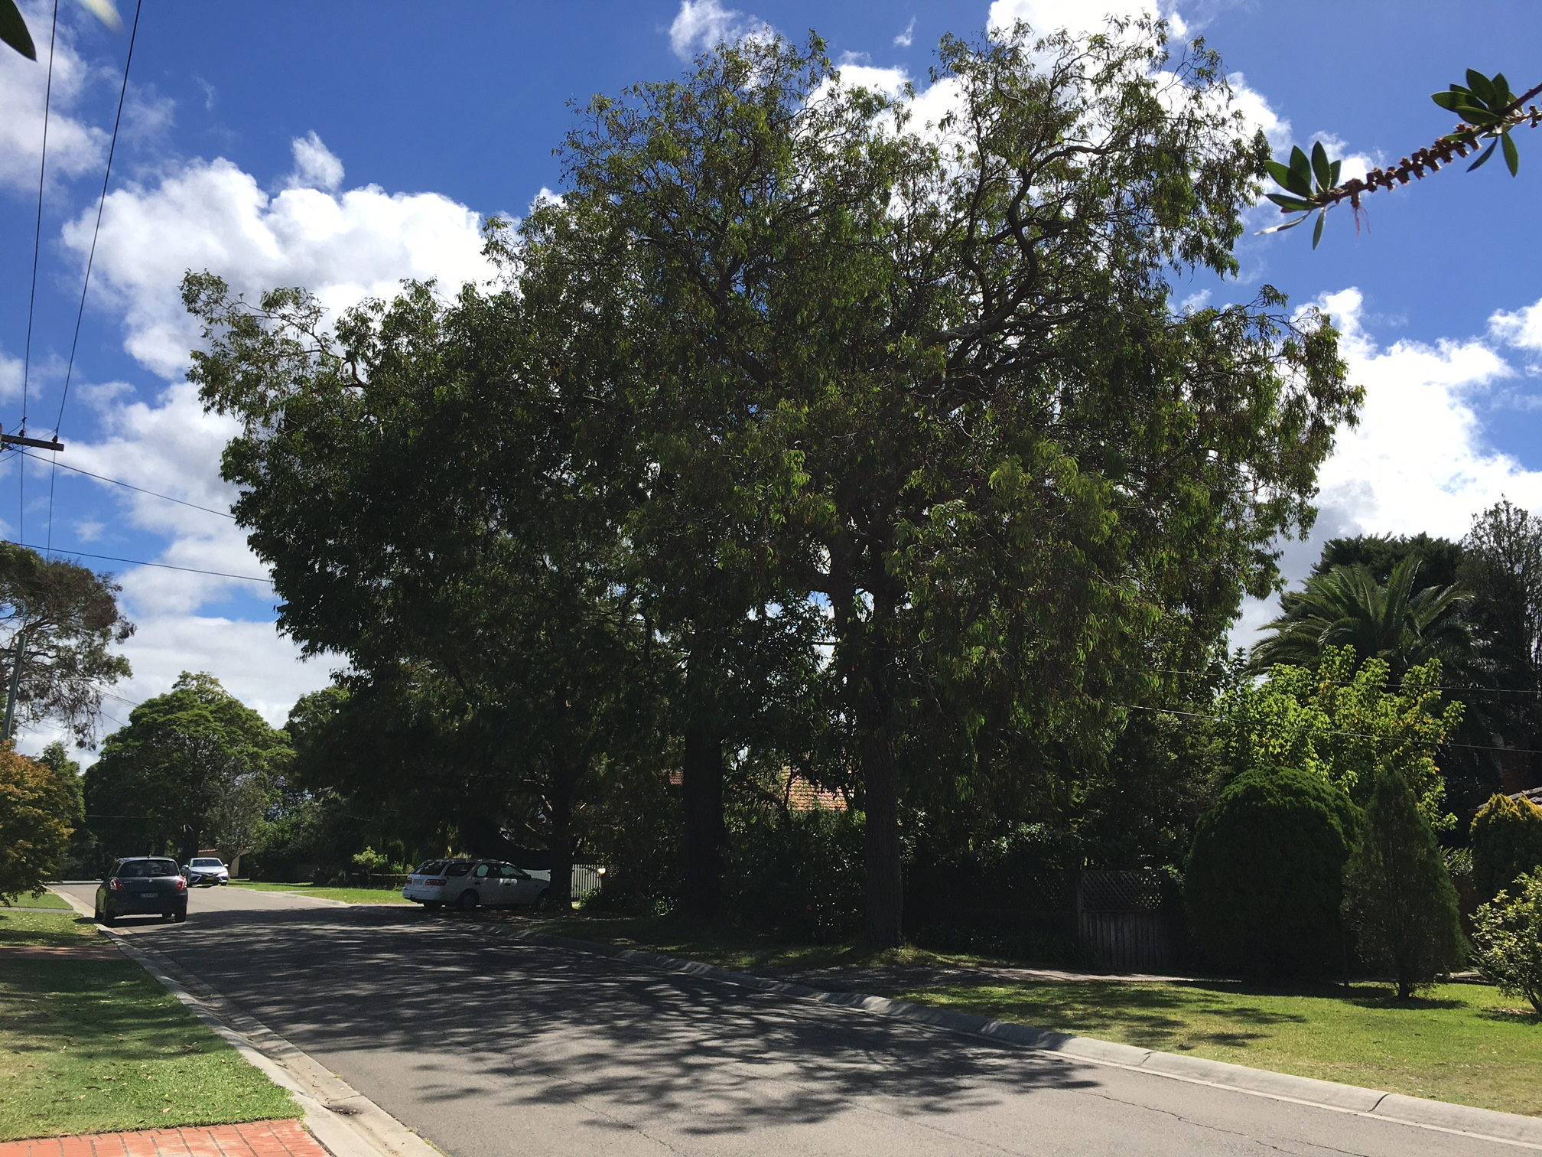
Provide shade, reduce temperatures
Glenelg St, Sutherland

Slide 5
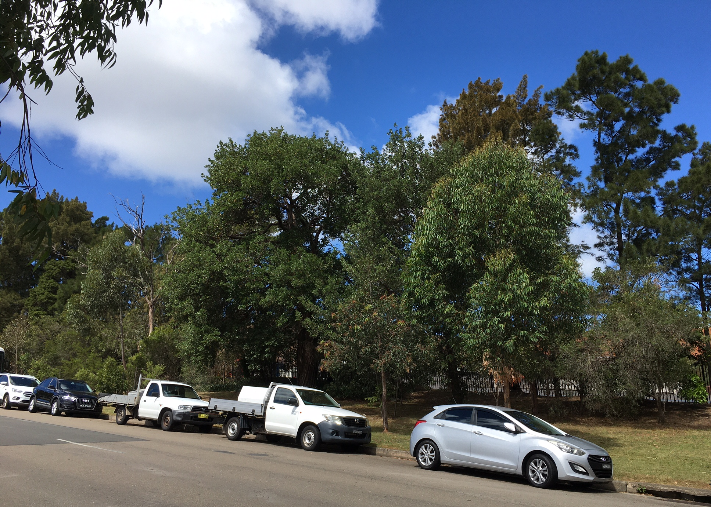
Provide privacy and screening
Of roads and rail lines
Of buildings eg units, carparks and industrial sites
Garnet Rd, Kirrawee, screening depot

Slide 6
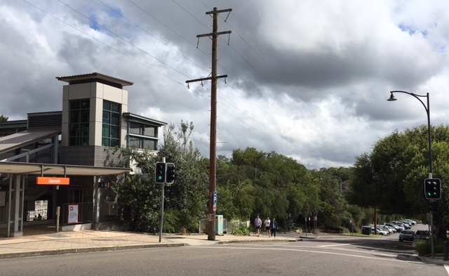
Provide screening
Jannali train station and rail line

Slide 7
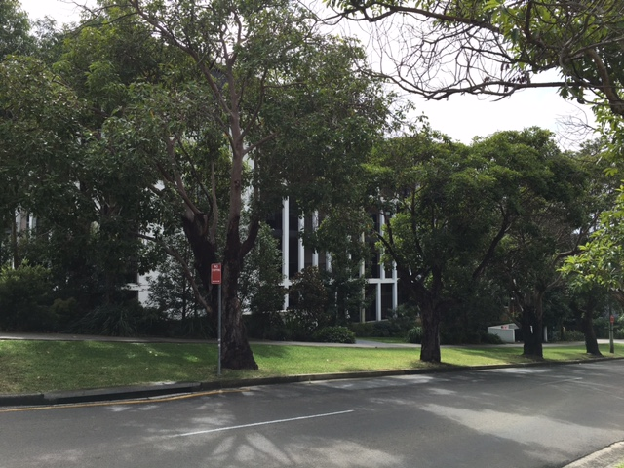
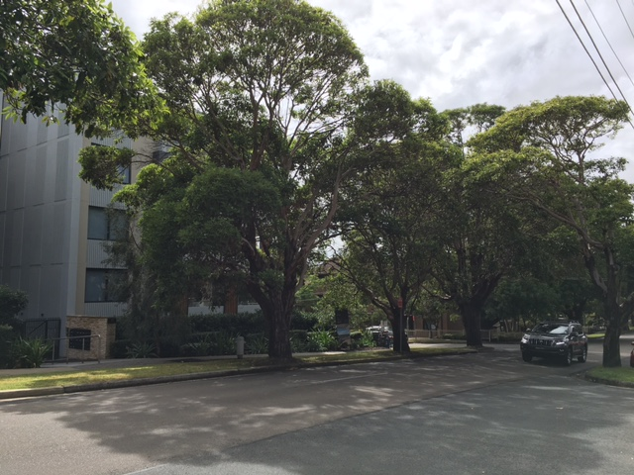
Improve aesthetics and amenity
Mitchell Ave, Jannali

Slide 8
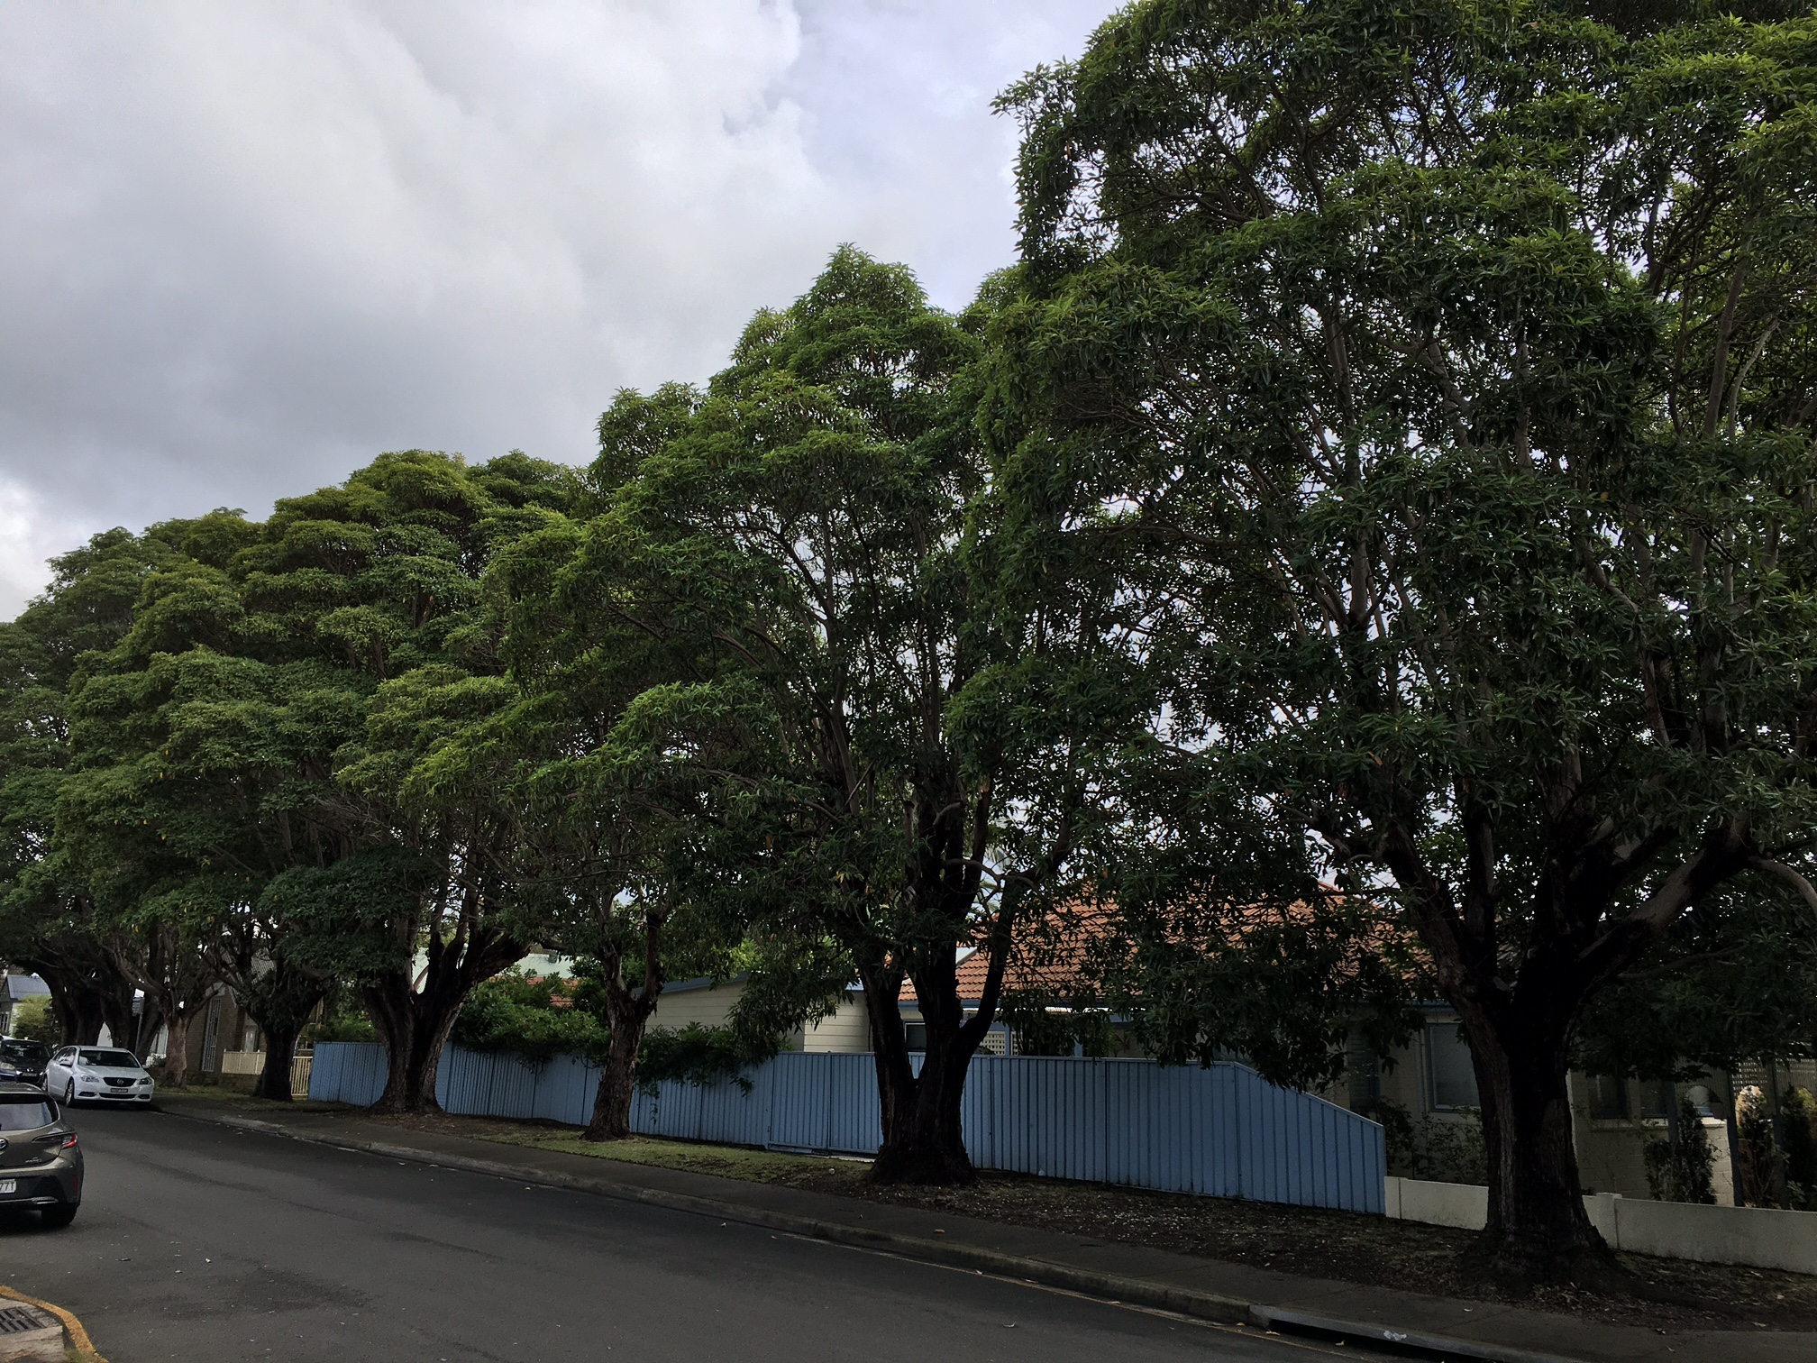
Encourage walking
Louise St, Jannali

Slide 9
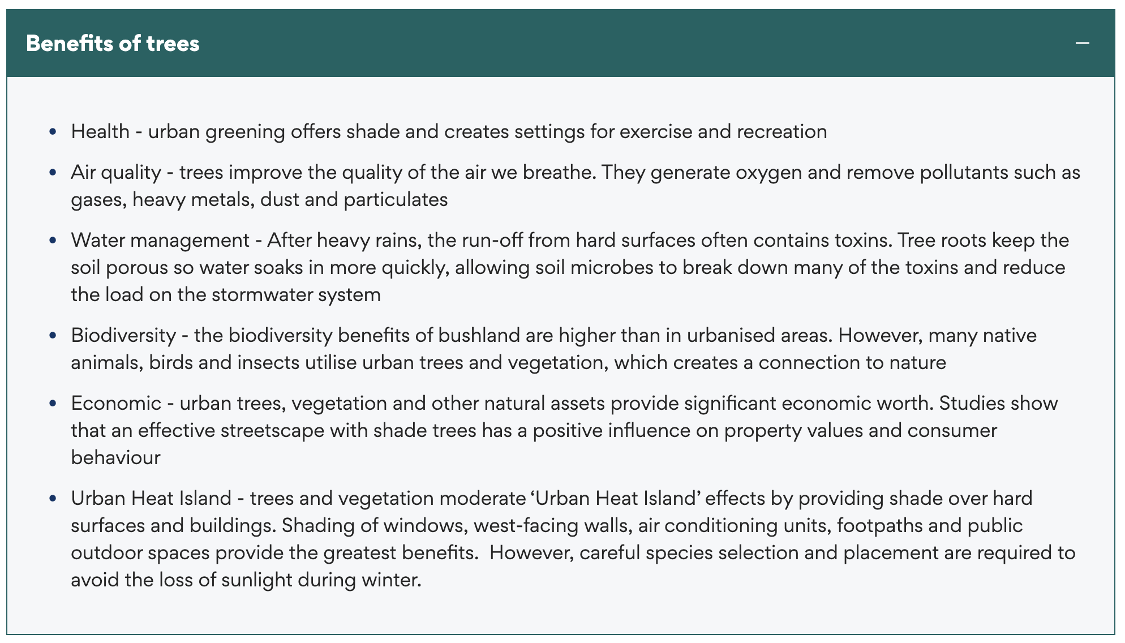
https://www.sutherlandshire.nsw.gov.au/living-here/trees#prune

Slide 10
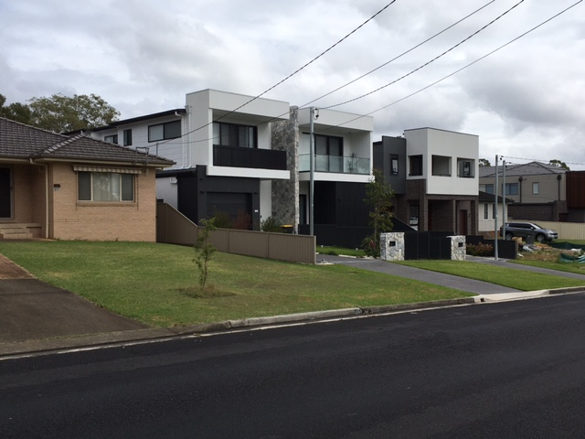
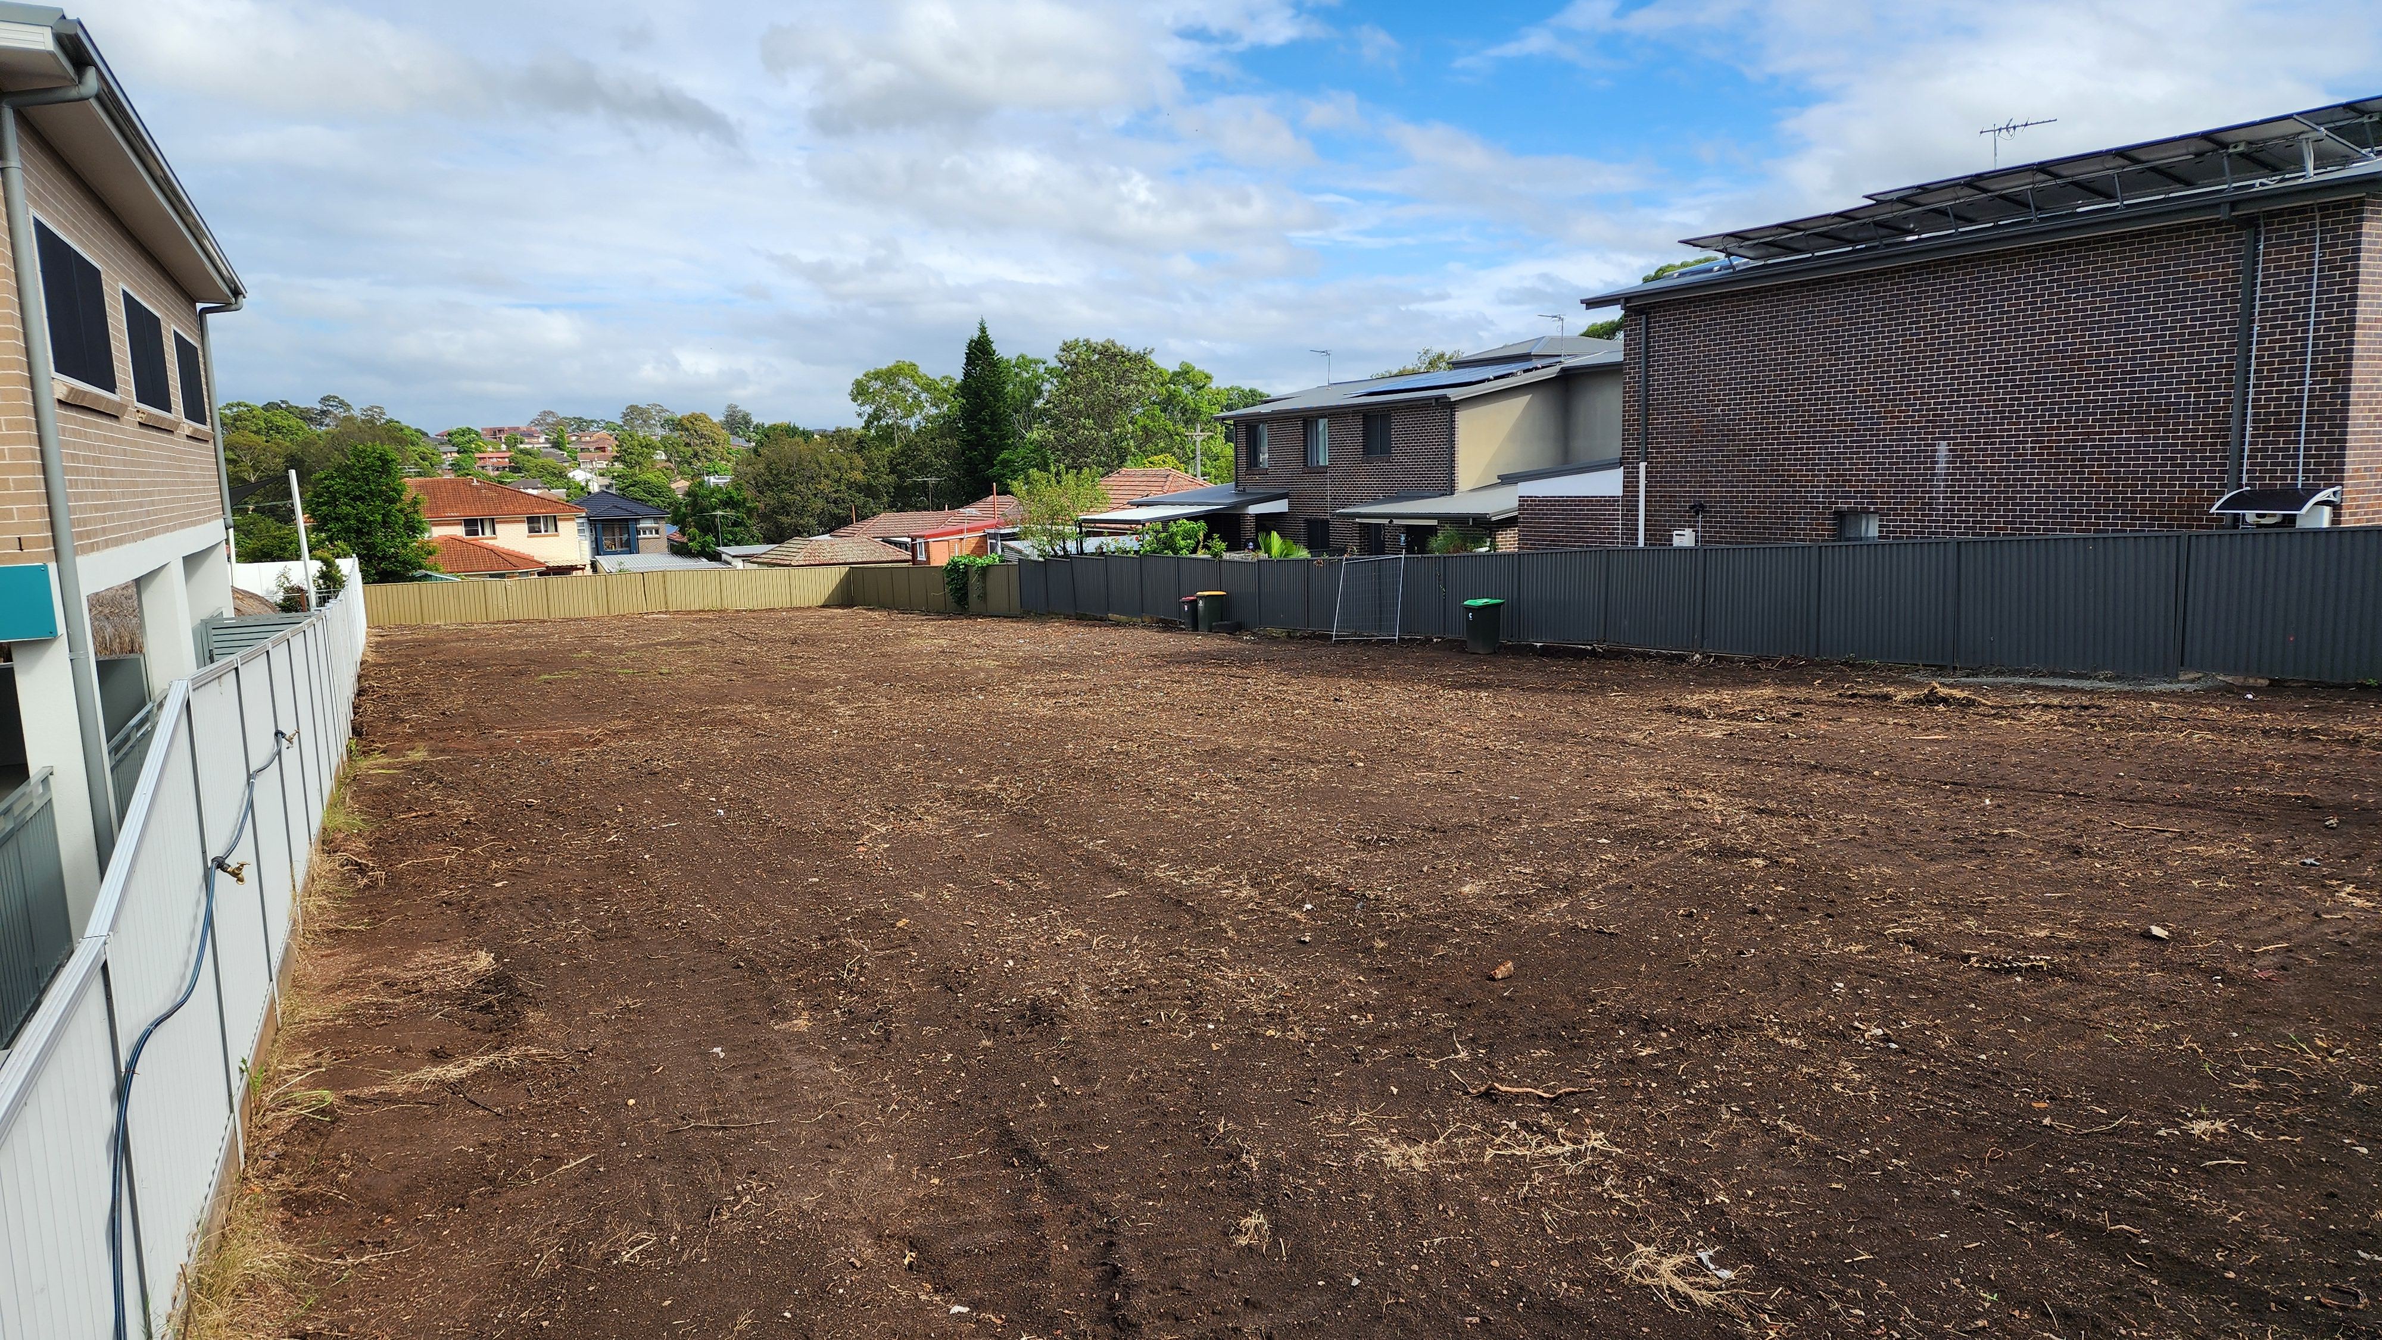
Why are street trees
INCREASINGLY important?
Loss of trees on private land due to development
Higher density of urban development,
more hard surfaces, less green space
Climate change and higher temperatures
Sutherland Rd, Jannali
Pendle Hill

Slide 11
Challenges and threats – private
The Number 1 threat is… US (people)
Existing street trees are removed by private sector for
  Development (duplexes)
  Parking and driveways
  Views
  Aesthetics (branches, leaves, fruit)

Slide 12
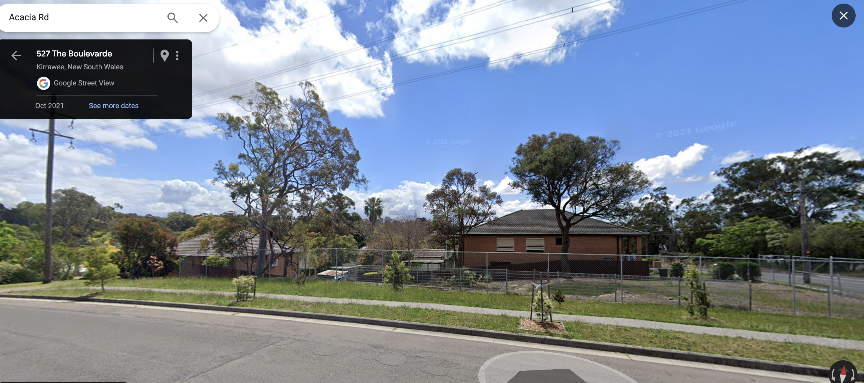
Count the street trees
Corner Acacia Rd/The Boulevarde, Kirrawee

Slide 13
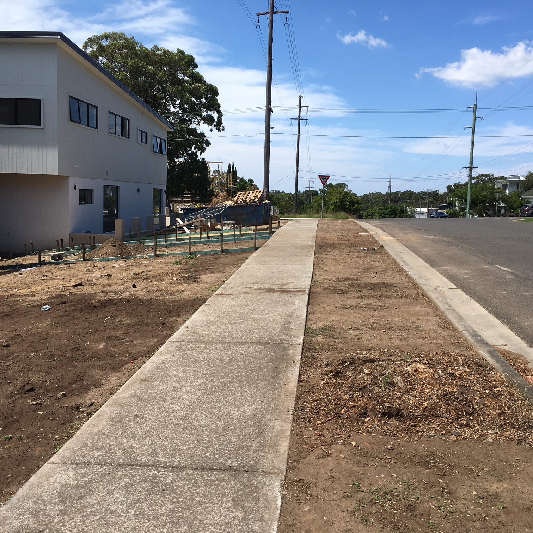
Development
Corner Acacia Rd/The Boulevarde, Kirrawee, duplex site
Melaleuca removed by builders

Slide 14
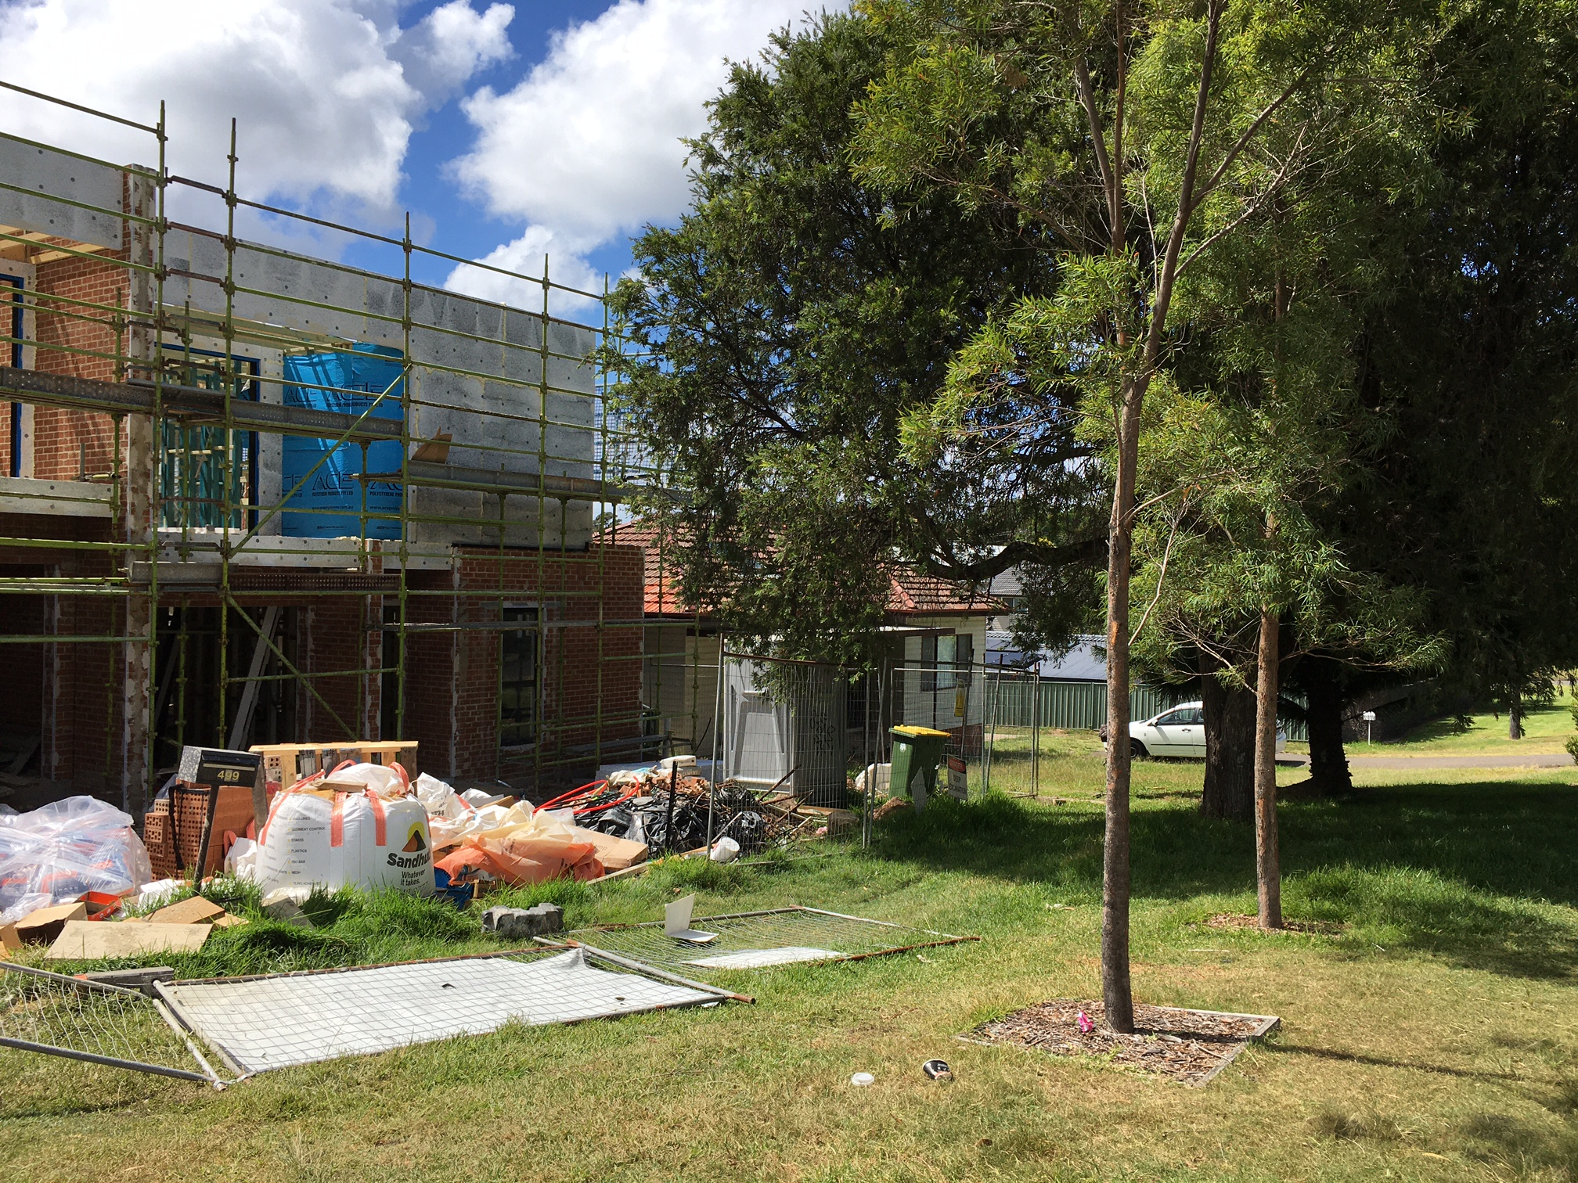
Development
The Boulevarde, Sutherland, corner duplex site

Slide 15
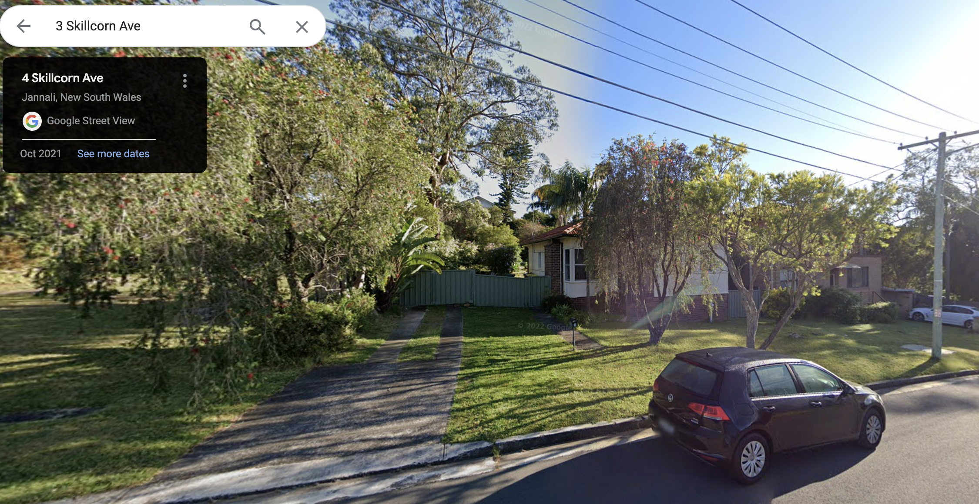
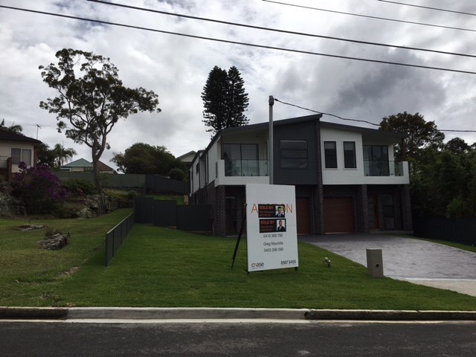
Development

Slide 16
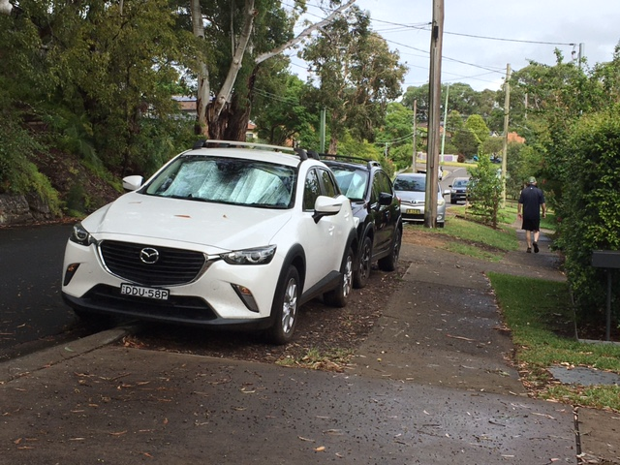
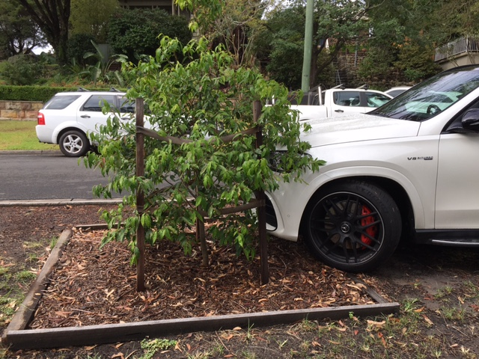

Parking and driveways
Woronora Cres, Como

Slide 17
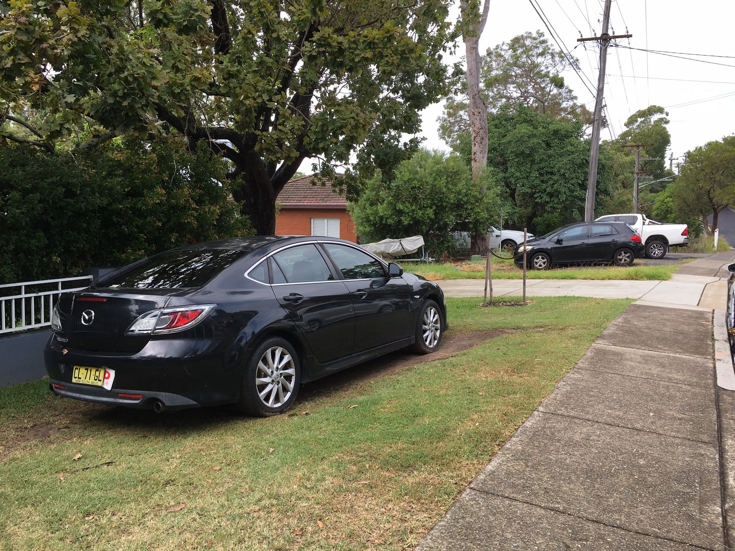



Parking
Sutherland Rd, Jannali

Slide 18
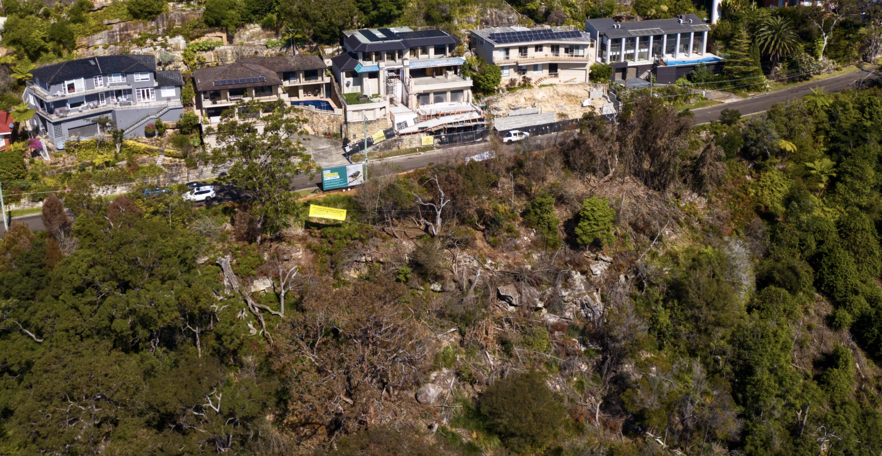
Views
Castle Cove, 256 trees killed on public reserve
www.smh.com.au/national/doom-with-a-view-the-chainsaw-vandals-killing-trees-for-a-better-outlook-20231102

Slide 19
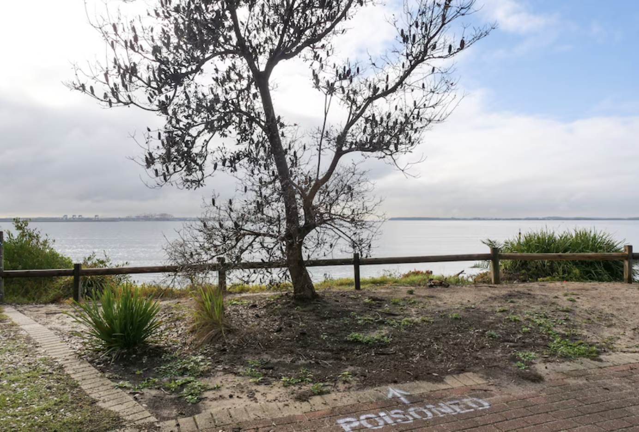
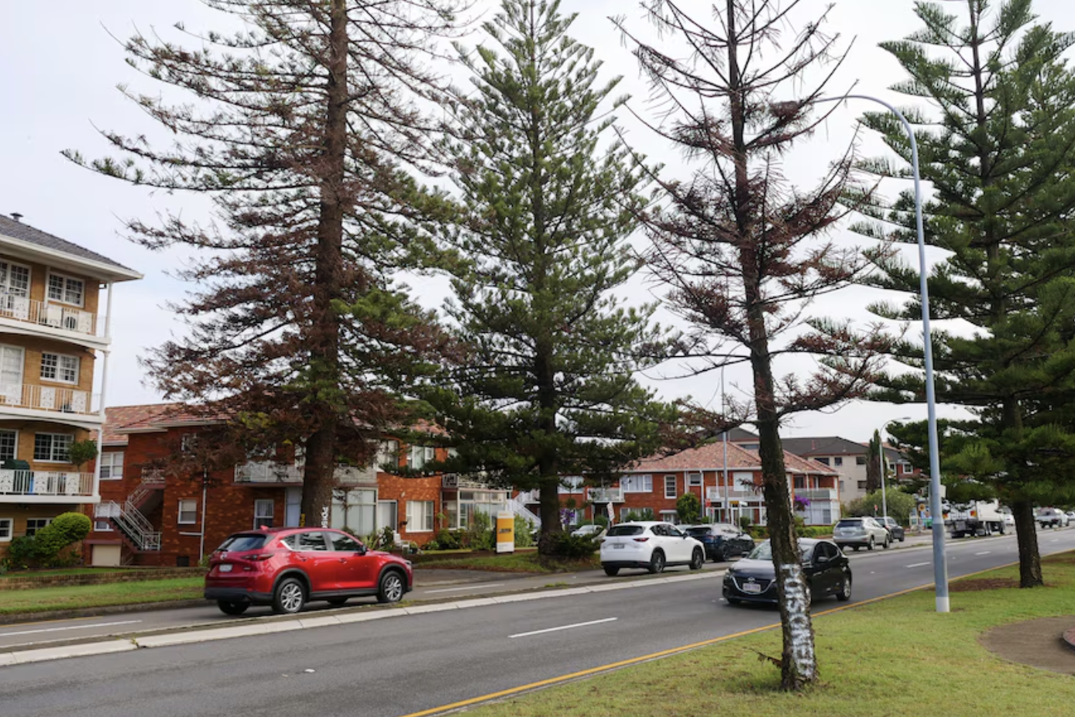
Views
Monterey
www.abc.net.au/news/2024-03-19/trees-vandalised-on-monterey-balmoral-waterfronts/103605682

Slide 20
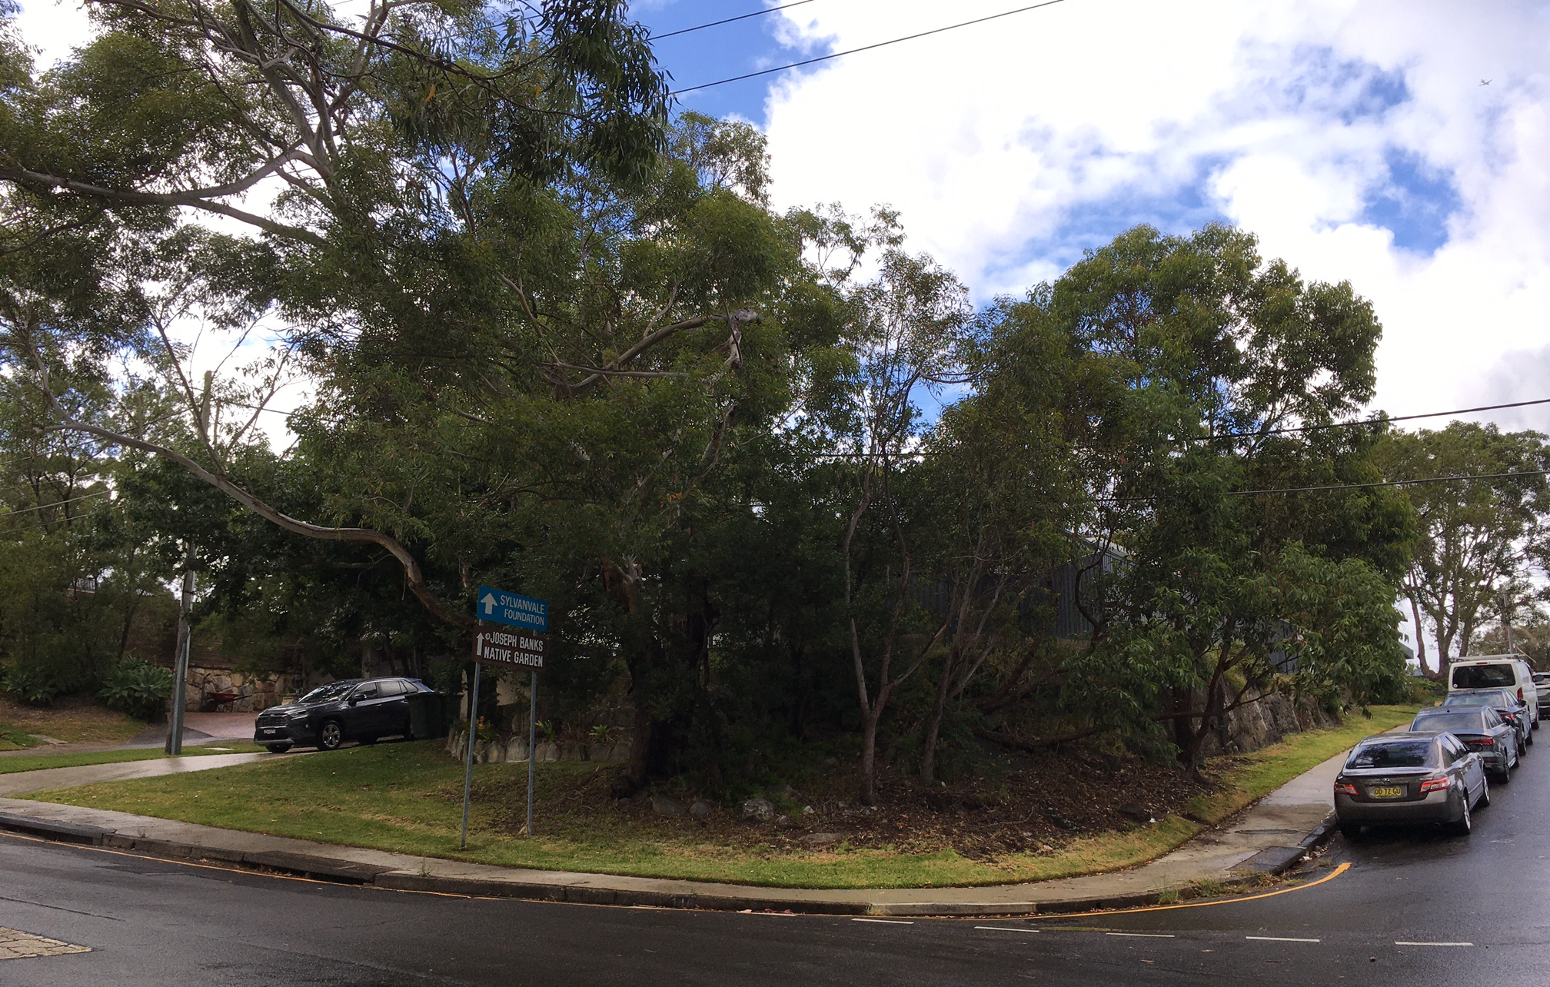
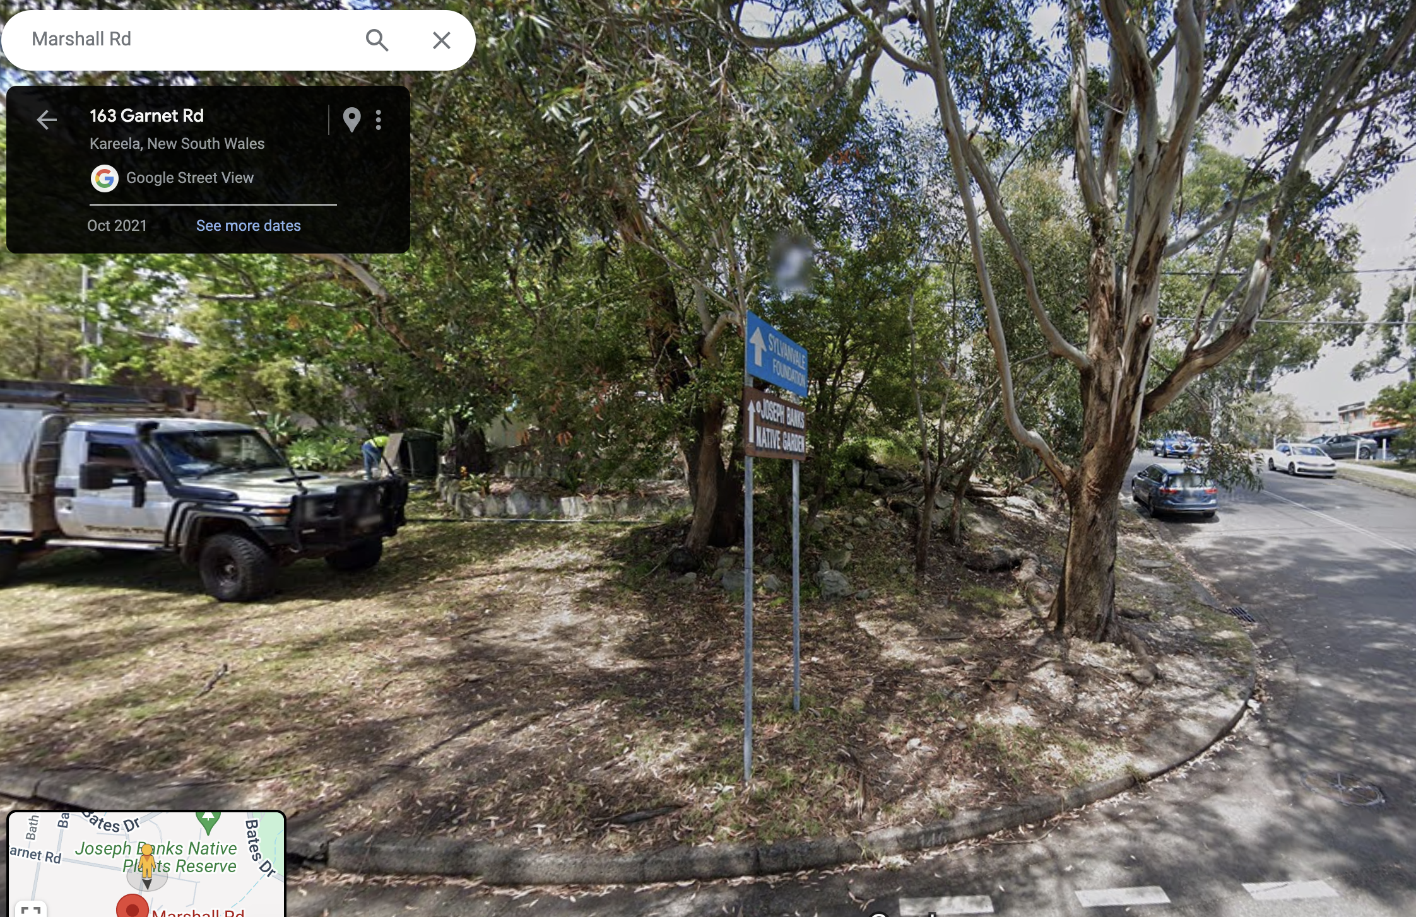
Challenges and threats – public
Existing street trees are removed by public sector for
  Transport: footpaths, road widening, parking
  Electricity lines
  “Risk and Safety” audits
Corner, Marshall and Garnet, Kirrawee

Slide 21
For transport
NSW Govt
Clearing for road widening eg Leonay St/River Road, Sutherland
Clearing for Active Transport Link, Sutherland to Cronulla
Clearing by utilities under power lines: Kirrawee
Clearing Moreton Bay figs for light rail on Anzac Parade
Clearing at Cammeray for Western Harbour Tunnel
Sutherland Council
Car park at Sutherland Leisure Centre

Slide 22
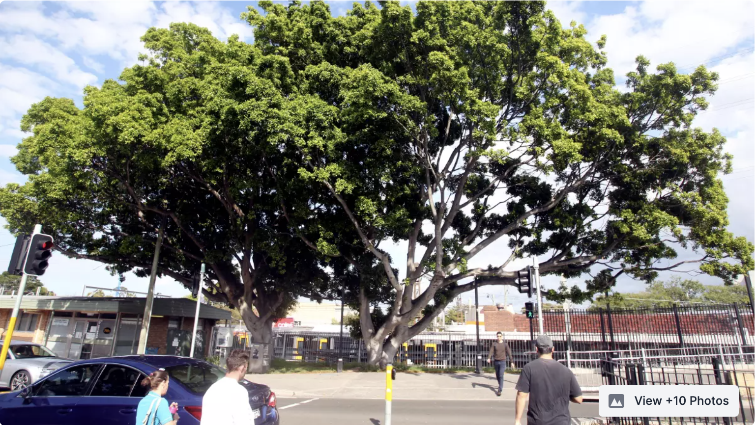
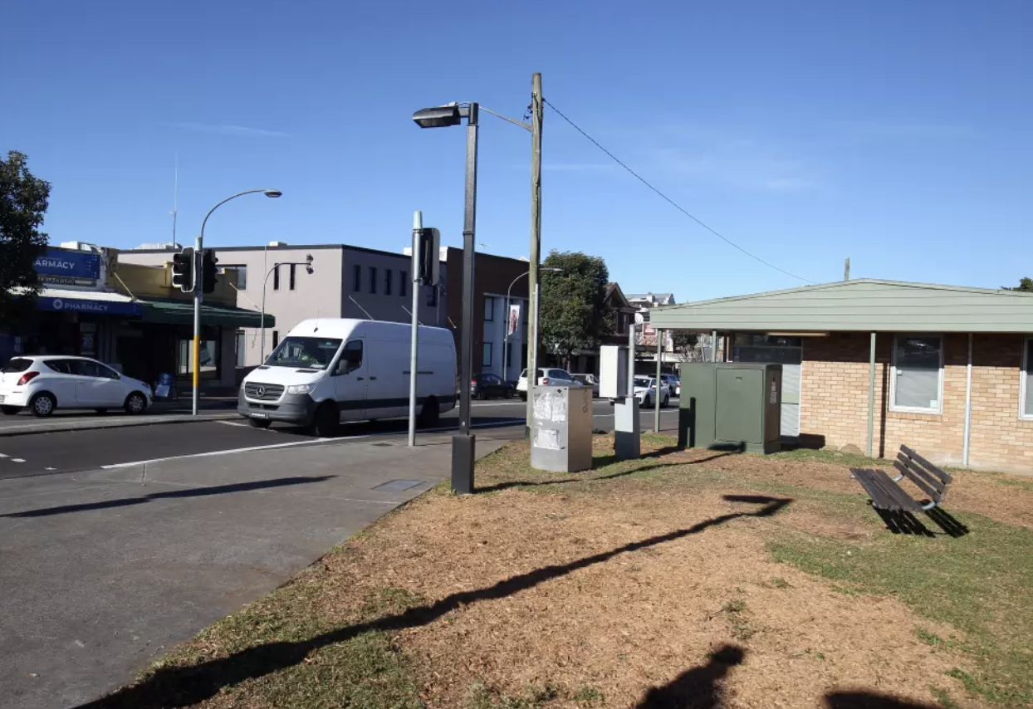
For risk and safety audits
April 2021: Port Jackson fig fell down, Eton/President, Sutherland centre
Council audit: many mature street trees removed and not replaced
July 2021: Council removed 2 Hills figs at Sutherland station
2023: Council replanted lilly pillies
Google Maps Street View for before and after
Source: The Leader
https://www.theleader.com.au/story/7352186/station-fig-trees-cut-down /

Slide 23
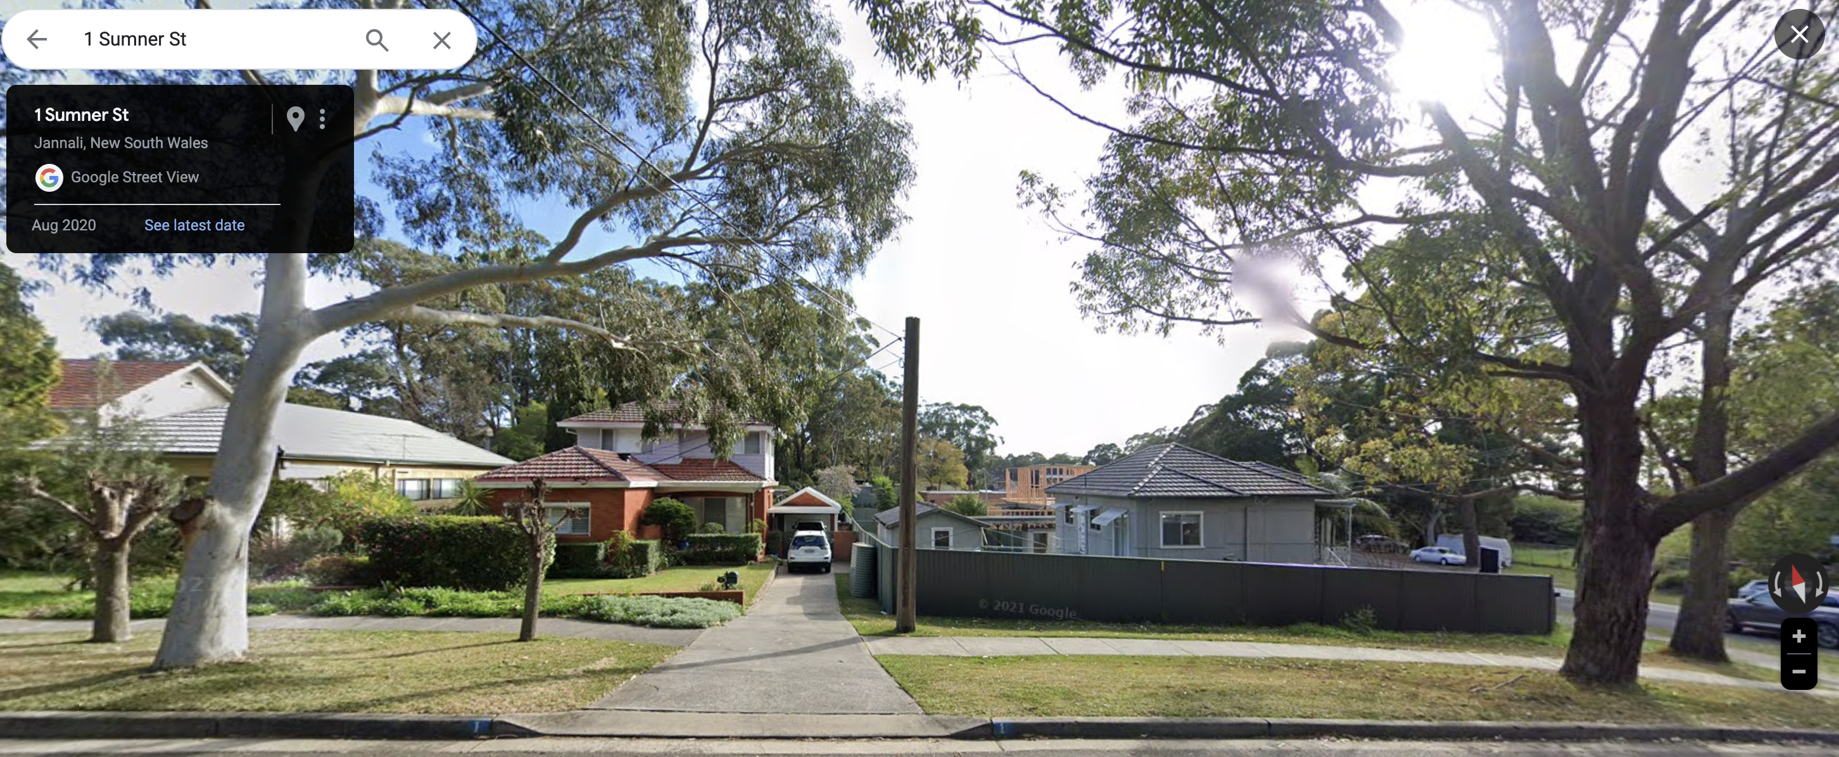
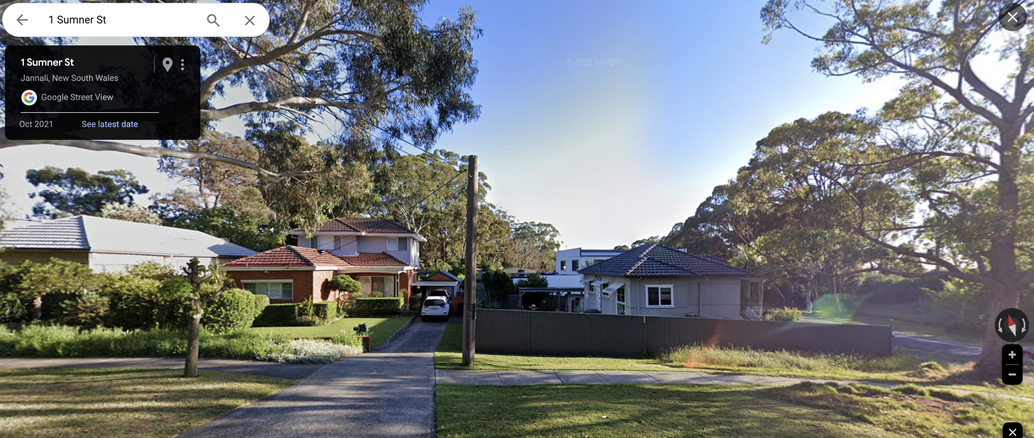

Slide 24
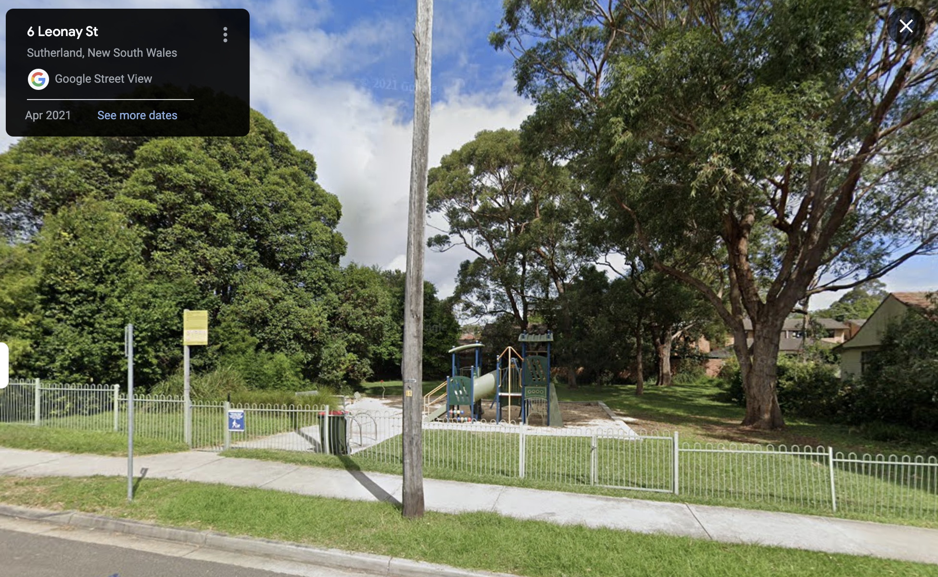
Safety trade-offs
Playground at Leonay Street, Sutherland

Slide 25
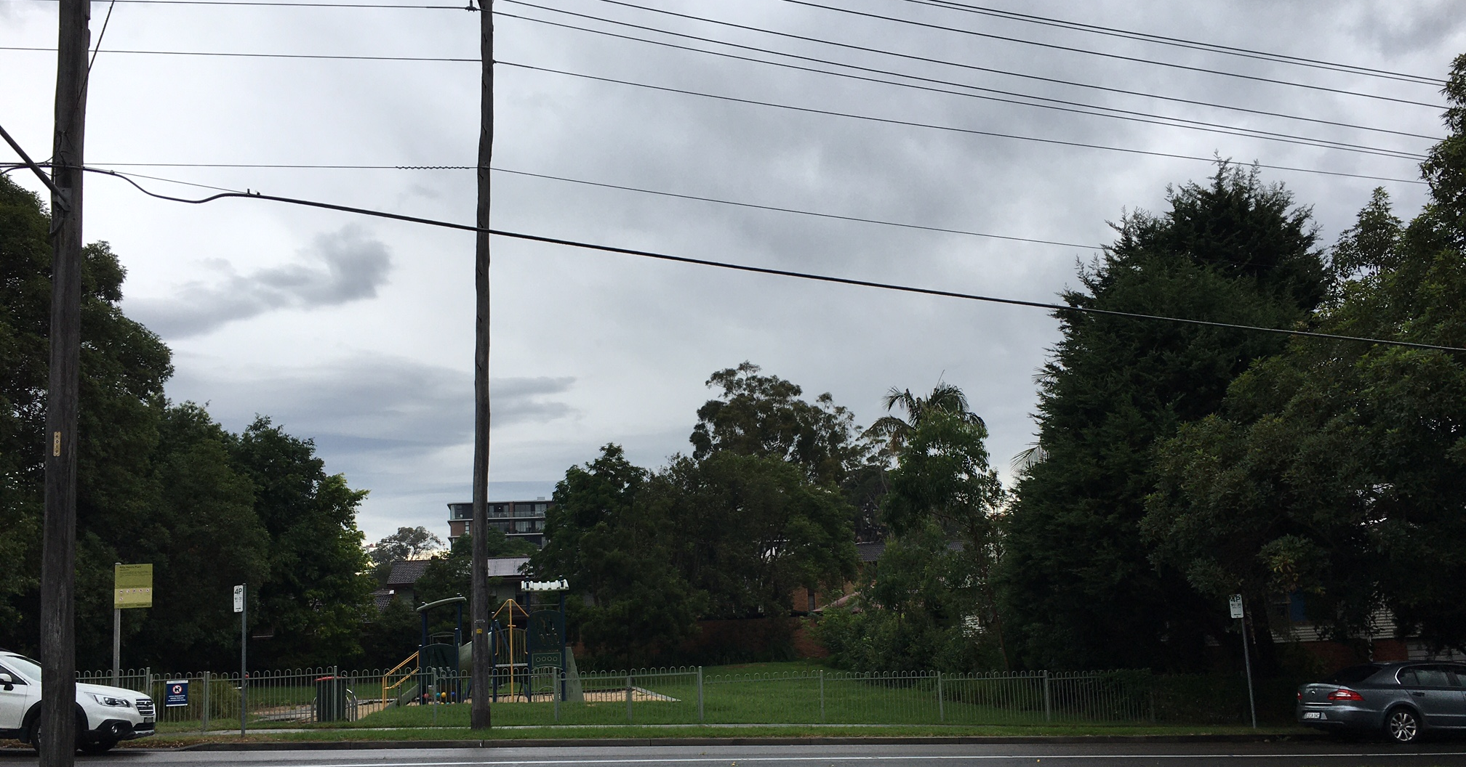
Now
Playground at Leonay Street, Sutherland

Slide 26
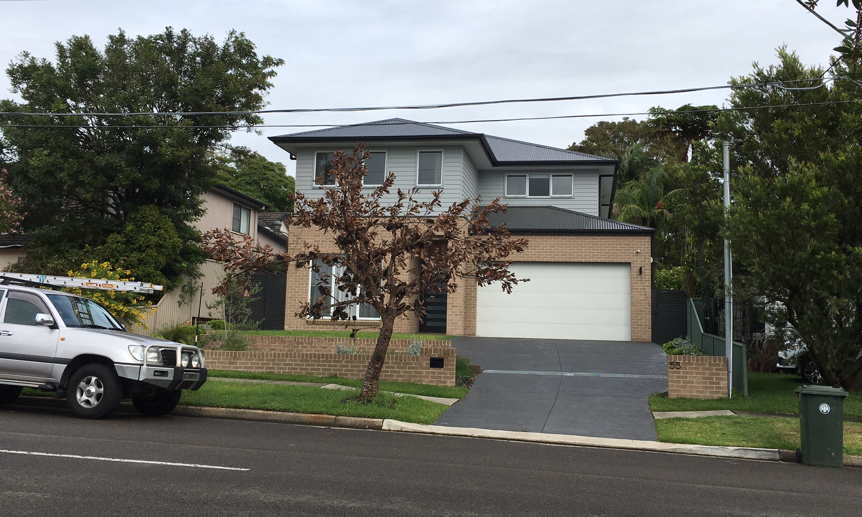
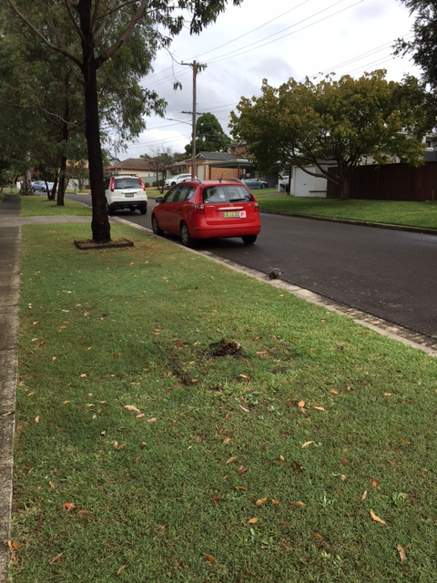
Other challenges and threats
Slow death from soil compaction, changed water flows
Natural aging of trees
Climate change: hotter and drier
Wolger St, Como
Bulumin St, Como

Slide 27
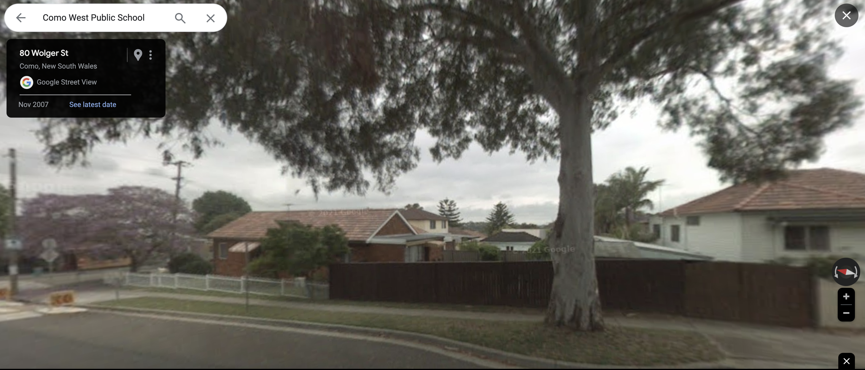
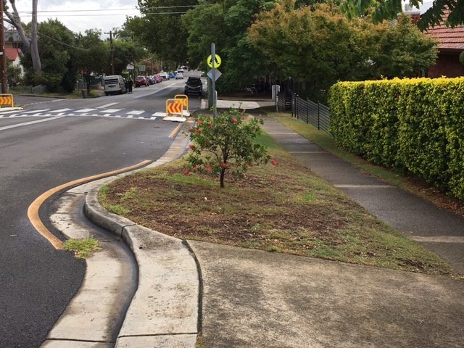
Natural aging
Como West School
Tree gone by 2013, replacement Callistemon has struggled since
March 2024

Slide 28
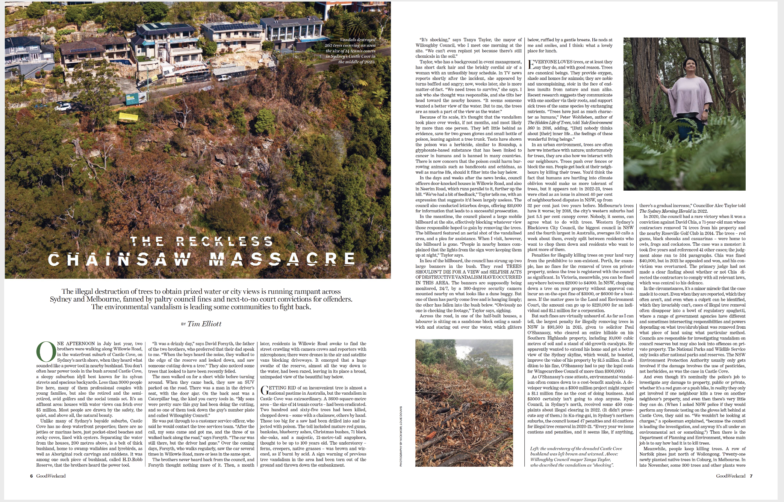
Laws about trees
For private land
  Laws rarely enforced, fines are low and rarely charged
  Need evidence
  “Falls between cracks” and “regulatory spaghetti”:
  Council, Police, EPA, DoP, NPWS
For government land
  Consultation process,
  but trees still removed
  Poor monitoring of approval
  conditions and replacements
SMH, 27 Jan 2024

Slide 29
Govt policy on trees – State
NSW Government: 5 Million Trees initiative, 2018
“The NSW government has committed to combating Sydney's heat island effect by planting 5 million trees over the next 12 years, in a bid to offset the cracking pace of development.
NSW Premier Gladys Berejiklian said the government would spend $38.7 million over the next four years on its "Five Million Trees" initiative, as part of its plan to boost Sydney's existing tree canopy from 16 per cent to 40 per cent by 2030”,
SMH 11 April 2018
“More talk than action”
  Planting not enough
  Need KPIs for survival

Slide 30
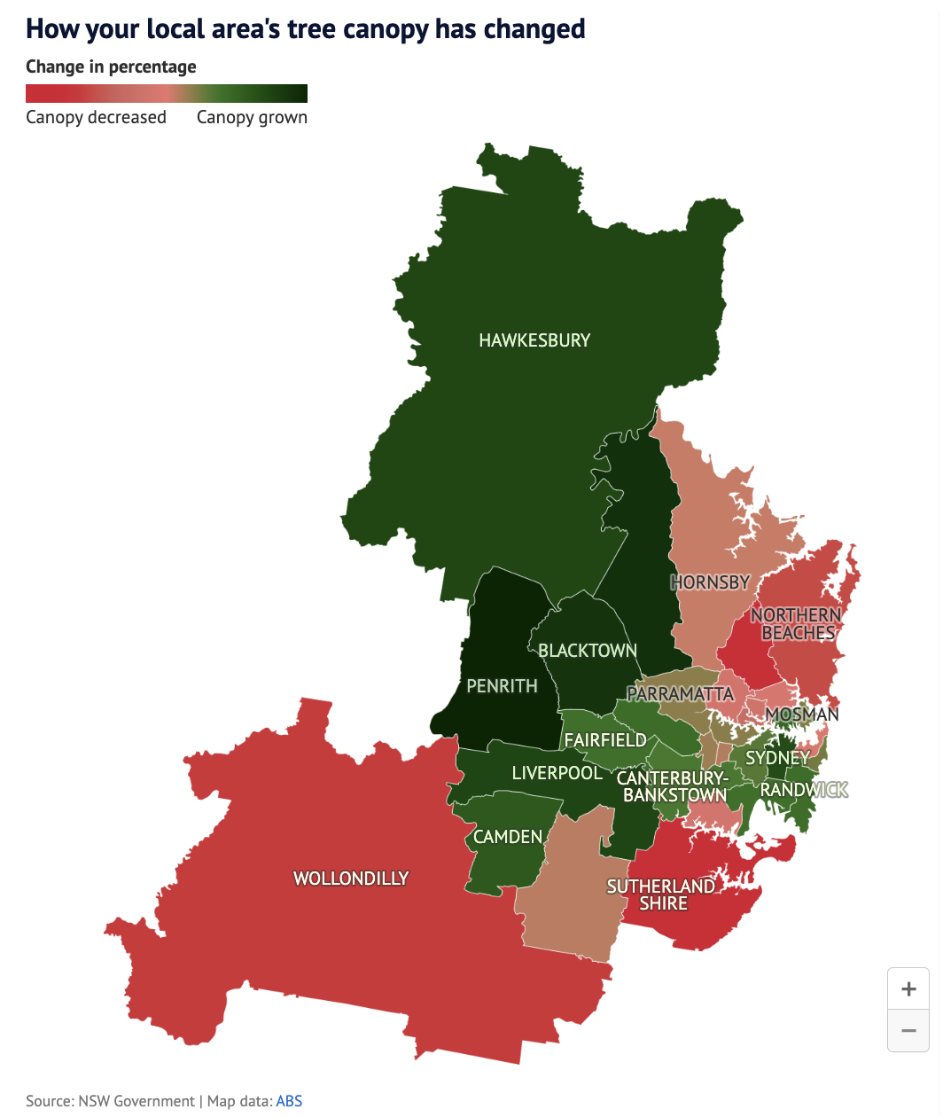
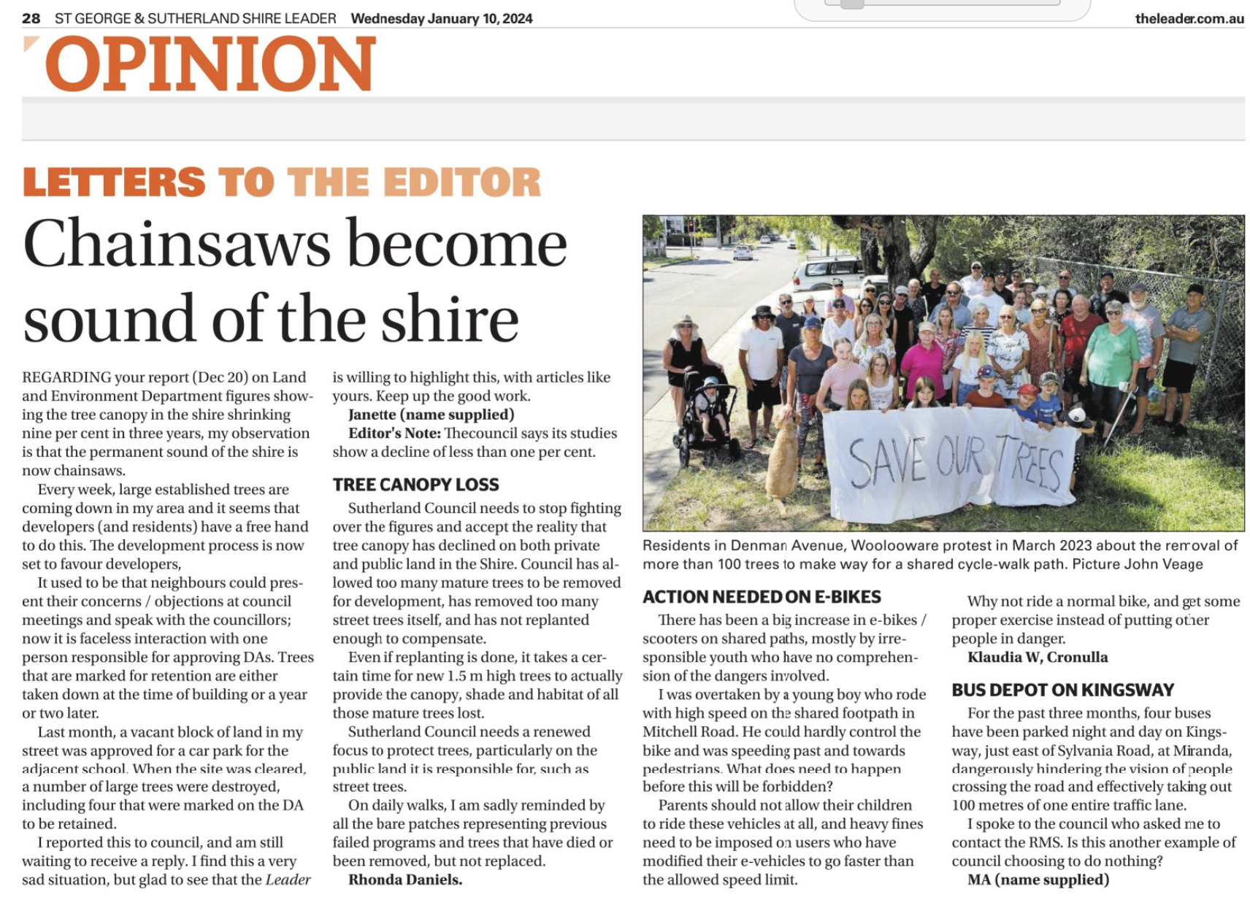
Changes in canopy cover, 2019 to 2022
Sutherland Shire
2019: 37.4%
2022: 28.6%
-8.8%
SMH, 2 Jan 2024
https://www.smh.com.au/national/nsw/sydney-s-leafy-suburbs-are-no-longer-where-you-think-20231226-p5etow.html

Slide 31

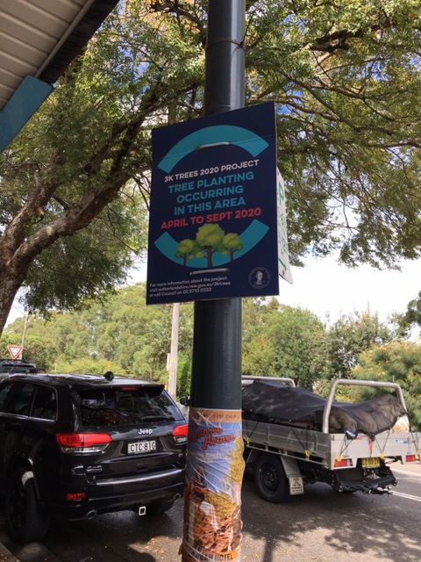
Govt policy on trees – Local
Sutherland Council
  Urban Tree and Bushland Policy,
  Nov 2021:
  “no net loss in canopy cover”
  Planting programs
  Verge garden policy
  DAs: who monitors
  and follows up conditions
www.sutherlandshire.nsw.gov.au/__data/assets/pdf_file/0010/4411/Urban-Tree-and-Bushland-Policy-and-Schedules-Adopted-November-2021.pdf
Jannali

Slide 32
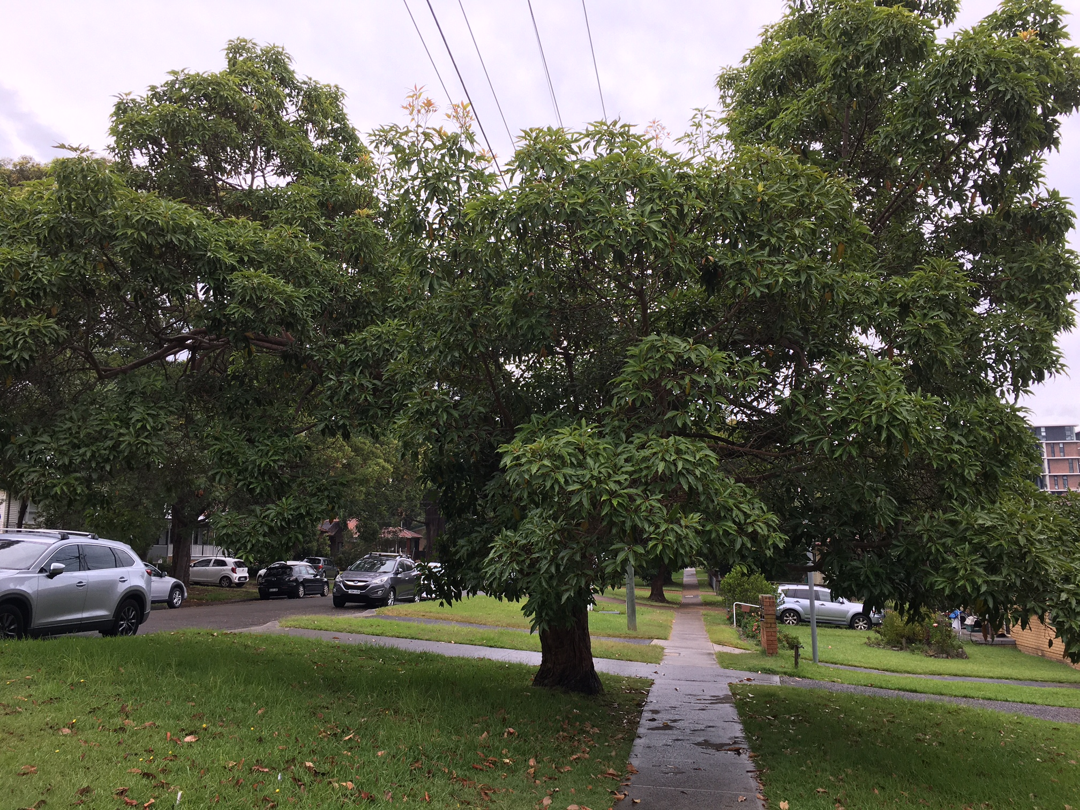
What to plant
Climate change research program
  Best trees for hotter, drier future
  Need diversity of species
  Need genetic diversity
Plant more naturally
  Plant in groups, not just a single tree in lawn
  Plant shrubs and grasses at base of trees
The very hardy and common Lophostemon confertus (brush box)

Slide 33
Taking action – People do care
Similar threats in most Council areas
Oatley Flora and Fauna
Total Environment Centre – SOS Green Spaces
+ Nature Conservation Council
Range of actions possible:
local to global, “pen or spade”
Actions through the lifecycle:
existing, new, protect to maturity, replace

Slide 34
Taking action – What we can do
For existing street trees
Protect the trees we have – protect, weed, water
Report damage or threats to Council: email or Snap Send Solve
Ensure replacements
Comment on local DAs:
sign up for Planning Alerts at https://www.planningalerts.org.au/
Improve Council’s tree policy
Lobby Councillors – see addresses on Council website
Go public – Write, use social media

Slide 35
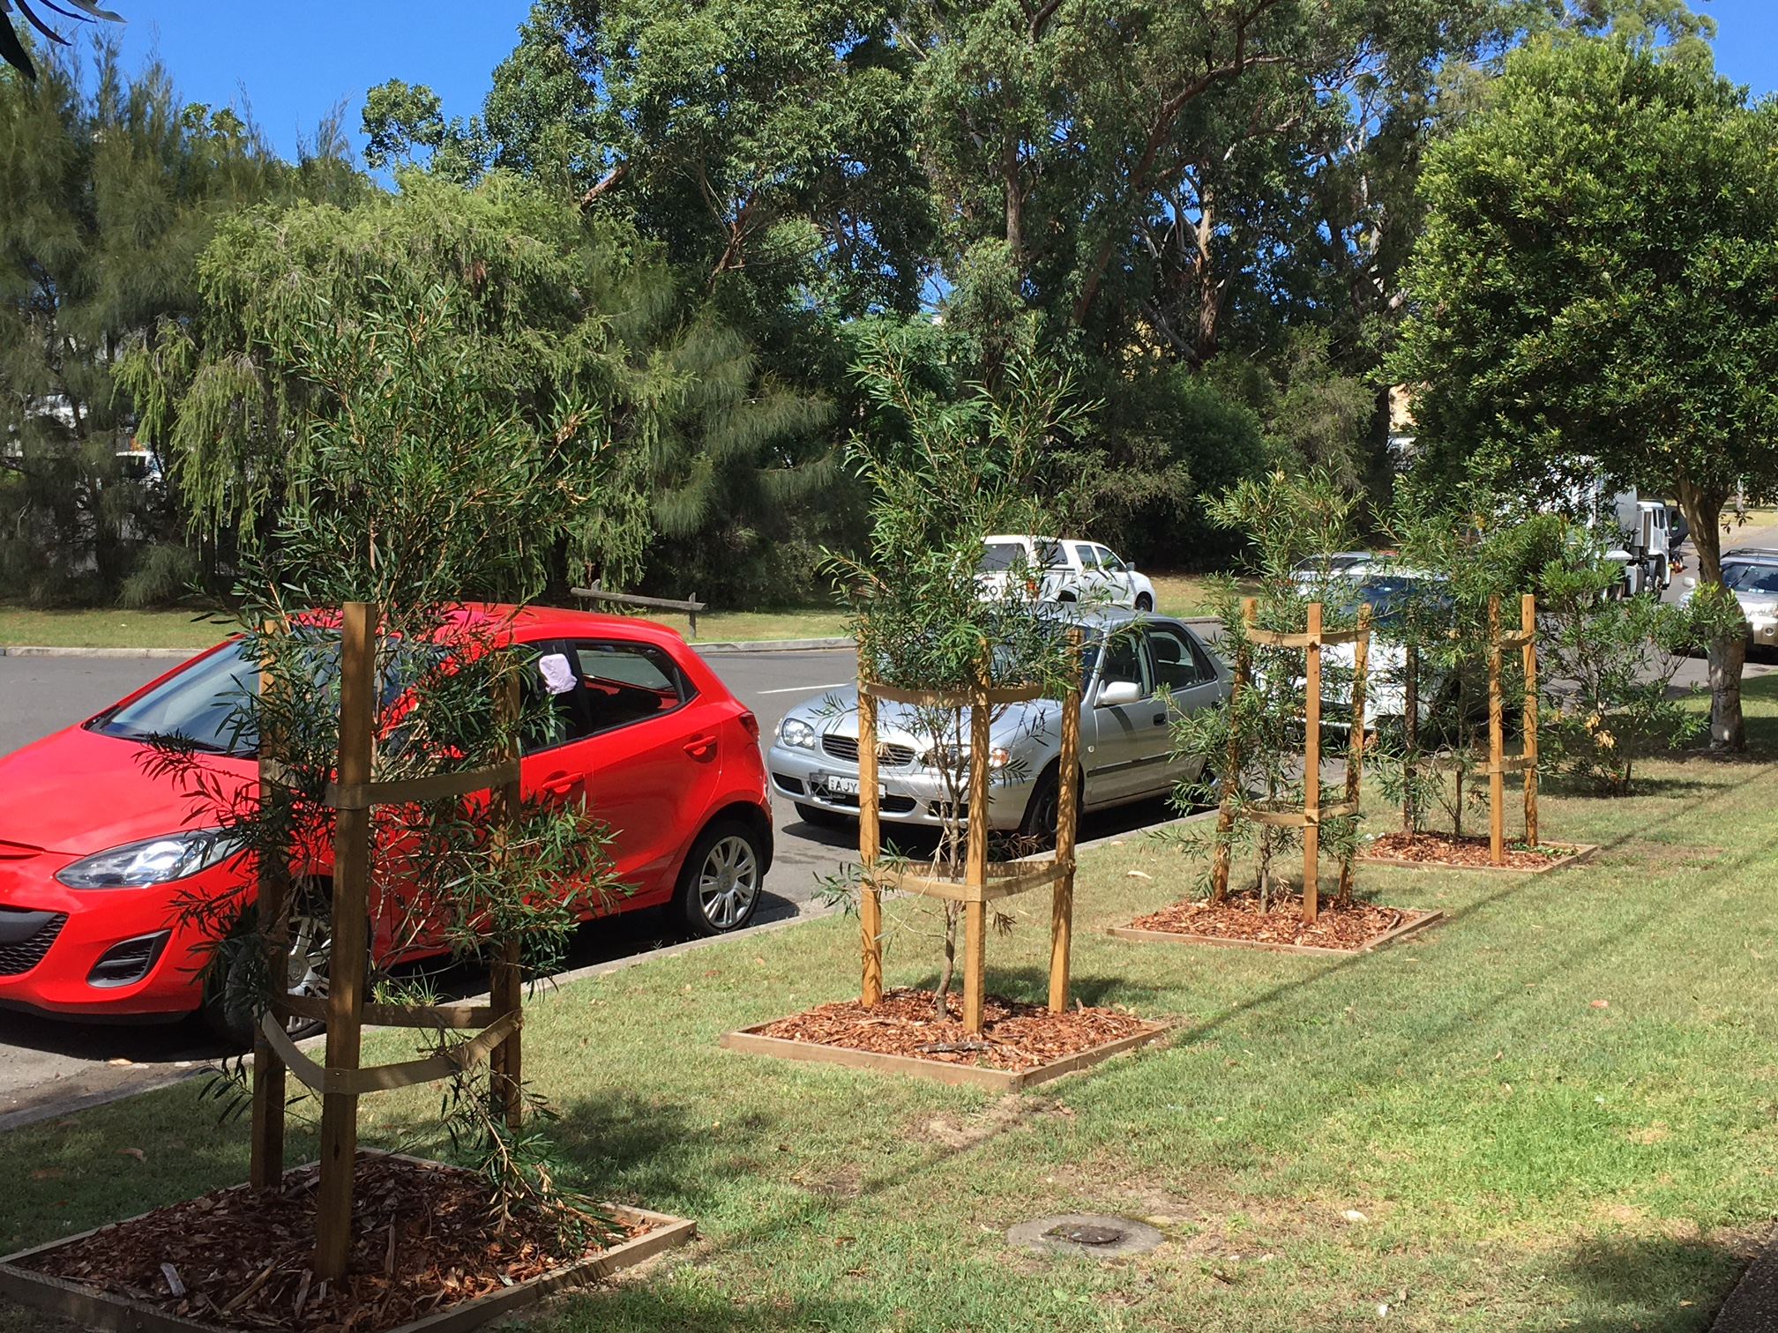
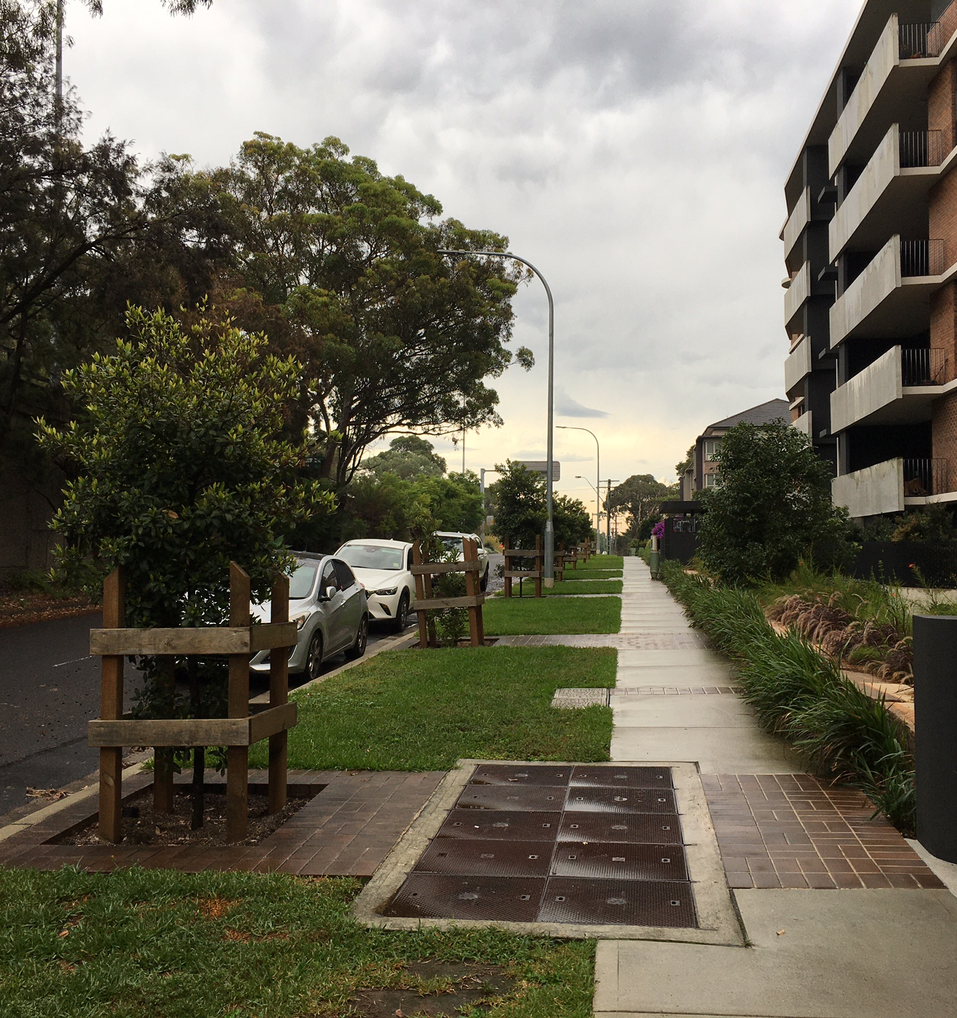
Taking action – Physically protect
Bath Rd townhouses, Kirrawee, replacement trees
Grand Vermont, Sutherland

Slide 36
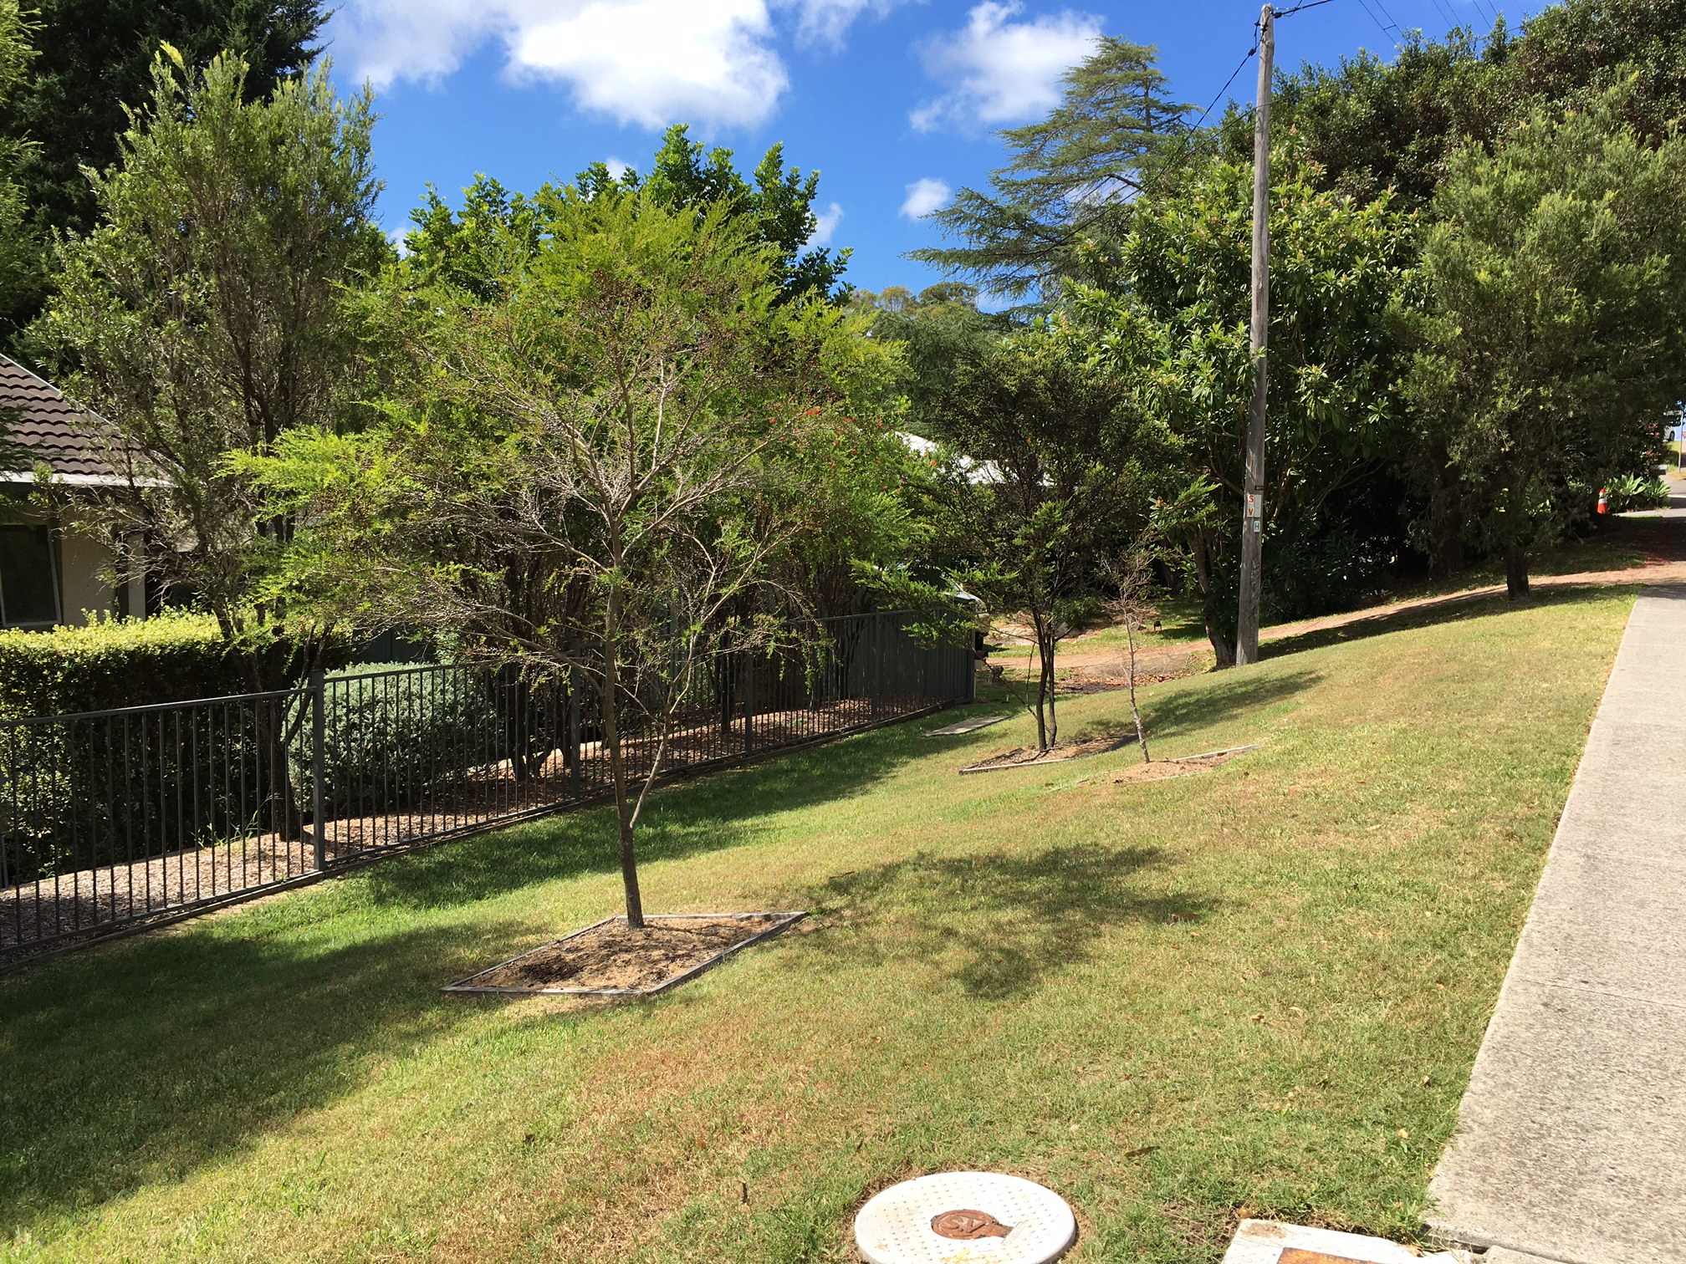
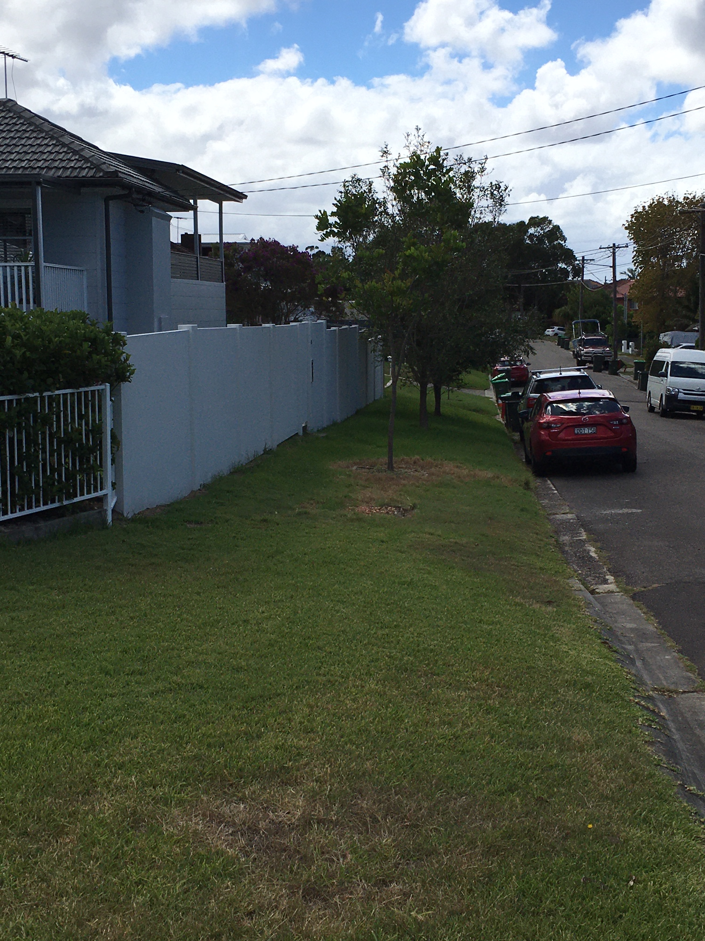


Taking action –
Replant to replace removed or dead trees
The Boulevarde, Kirrawee,
dead or missing trees

Slide 37
Taking action – What we can do
For more street trees
Strengthen street tree policy with stronger KPIs
Develop program for people to ask for street trees
Plant trees in groups
“Adopt a tree” for care and maintenance
Lobby Councillors
Go public
Soldiers Rd, Jannali

Slide 38
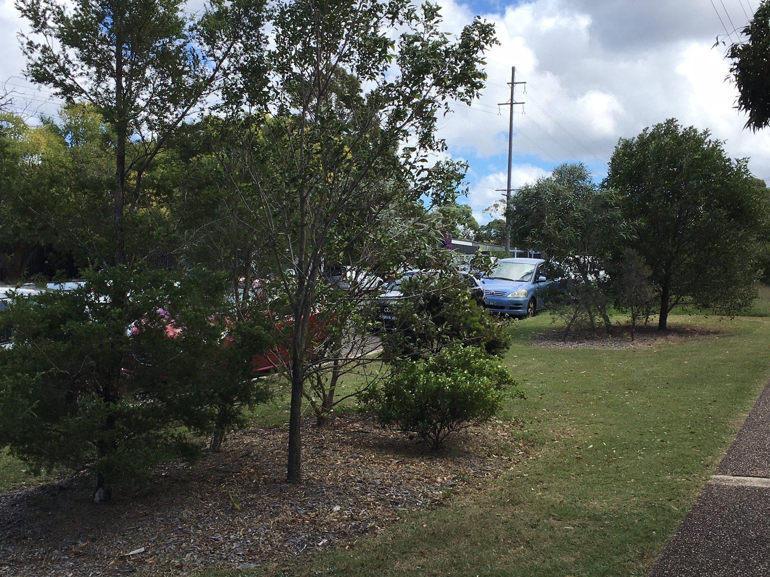
Taking action – Plant in groups
The Boulevarde, Kirrawee, replacements under power lines

Slide 39
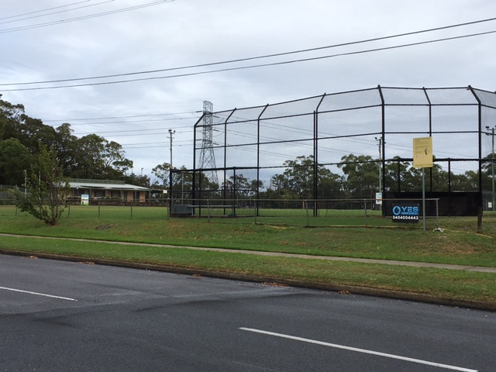
Taking action – Not just in front of houses
Cul-de-sac, The Boulevarde
and Oak Rd, Kirrawee
Soldiers Rd, Jannali

Slide 40
In summary – It’s up to US
We need to be alert to threats and take action
Take action individually or as group
Take the action that suits you – pen or spade
Treat street trees as assets
Strengthen and enforce laws protecting street trees
Protect and monitor trees
Replace lost trees promptly
Have KPIs for survival, not just planting

