Slide 1
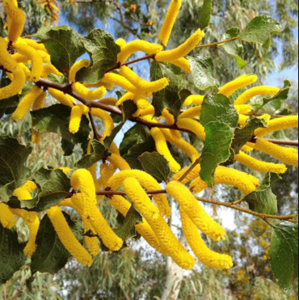
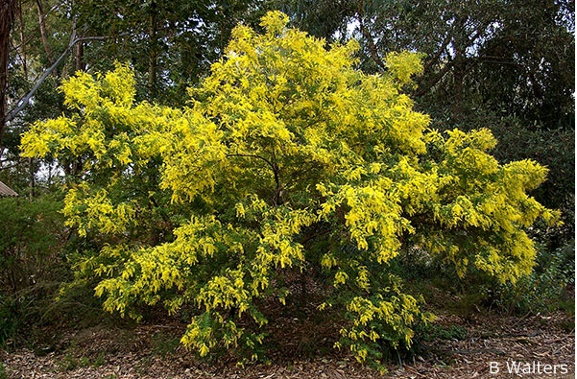
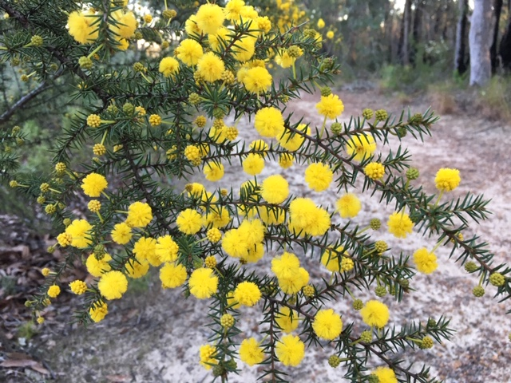

Wonderful world of wattles
Rhonda Daniels, Australian Plants Society
rhdaniels@bigpond.com

Slide 2
Outline
Acacias = wattles
Diversity of acacias
– flowers, foliage, fruit
Local acacias
Aboriginal and
cultural significance
Acacias in the garden
Acacia brownii RD

Slide 3
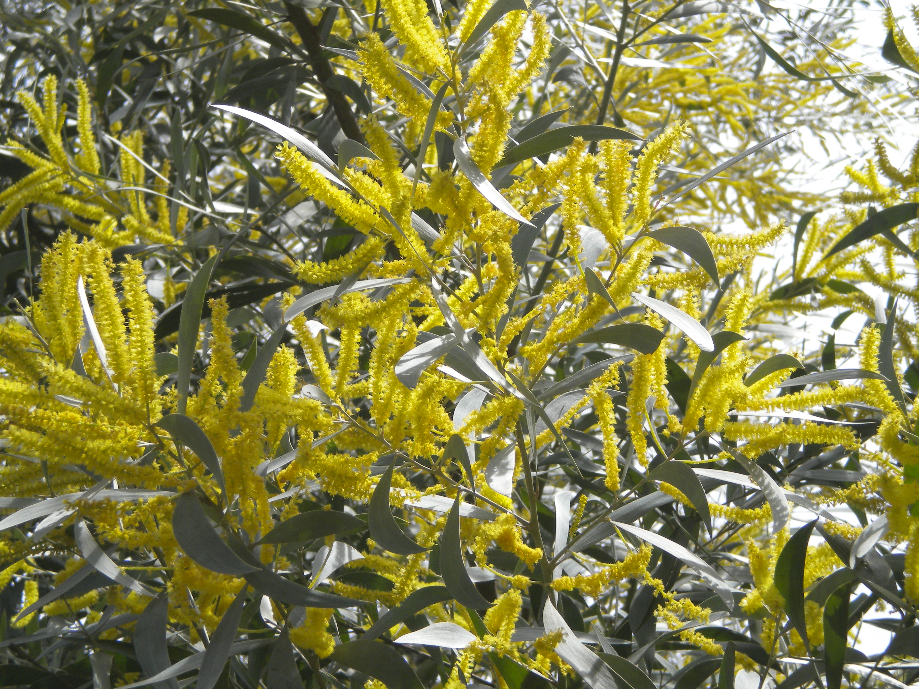
Wattles – why wonderful?
About 1,000 Acacia species in Australia
Found in most ecosystems including rainforest
Shrubs to trees
Tough, quick growing, opportunistic
Flower through the year inc winter
A blaze of bright colour
Food source
Fix nitrogen in the soil through soil
bacteria that inhabit and form
nodules on the roots
Acacia binervia RD

Slide 4
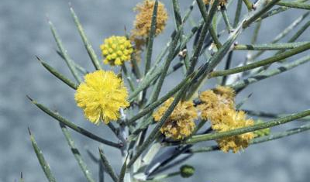
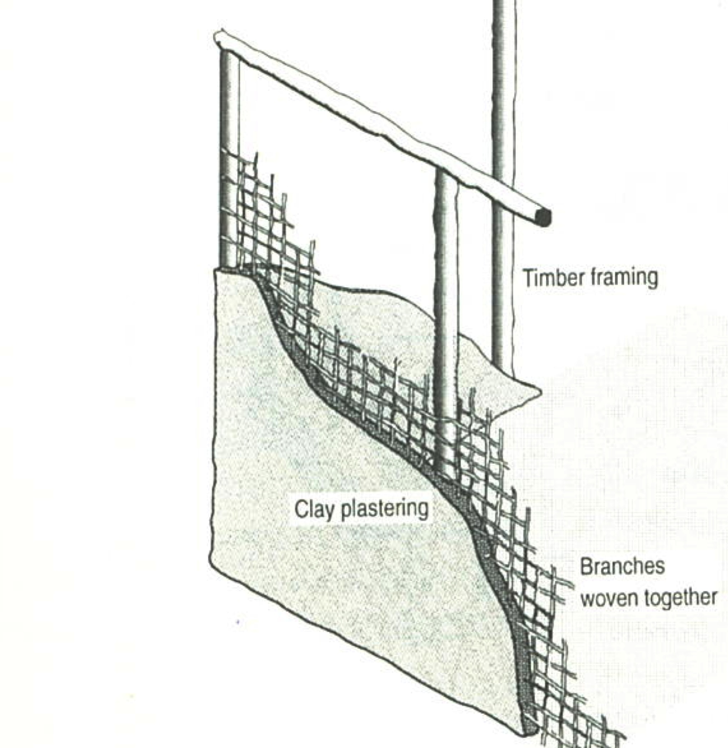
All about acacias
Acacia vs wattle
Acacia genus has a complex history – genus and family
Acacia is in Fabaceae family (subfamily Mimosoideae),
related to peas and sennas
Wattle = Anglo-Saxon word
for interwoven saplings used
in clay/plaster walls for
“wattle and daub” huts
Acacia first adopted in 1754 for an African species
Acacia derived from Greek ‘ake’ or ‘akis’, a sharp point
Acacia carneorum www.anbg.gov.au
From wattle and daub to concrete and steel

Slide 5
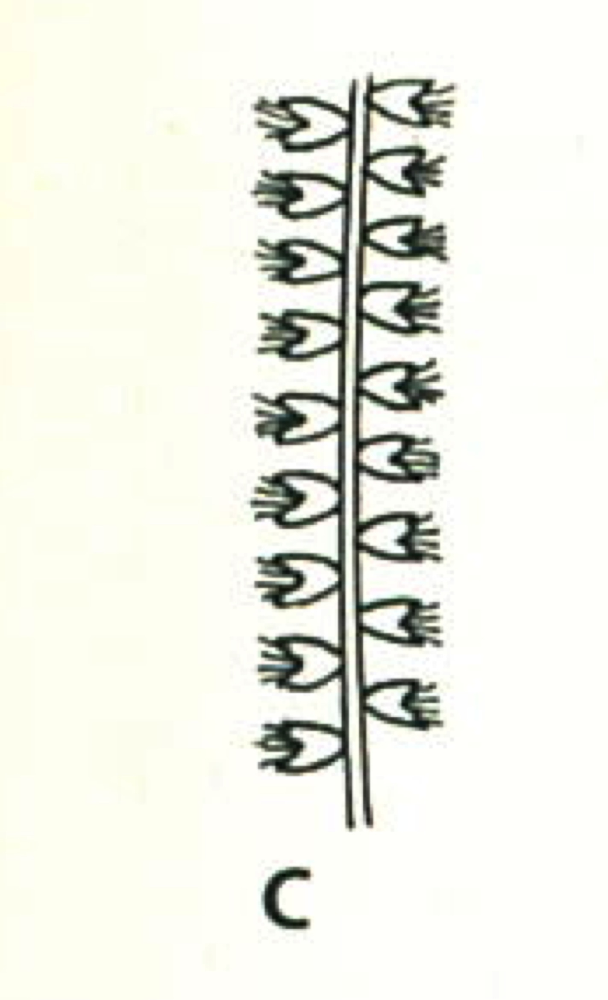
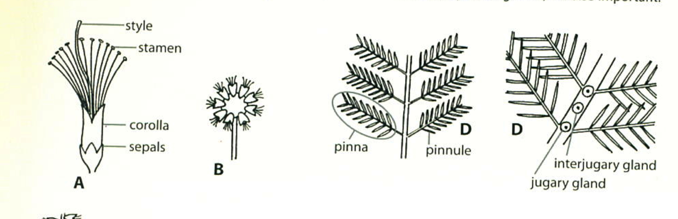
Diversity of flowers
Two types of inflorescence: ball or cylindrical spike
Cream, lemon, yellow or gold flowers
Many flower in winter, some strongly scented
Pollinated by insects
Yellow pigment
Yellow pigment of A. longifolia is a derivative of kaempferol,
a natural sunscreen which absorbs UV strongly
Stamens are yellow in normal light, but black in UV to insects
UV-absorbing pigments act to prevent UV-induced damage to genetic material in flowers
Source: Fairley and Moore
Source: Australian Plants, Autumn 2019

Slide 6
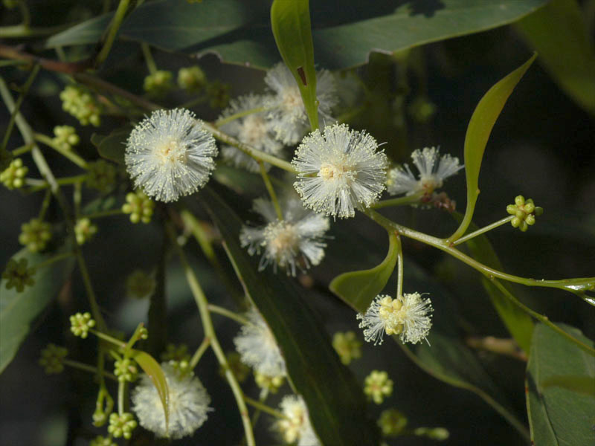
Acacia binervata Coastal Plants of RNP CD

Slide 7
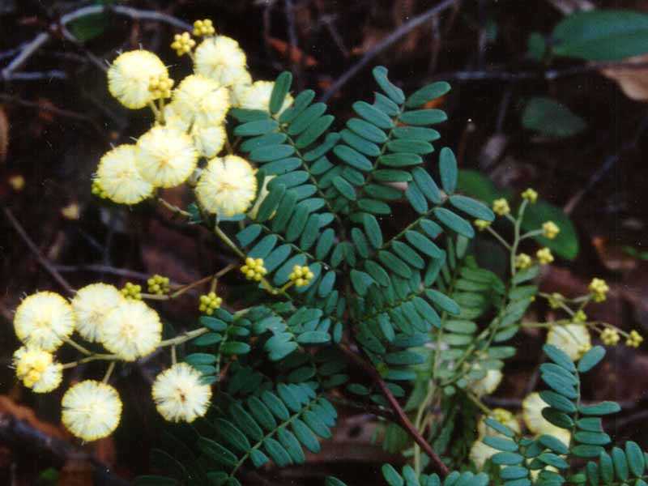
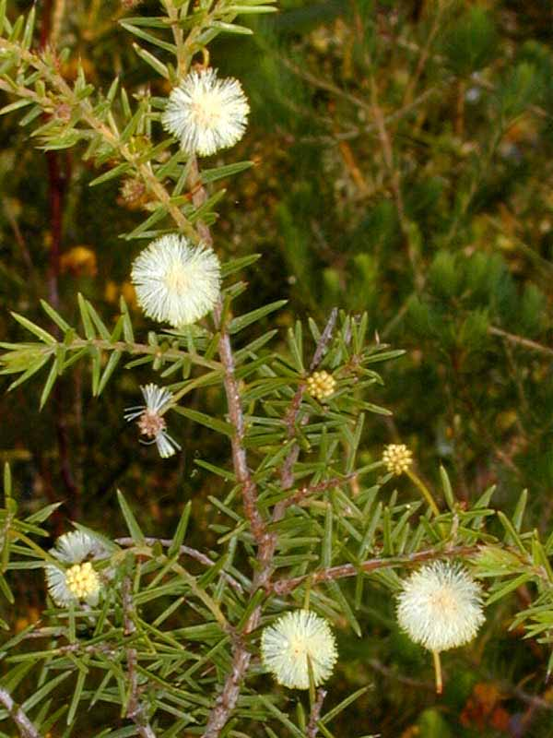
Inflorescence – ball
Acacia terminalis Coastal Plants of RNP CD
Acacia ulicifolia Coastal Plants of RNP CD

Slide 8
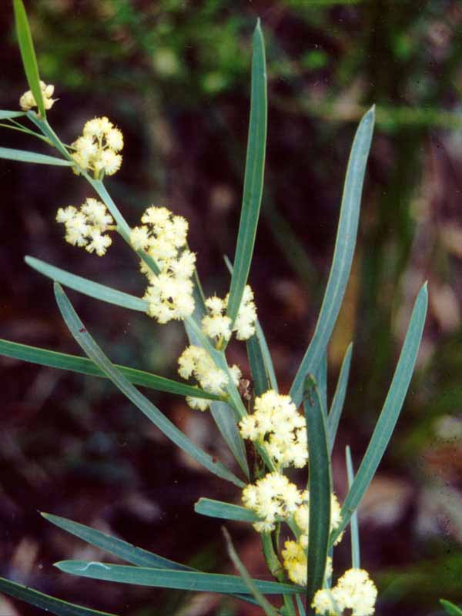
Acacia suaveolens Coastal Plants of RNP CD

Slide 9
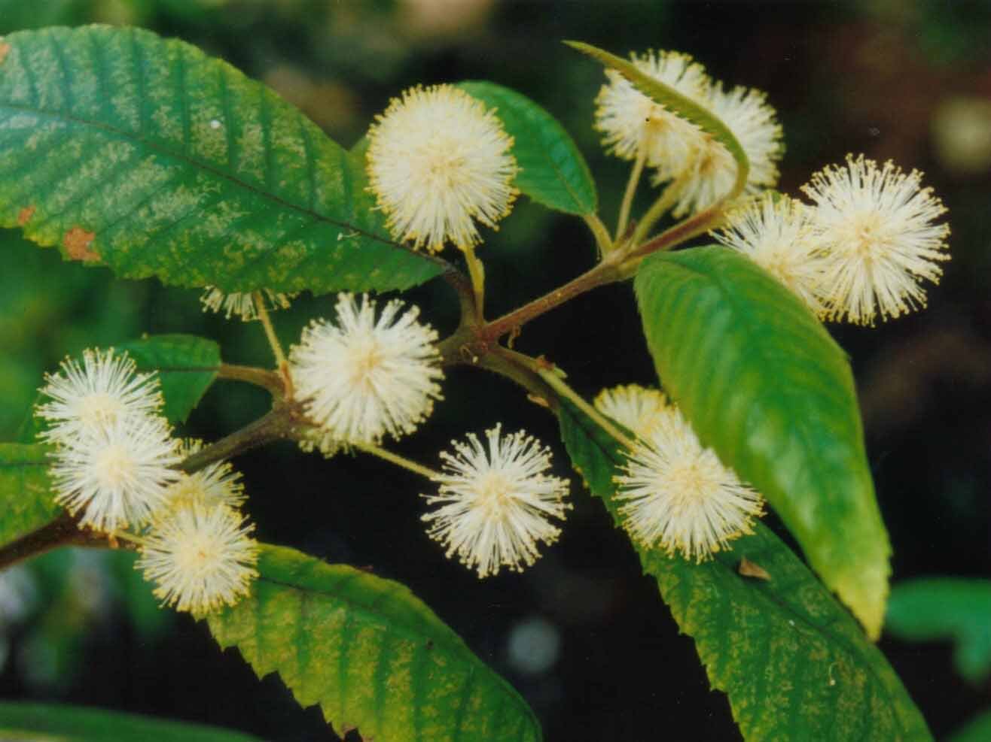
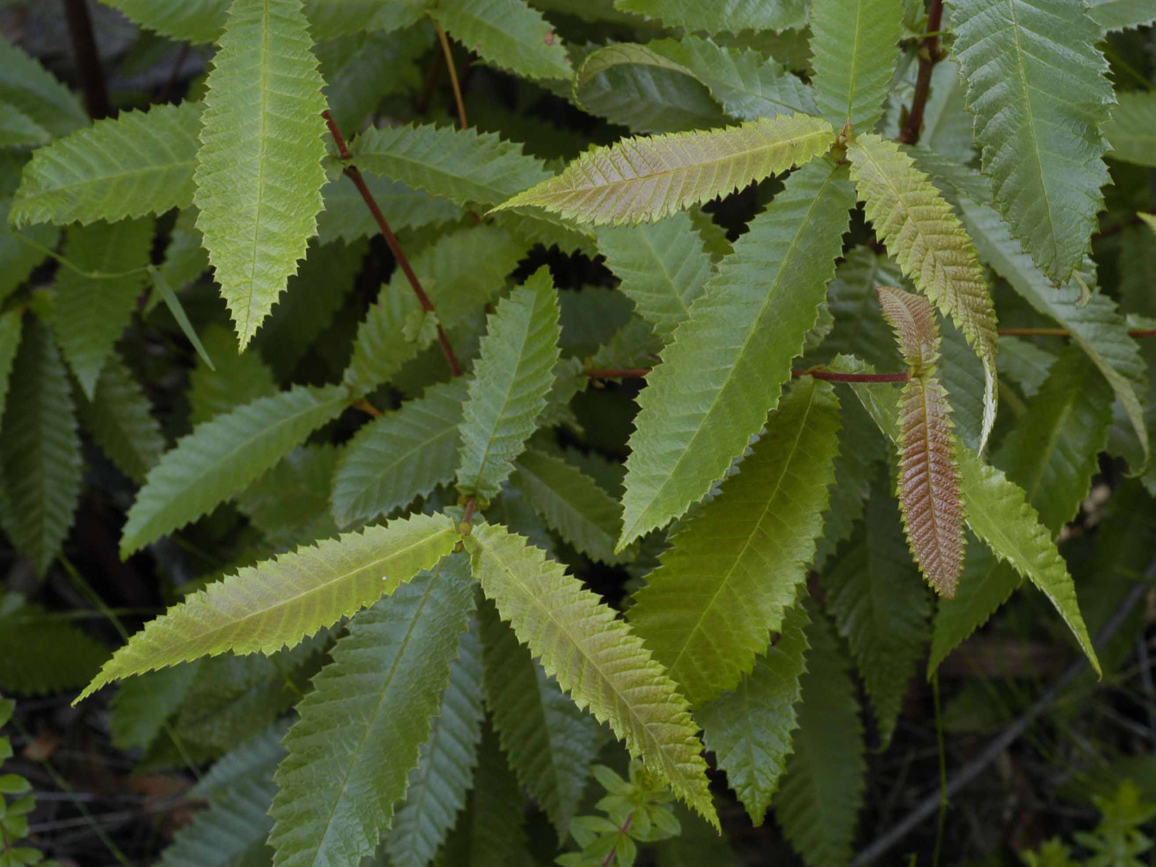
Not a wattle
Callicoma serratifolia Coastal Plants of RNP CD
(Black wattle, Cunoniaceae)

Slide 10
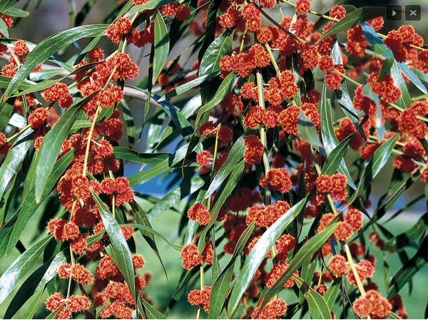
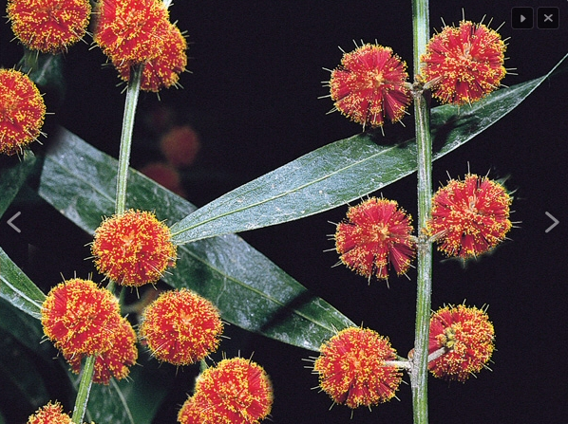
Flowers – red ball
Acacia leprosa
Acacia leprosa ‘Scarlet Blaze’
Acacia leprosa ‘Twilight Glow’
Acacia leprosa ‘Scarlet Blaze’ www.gardeningwithangus.com.au
Also
Acacia leprosa x howittii ‘Twilight Glow’

Slide 11
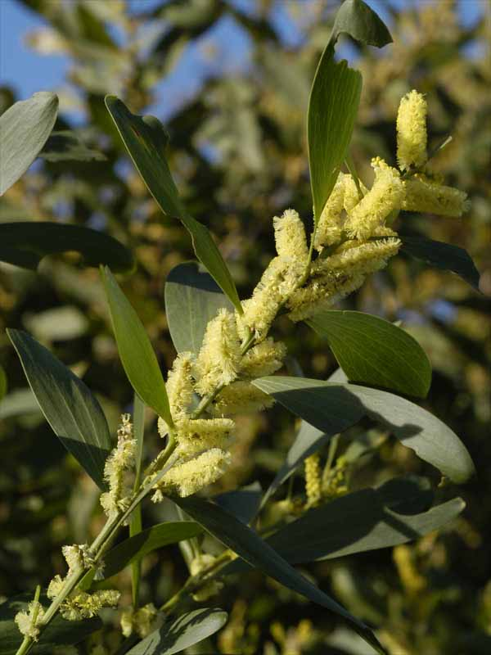
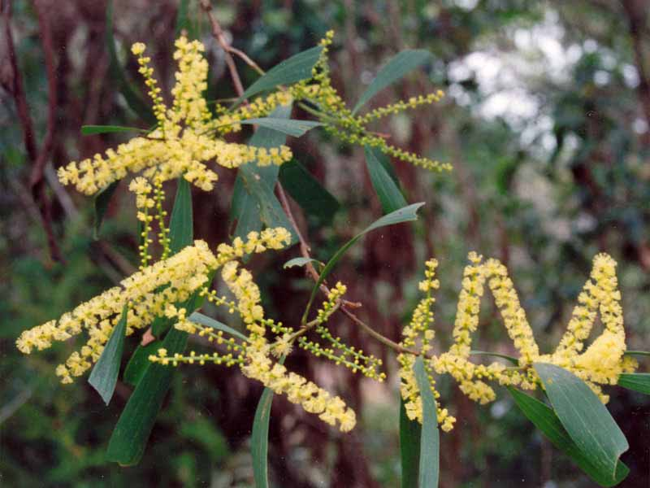
Inflorescence – rod
Acacia binervia RD
Acacia sophorae Coastal Plants of RNP CD
Acacia longifolia Coastal Plants of RNP CD

Slide 12
Acacia denticulosa (Sandpaper wattle)
Deskgram.net

Slide 13
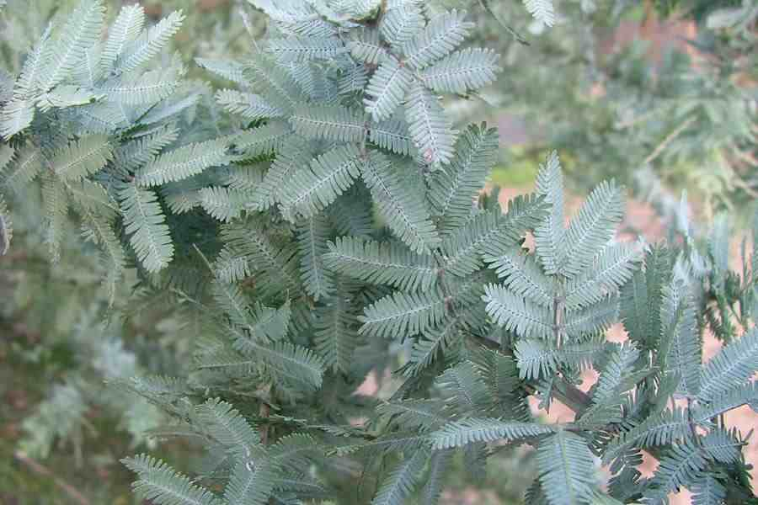
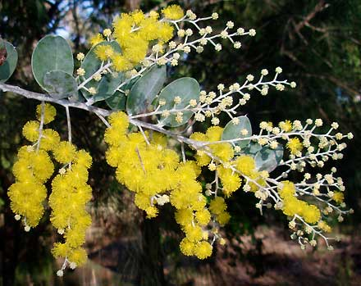
Diversity of foliage
Two groups of acacias:
  feathery bipinnate (fern-like) leaves
  leaves reduced to phyllodes which are flattened leaf stalks performing the function of leaves
All acacias have the bipinnate leaves as seedlings
Great diversity in phyllode form
Evolution
Bipinnate is ancestral form (from Africa) with many glands, but leaf vulnerable to heat and dryness
As Australia dried out, feathery wattles survived in damp, sheltered habitat
Phyllode forms evolved in dry continent
Tough to reduce evaporation, with one gland and aligned vertically
Acacia baileyana
Acacia podalyriifolia

Slide 14
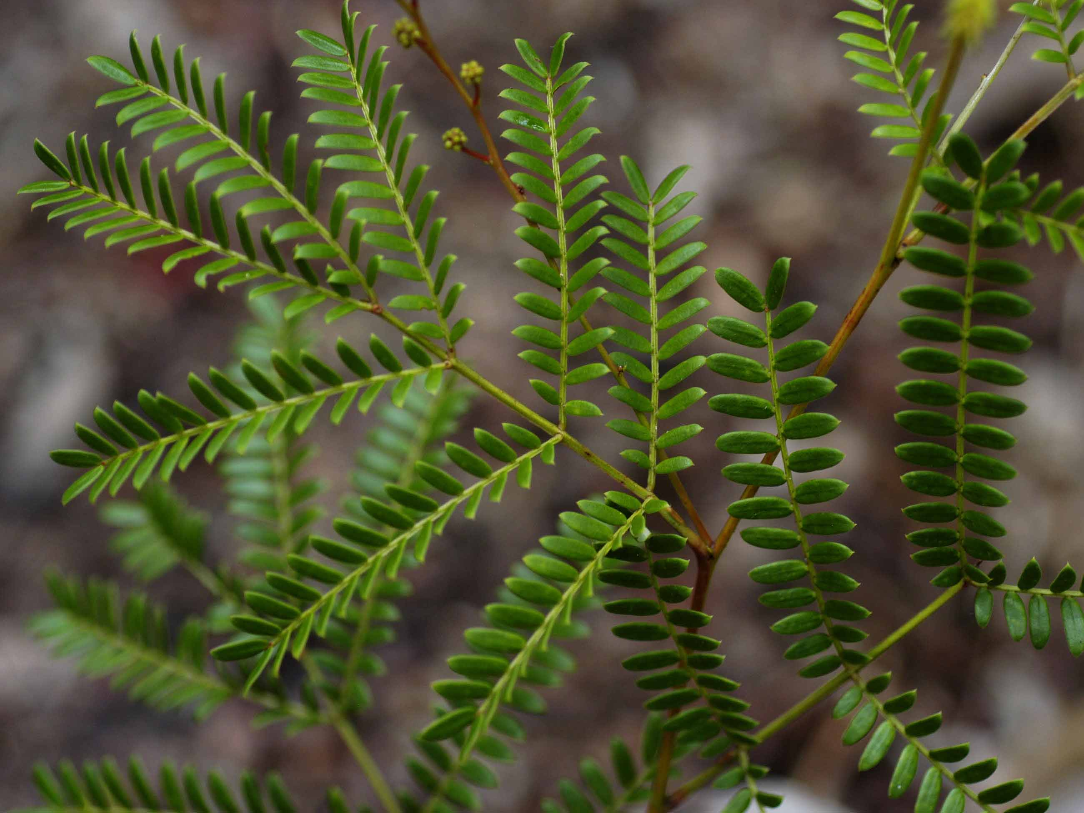
Foliage – bipinnate
Acacia terminalis Coastal Plants of RNP CD

Slide 15
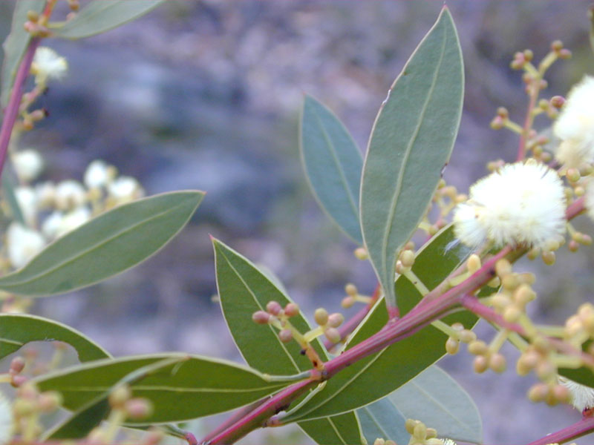
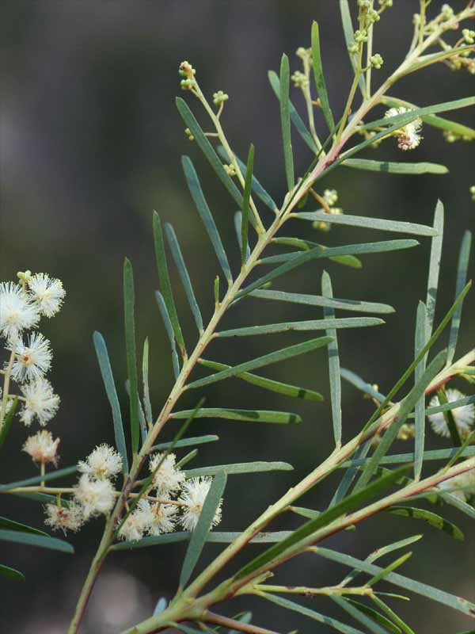
Foliage – phyllodes
Acacia ulicifolia
Coastal Plants of RNP CD
Acacia myrtifolia Coastal Plants of RNP CD
Acacia linifolia
Coastal Plants of RNP CD

Slide 16
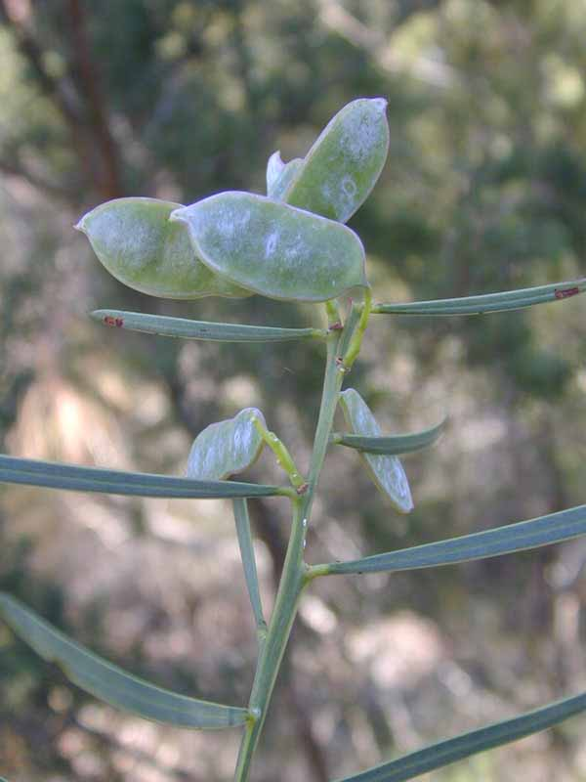
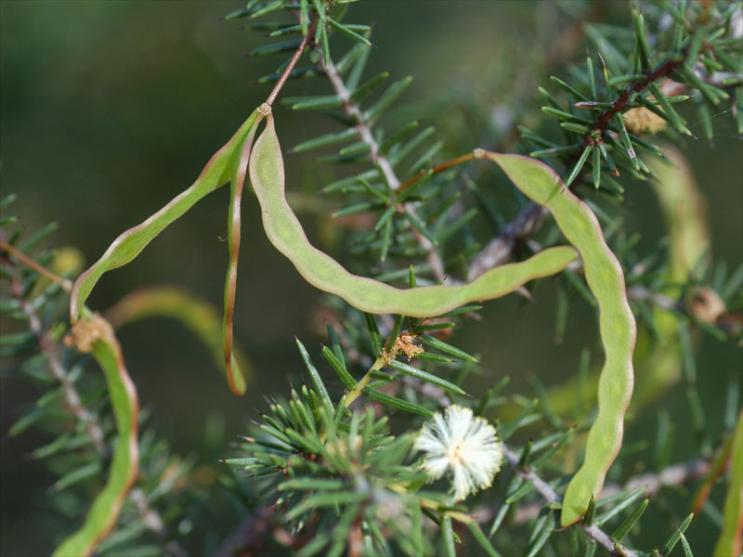
Fruit and seeds
Bean-like pods vary in size and shape
and split open when ripe
Single row of seeds
Seeds have tough coat
Seeds harvested by ants,
stored underground
Important food source for birds and people (not all seeds are edible)
Acacia suaveolens
Coastal Plants of RNP CD
Acacia ulicifolia Coastal Plants of RNP CD

Slide 17
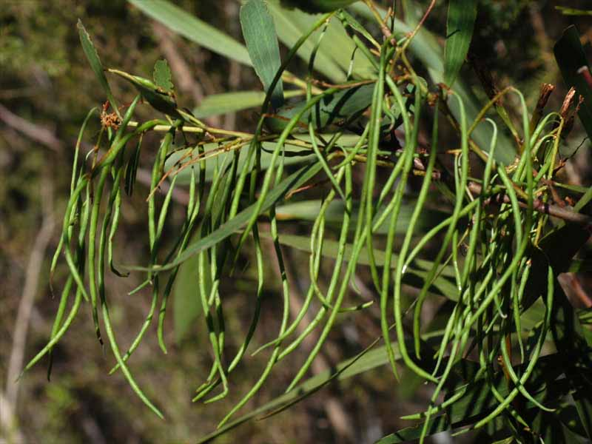
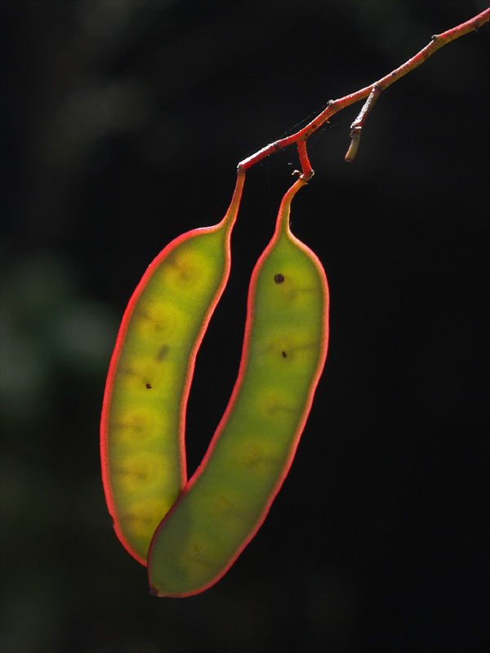
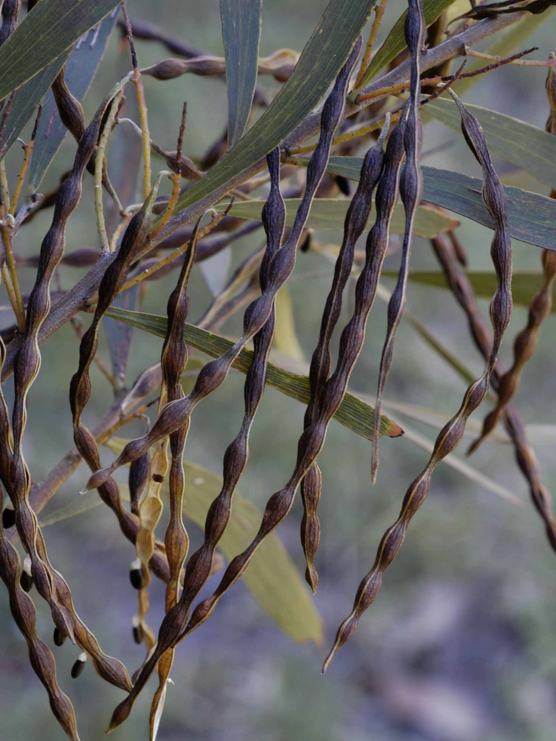
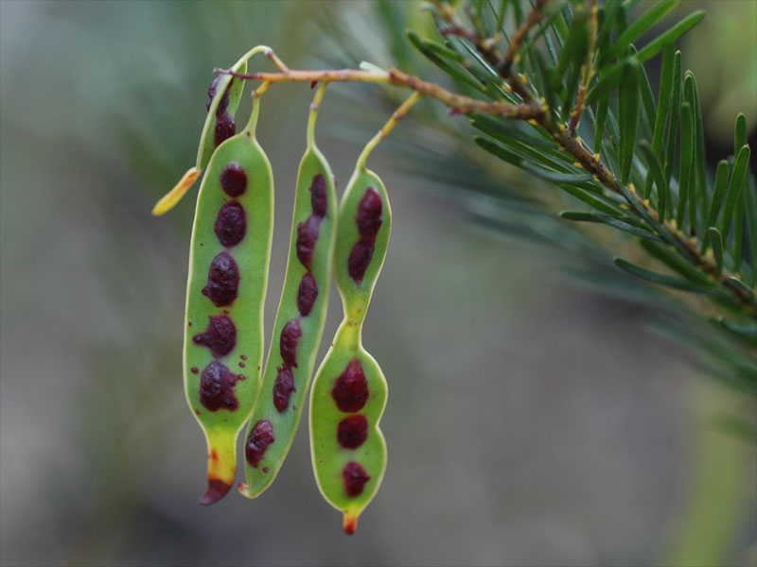
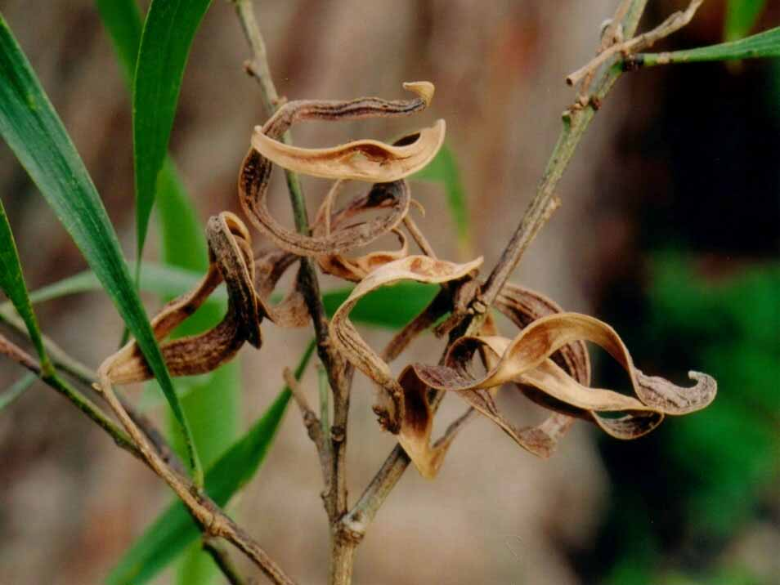
Acacia terminalis
Coastal Plants of RNP CD
Acacia floribunda
Coastal Plants of RNP CD
Acacia longifolia Coastal Plants of RNP CD
Acacia linifolia Coastal Plants of RNP CD
Acacia maidenii Coastal Plants of RNP CD

Slide 18
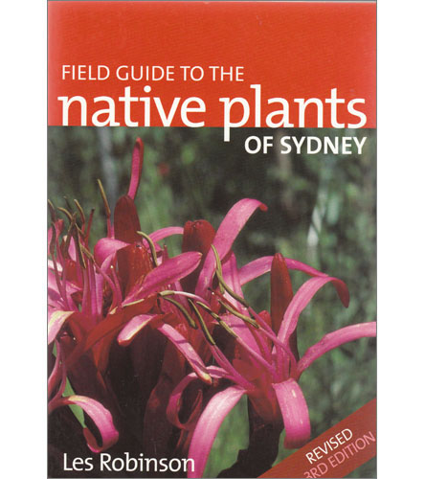
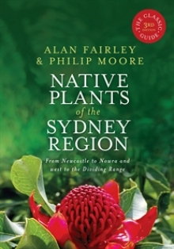
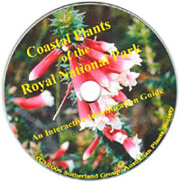
Acacias – identifying local species
Foliage: feathery or phyllode
Flower:
  Shape: ball or rod/spike
  Colour: cream/lemon or yellow
Pod: shape, colour, texture
36 species
60 species + 12
11 species

Slide 19
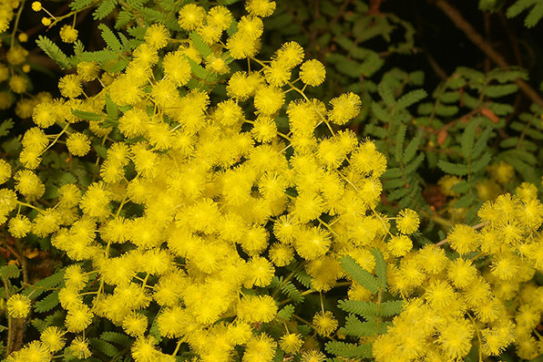
Acacia pubescens (Downy wattle)
Rare species found in open forest on clay soils
Found inner western Sydney
pubescens = finely hairy (branchlets)
Bushy shrub 1–3 m, bright yellow flowers, blueish pods
Acacia pubescens www.anpsa.org.au

Slide 20
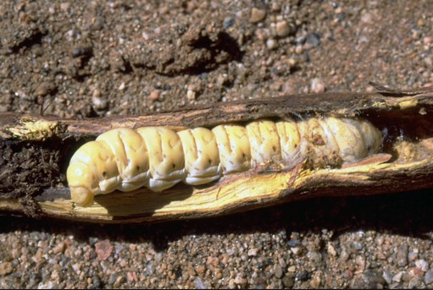
Aboriginal uses of acacias
Seeds extracted from pods ground into a flour and roasted
(check reference books before eating)
Gum from some species (eg Acacia decurrens) mixed with water and used for food (also gum arabic)
Bark and leaves thrown into water as fish poisons, with the tannins used to stupify fish
Bark and leaves used for medicinal purposes
Grubs under bark and roots eaten
– witchetty grubs (witjuri) under Acacia kempeana
Timber used for weapons and tools
www.worldwidewattle.com

Slide 21
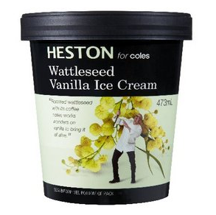
Cultural significance – other uses
Wattle saplings used to make wattle and daub huts
Bark of pinnate-leaved trees boiled in water as a tea substitute
due to the tannins
Tannins from acacias used in the leather industry:
  A. pycnantha has almost 50% tannic acid
  A. decurrens and A. mearnsii have 20–30% tannic acid
  150 kg of bark from 1 tree
Wood (eg Acacia melanoxylon) used in furniture making
Now: wattleseed flavouring for biscuits, icecream, drinks

Slide 22
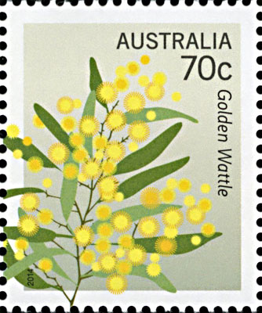
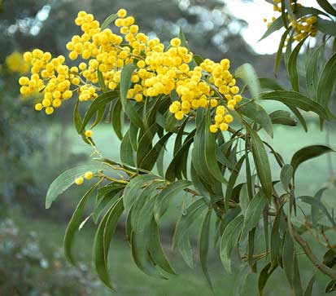
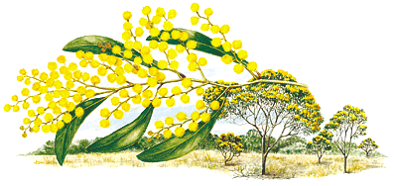
Did you know?
Our national floral emblem is Acacia pycnantha
(Golden wattle), proclaimed in 1988
Pycnantha from the Greek words
pyknos (dense) and anthos (flowers)
Widespread and important in tanning industry

Slide 23
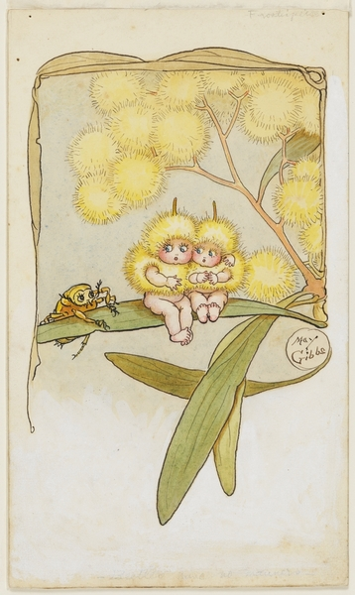
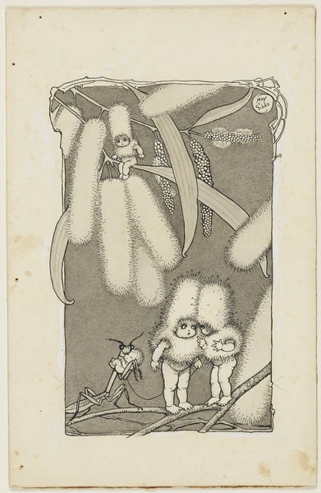
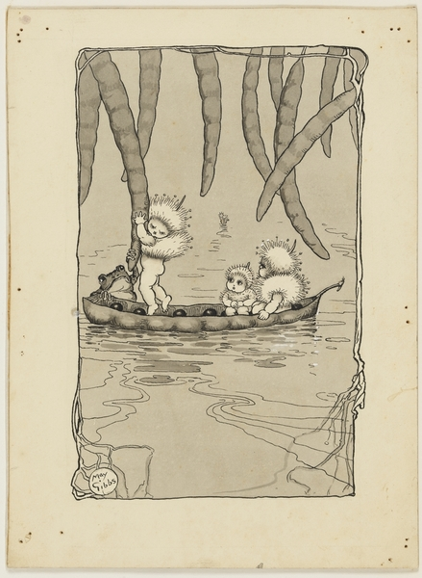
May Gibbs’ wattle babies
From State Library of NSW
Copyright: The Northcott Society and Cerebral Palsy Alliance

Slide 24

Symbols – Order of Australia
Designed by Stuart Devlin in 1975,
inspired by individual wattle blossom

Slide 25

Possibly Acacia buxifolia
www.worldwidewattle.com

Slide 26

National Wattle Day – 1 September
Floral emblem gazetted in 1988
Wattle Day declared in 1992
Wattle Day Association founded in 1998 to raise awareness of the day:
“a celebration of Australia – its land and its people”
www.wattleday.asn.au
Celebrate!
Wear a sprig of wattle
Go for a walk to enjoy local wattles
Organise a picnic, lunch, tea or BBQ
Banksia coccinea
Banksia praemorsa
Banksia menziesii
Banksia prionotes

Slide 27
Acacias in the garden
Growing acacias
Acacias are fast growing, but look out for borers
Prune after flowering
Propagating acacias
Seeds have a very hard coat and need fire or abrasion to germinate
Scarify (wear away) the seed coat with sandpaper or
pour boiling water over and soak to soften the coat
Harder to grow by cutting
Roots smell like garlic (nitrifying root bacteria nodules)
Buying acacias
Local: Sutherland Council Nursery, 345 The Boulevarde, Gymea
Cultivars: Sydney Wildflower Nursery, 9 Veno St, Heathcote

Slide 28
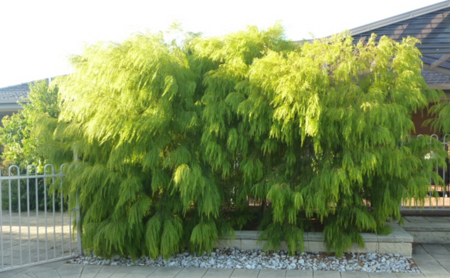
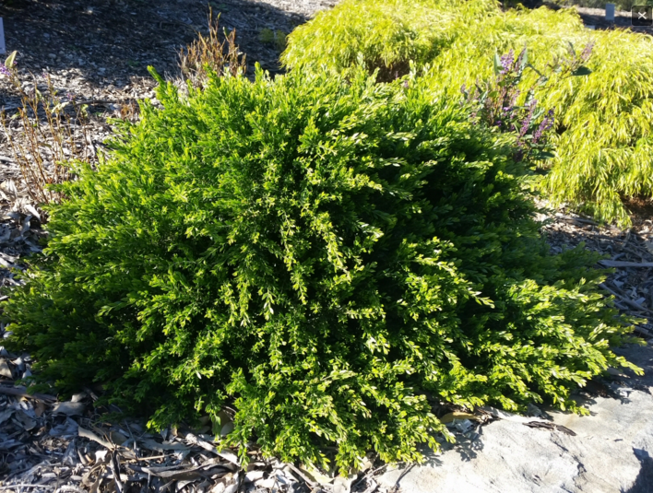
Acacias in the garden – cultivars
Acacia cognata ‘Lime Magik’
www.gardeningwithangus.com.au
Acacia howittii ‘Honey Bun’
www.gardeningwithangus.com.au
Shrubs
Acacia cognata
‘Limelight’, ‘Mini Cog’, ‘Fettucine’, ‘Green Mist’, ‘Bower Beauty’
Groundcover / Standard
Acacia cognata ‘Waterfall
Groundcover
Acacia howittii ‘Green Wave’

Slide 29
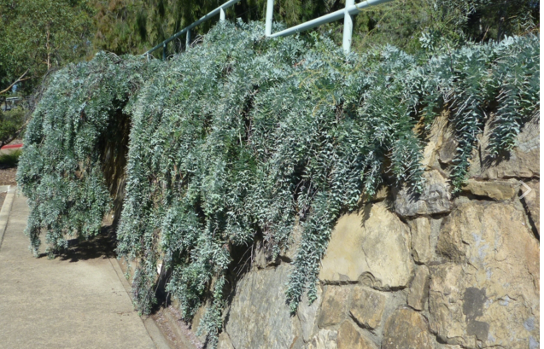
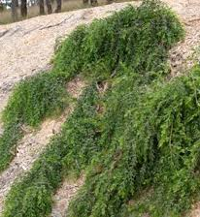
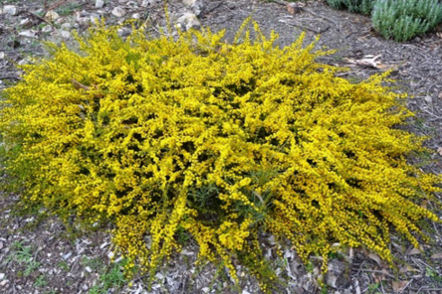
Acacia baileyana prostrate
www.gardeningwithangus.com.au
Acacia howittii ‘Green Wave’
www.bushlandflora.com.au
Groundcovers
Acacia saligna ‘Springtime Cascade’
Acacia cultriformis ‘Cascade’
Acacia amblygona www.austplants.com.au

Slide 30
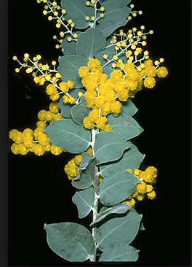
Too common!
Banksia coccinea
Acacia podalyriifolia www.anbg.gov.au
(Queensland silver dollar wattle)
Acacia baileyana (Cootamundra wattle)
Banksia praemorsa
Banksia menziesii
Banksia prionotes

Slide 31
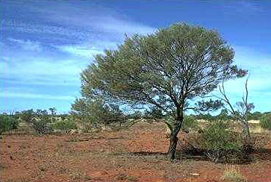
Myths
False: Acacias cause allergies
Fact: Acacias have large, sticky, heavy pollen which is dispersed by insects, not blown by wind, and is unlikely to cause allergies
People may be sensitive to fragrant oils
False: Acacias are too short-lived for gardens
Fact: Fast-growing, provide canopy and ecosysem, subject to borers
Fact: Acacia aneura (mulga) is very long lived
Acacia aneura (mulga wattle)

Slide 32
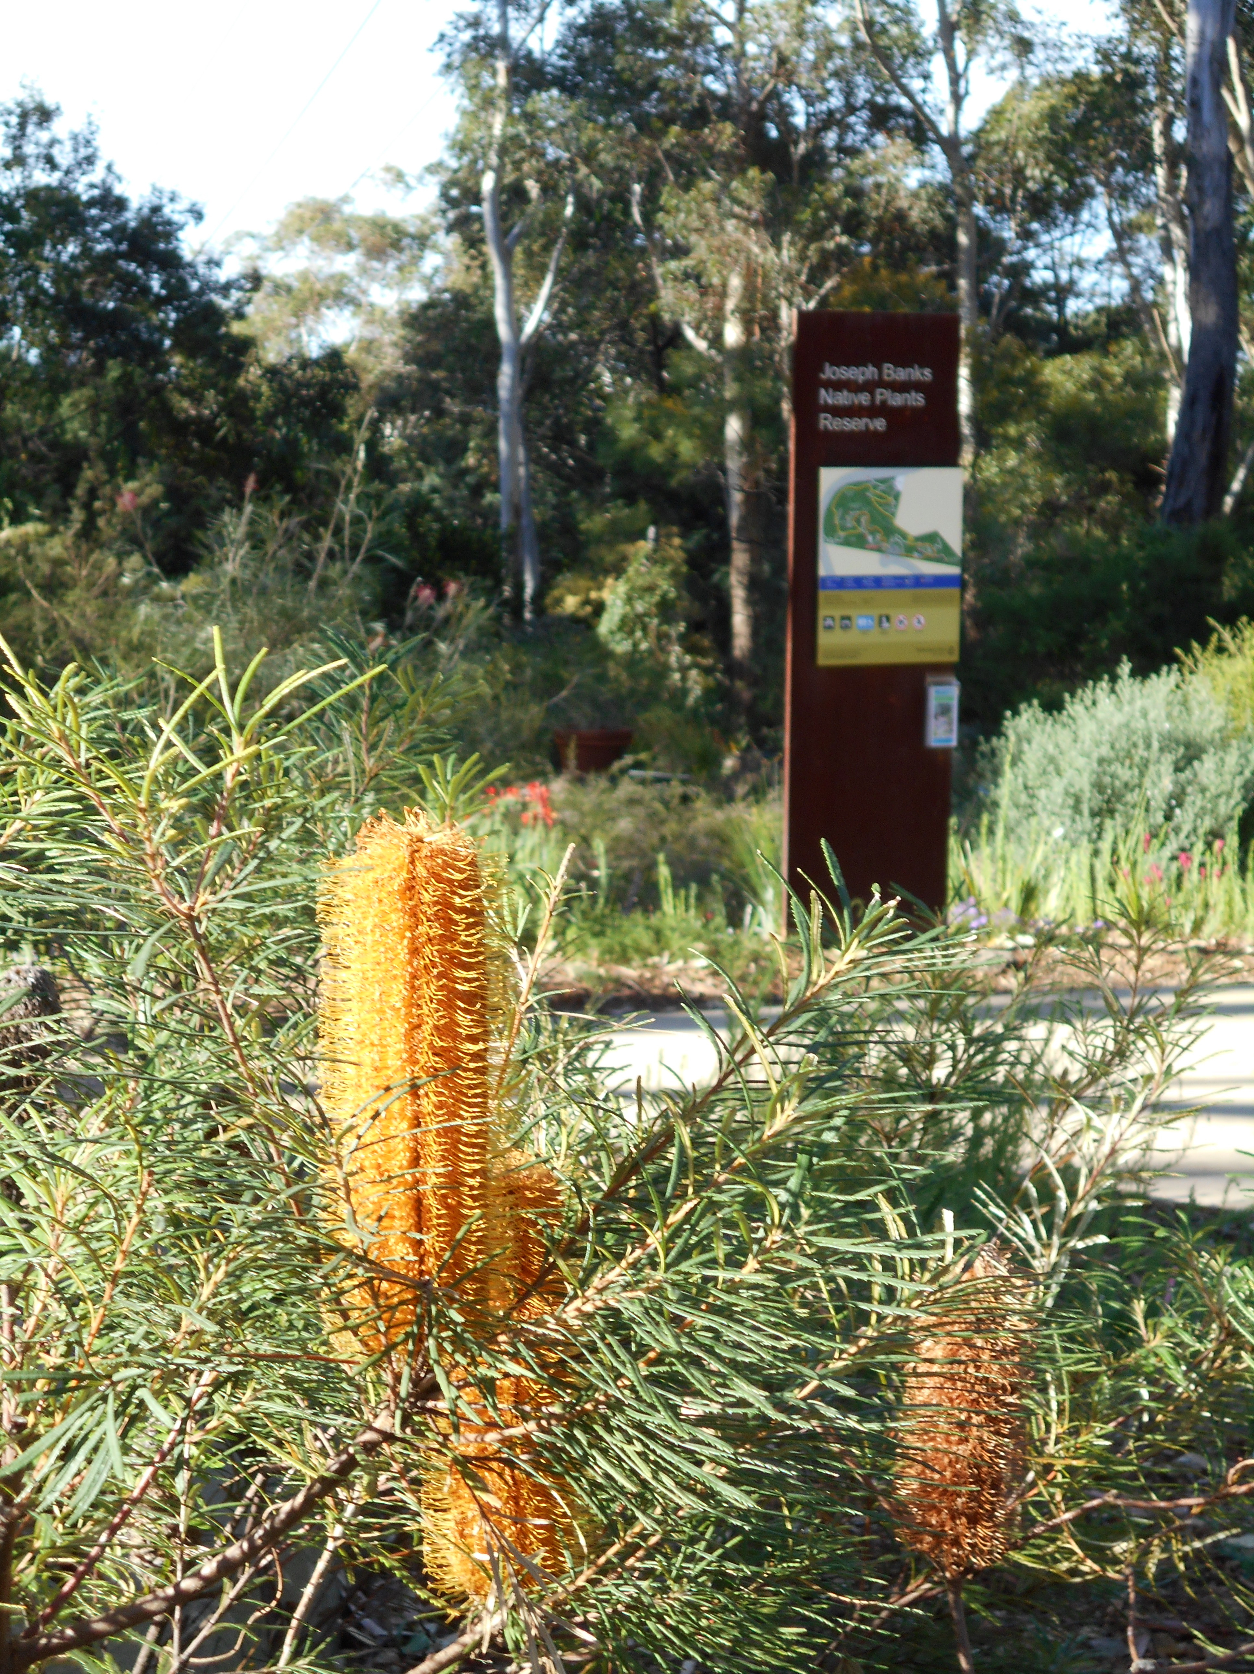
Joseph Banks Native Plants Reserve, Kareela
Established in 1969 by Sutherland Council as a Cook bicentenary project 1770–1970
50th anniversary in 2020
Named after Sir Joseph Banks,
naturalist and patron of the sciences
Acacia garden plus natural areas
with labelled plants
Similar reserves established at similar time:
  Sylvan Grove at Picnic Point
  Stony Range at Dee Why
  Ku-ring-gai Wildflower Garden

Slide 33

Ralph Cartwright

Slide 34



Acacia garden
Acacia triptera (spurwing wattle)
wikipedia
From APS East Hills newsletter May 2018
Acacia aphylla (leafless wattle) wikipedia
2014
Acacia macradenia (zig-zag wattle)

Slide 35




Acacia fimbriata
Acacia podalyriifolia
Acacia macradenia
35

Slide 36

Acacia glaucoptera RD

Slide 37
Acacia binervia RD

Slide 38

Acacia fimbriata RD

Slide 39


More on acacias
Acacia Study Group of the Australian Native Plants Society (Australia) with regular newsletter FREE www.anpsa.org.au
Hitchcock, M. (2012) A Celebration of Wattle: Australia’s National Emblem.
Robinson, L. (2003) Field Guide to the Native Plants of Sydney, Kangaroo Press.
WATTLE version 3 (2023)
interactive identification online + app $9.95, https://apps.lucidcentral.org/wattle
www.worldwidewattle.com (WA Herbarium)
Coastal Plants of Royal National Park CD-Rom (2006) Australian Plants Society Sutherland

Slide 40
Amazing acacias!
1,000 species in Australia + cultivars = there’s one for every spot
2 types of flower arrangements and 2 types of foliage
Our national floral emblem is Acacia pycnantha
Celebrate Wattle Day on 1 September
Acacias unlikely to cause allergies as pollen is dispersed by insects
Acacias are fast growing and good for gardens
Have a closer look at an amazing acacia near you!

